Slide 1
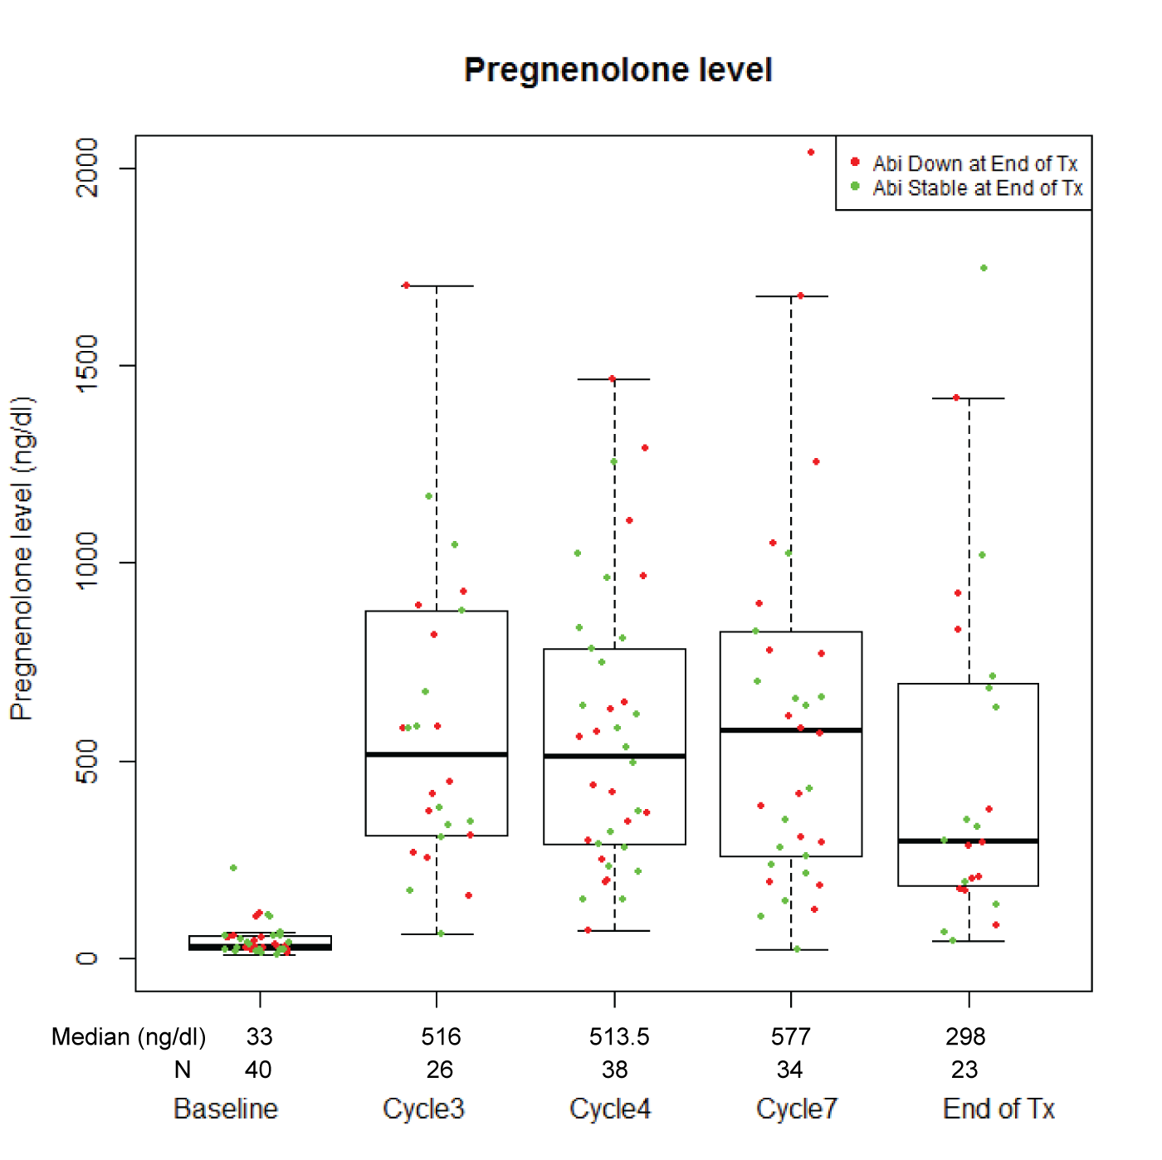
Supplement Figure 3 Panel A

Slide 2
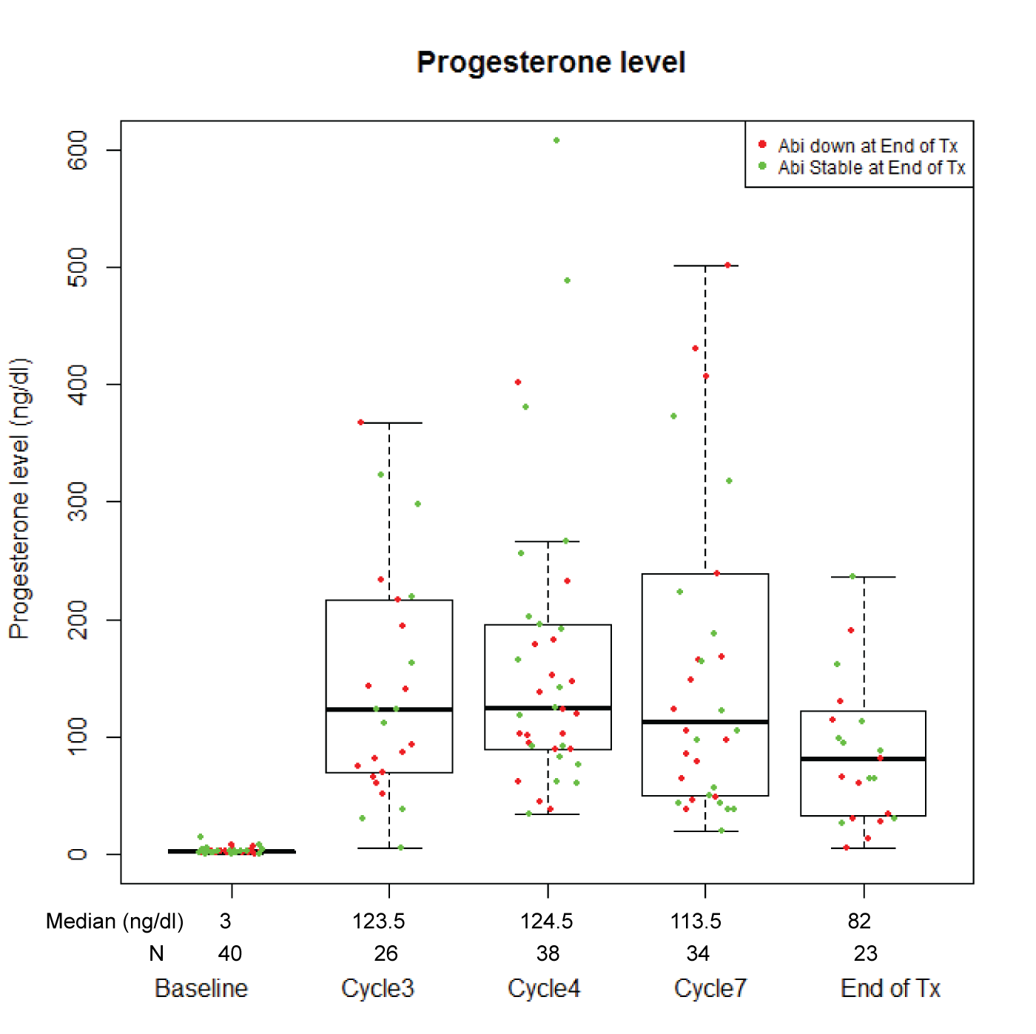
Supplement Figure 3 Panel B

Slide 3
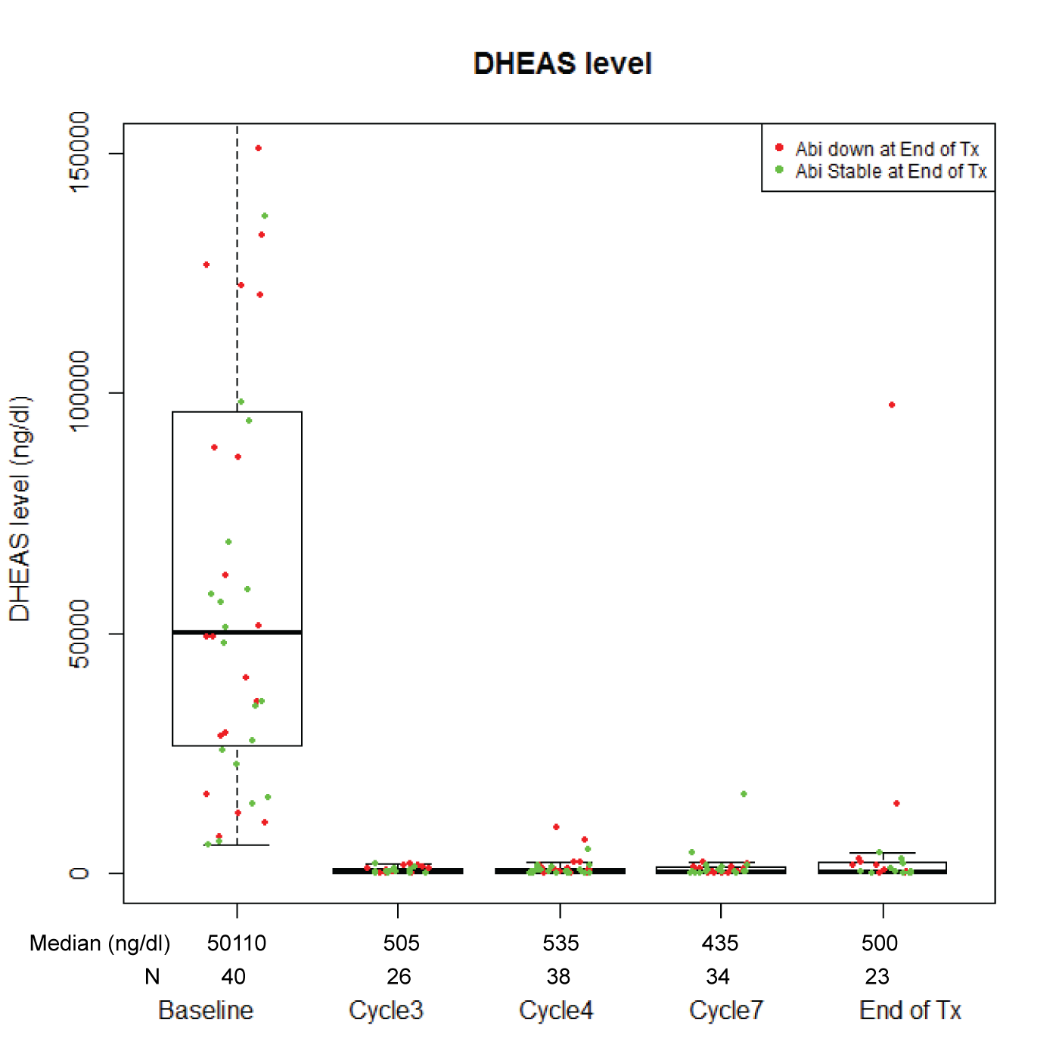
Supplement Figure 3 Panel C

Slide 4
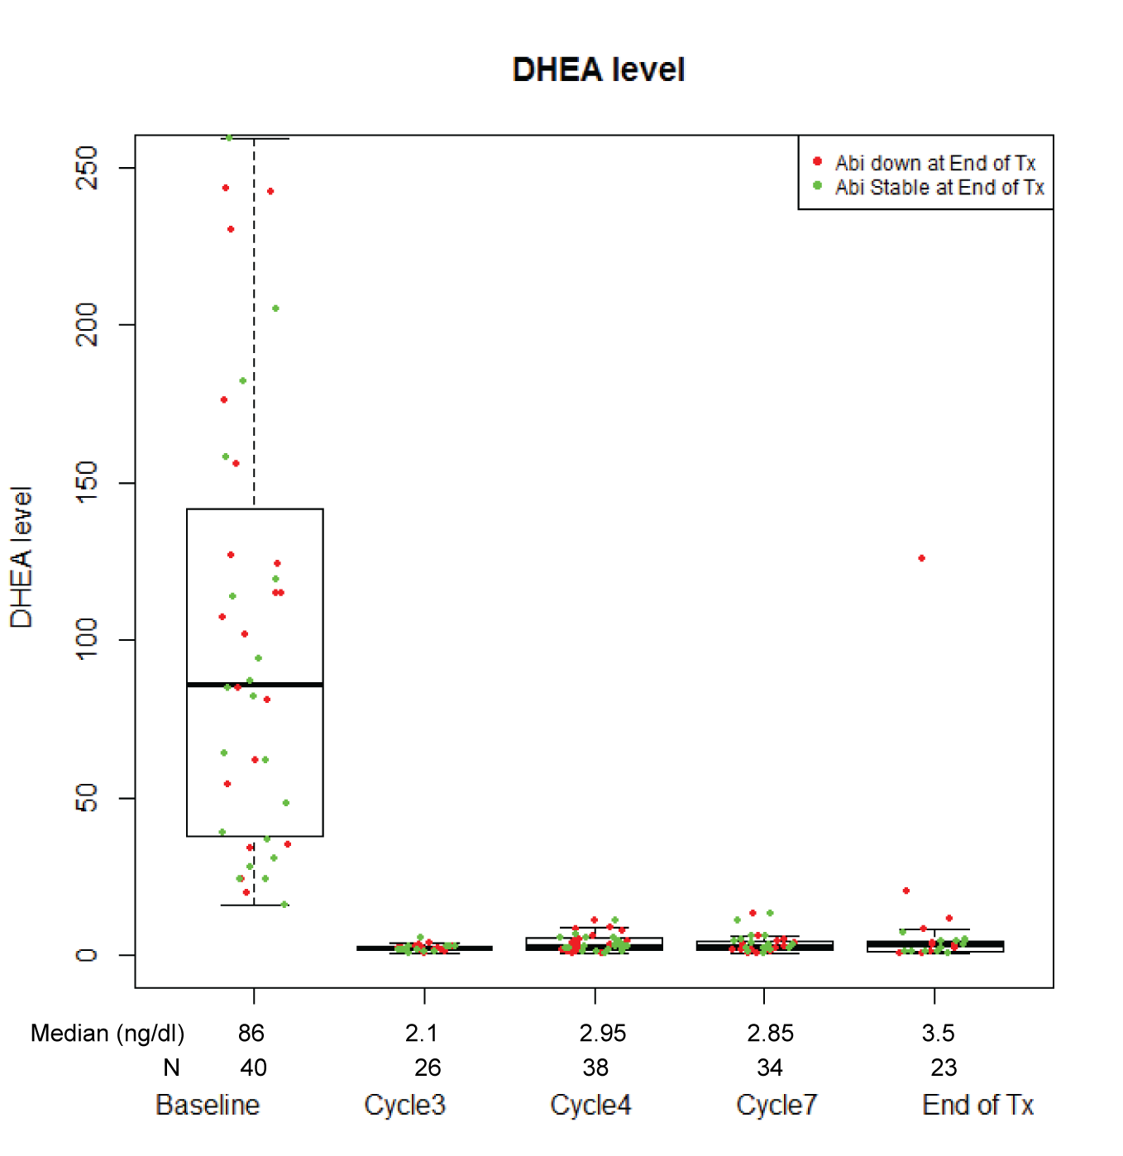
Supplement Figure 3 Panel D

Slide 5
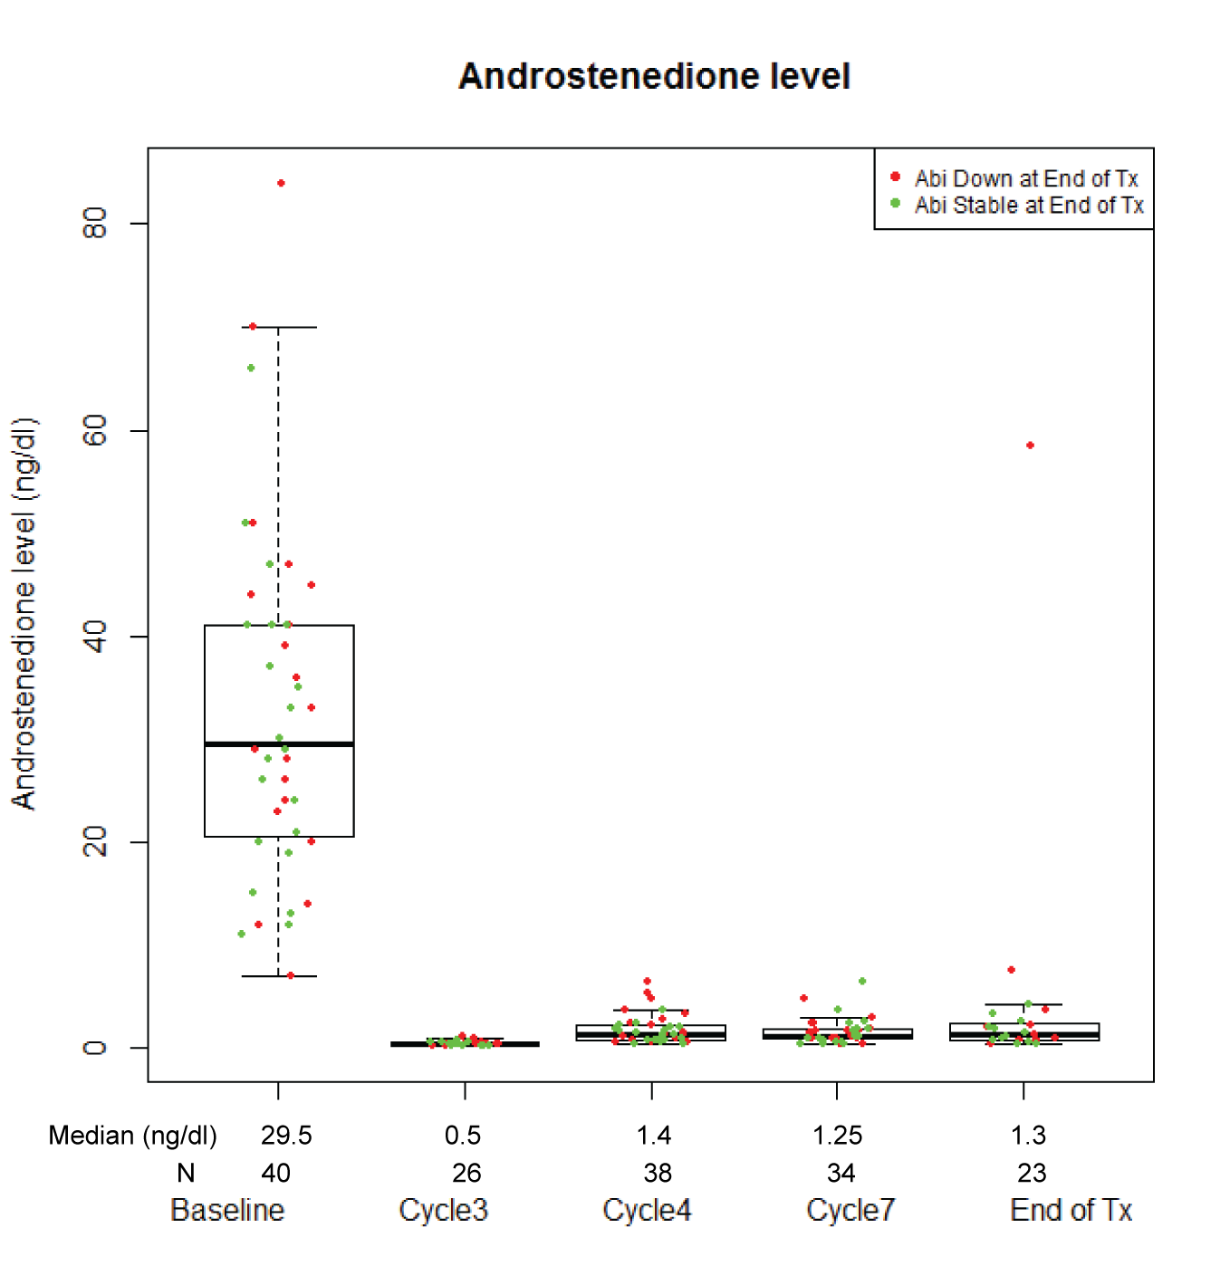
Supplement Figure 3 Panel E

Slide 6
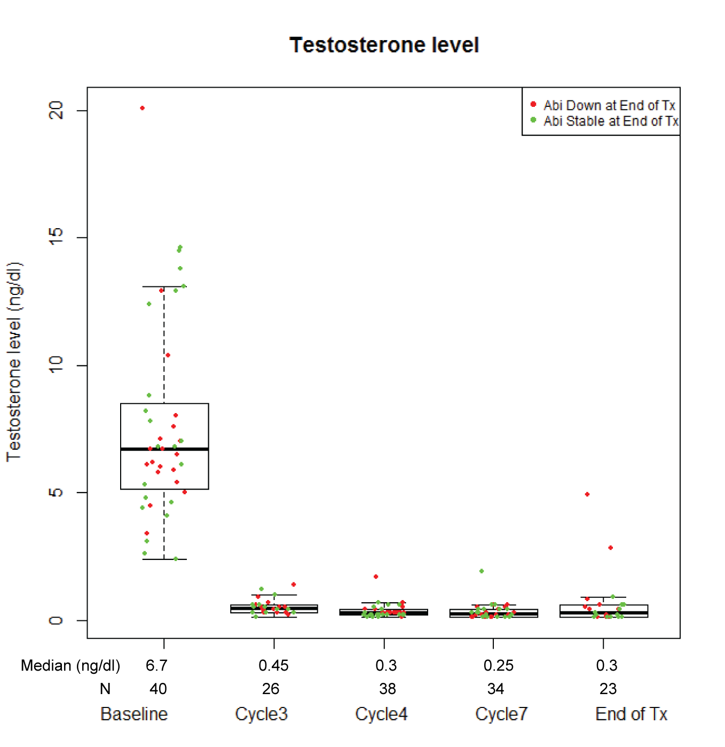
Supplement Figure 3 Panel F

Slide 7
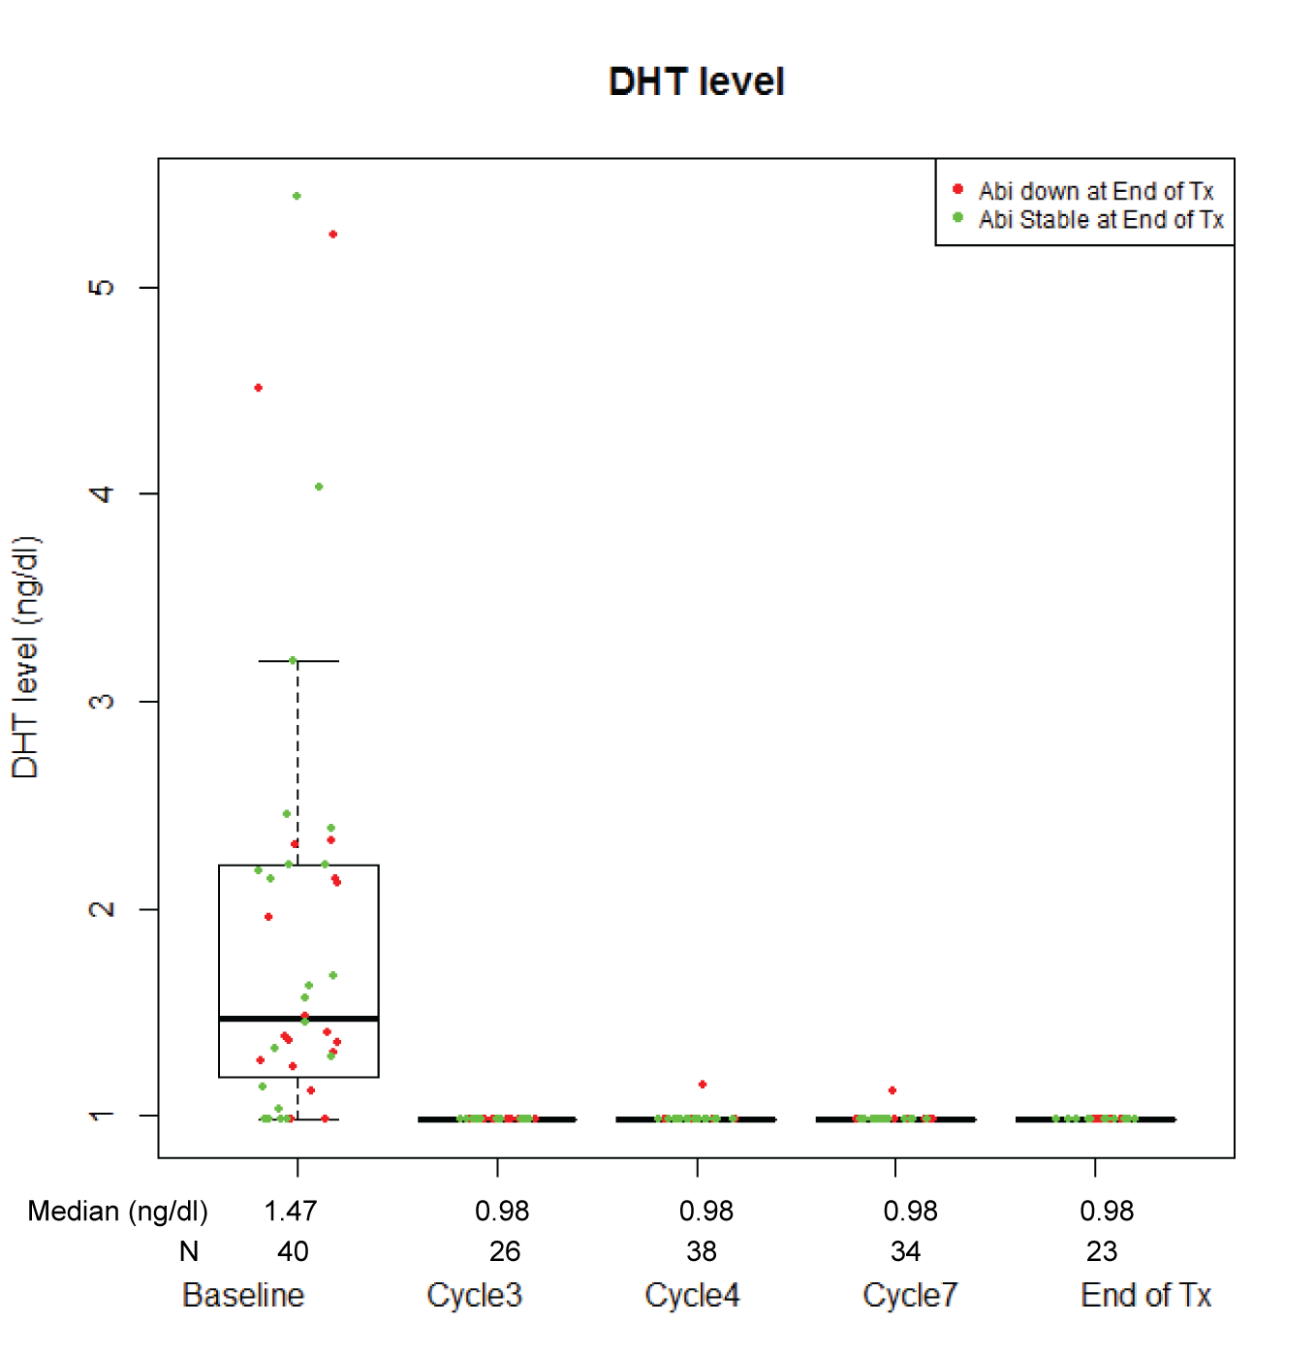
Supplement Figure 3 Panel G

Slide 8
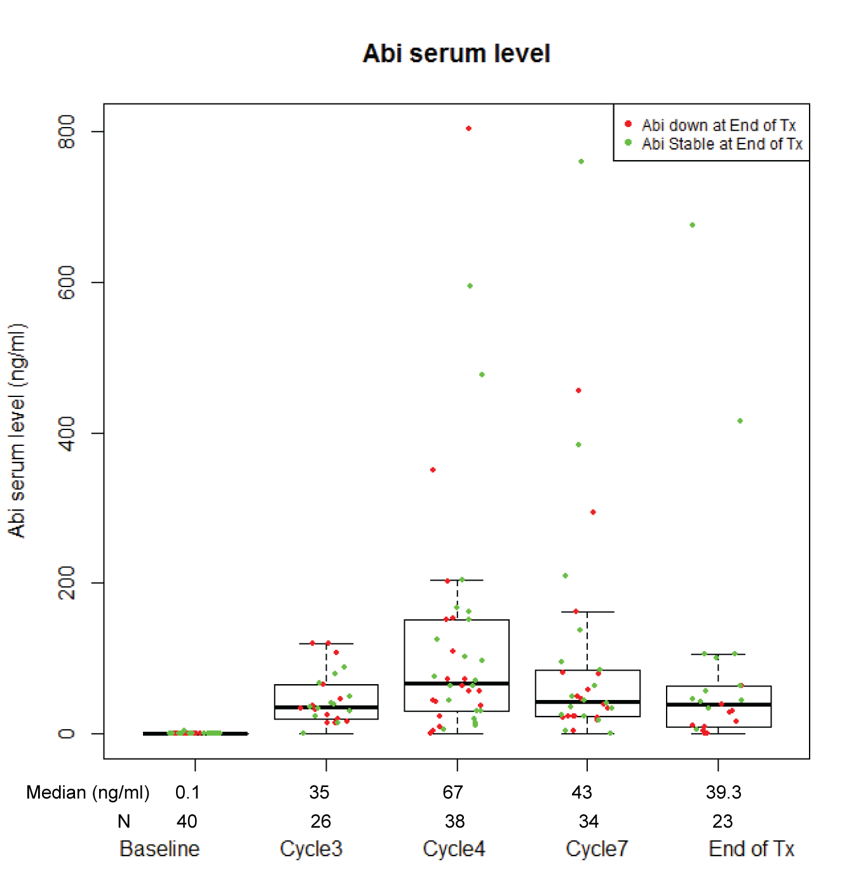
Supplement Figure 3 Panel H

