Slide 1
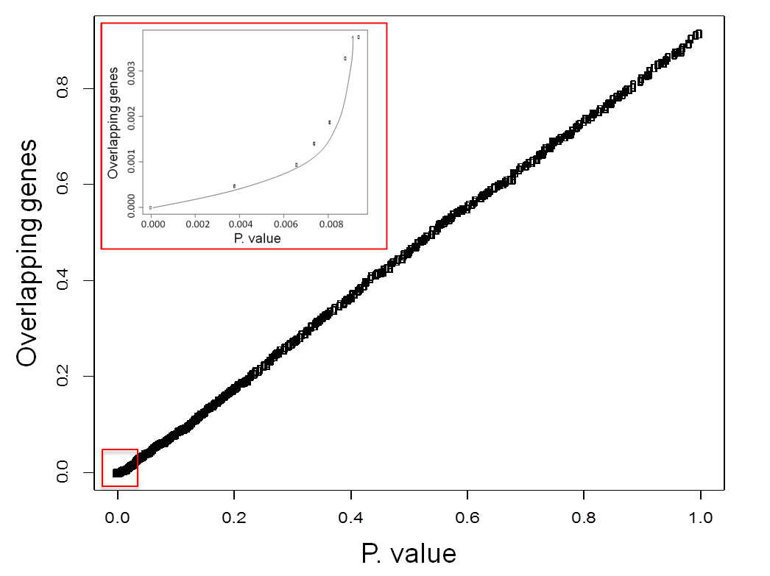
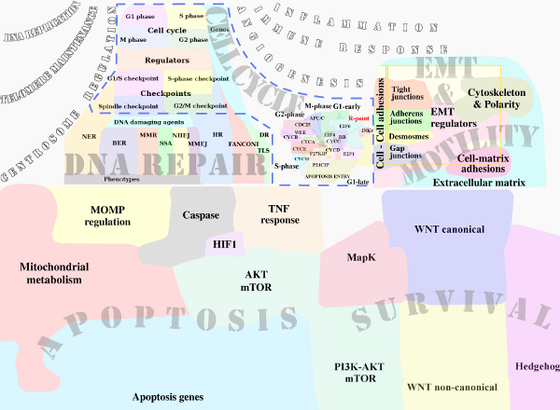
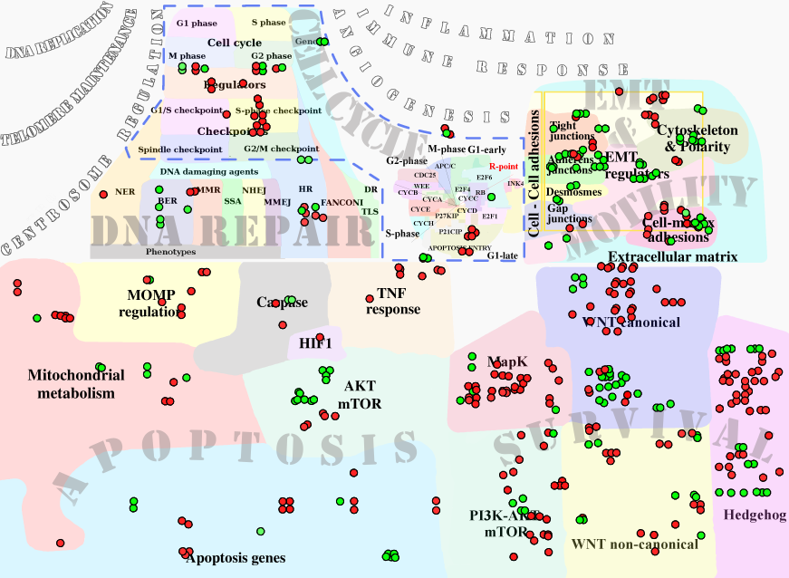
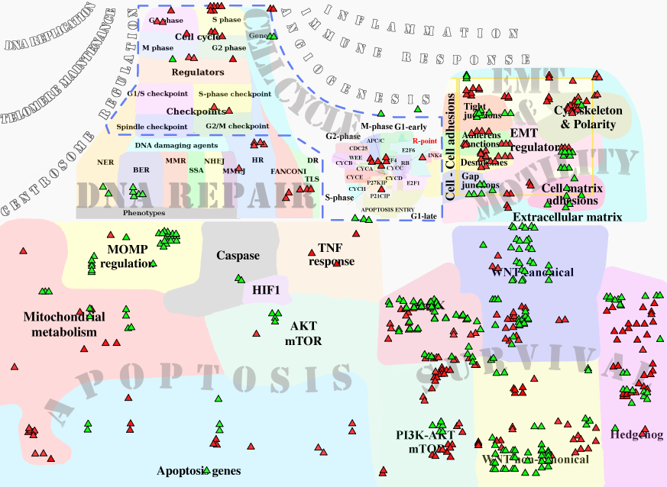
Supplementary figure S3
A
B
C
D
Supplementary figure S3. Estimation and functions of genes uniquely correlated with sensitivity to AsiDNA or olaparib. (A) Number of non-overlapping genes correlated with survival to AsiDNA and Ola. Relationship between the number of non-overlapping genes and the p-value from LOO Spearman correlation analysis of expression data from BC cell lines. (B) Atlas of Cancer Signaling Network (ACSN) global map. (C, D) Coverage of ACSN map with unique genes correlated with survival to AsiDNA or Ola in BC cell lines. Distribution of non-overlapping genes robustly correlated with survival to AsiDNA (C) or Ola (D). Red - Positive correlation with survival to treatment; Green - Negative correlation with survival to treatment. Functional modules as WNT-canonical, Cell-matrix adhesion, Cell polarity, MOMP are implicated in survival to both treatments, but regulated in an opposite manner.

