Slide 1
A
B
miR-29b-1-3p
1.5
miR-29b-1-5p
1.5
miR-29a-3p
ESR1
miR-29a-5p
1.0
1.0
Relative gene expression
Relative gene expression
0.5
0.5
0.0
0.0
MCF-7
CHO-K1
CHO-K1
Supplementary Figure 1: Basal expression of miR-29b-1-3p, miR-29b-1-5p, miR-29a-3p, miR-29a-5p and ESR1 (ERα) transcripts in CHO-K1 cells. A&B) Cells were ‘serum-starved’ for 48 h and (A) miRNA and (B) ESR1 expression was determined by qPCR. Values are relative to miR-29b-1-3p and MCF-7 in (A) and (B) respectively. Each bar is the mean ± SEM of triplicate determinations.

Slide 2
A
B
*
1.5
1.0
Relative miR-29b-1 expression
0.5
*
*
0.0
Control
29b-1
29a
Anti-miR-
C
D
*
1.5
1.0
Relative miR-29a expression
0.5
*
*
0.0
Control
29b-1
29a
Anti-miR-
Supplementary Figure 2: Successful knockdown and upregulation of miR-29b-1 /a in CHO-K1 cells. (A -C) Cells were ‘serum-starved’ and transfected with anti-miR-control, anti-miR-29b-1/a (3p), pre-miR control, or pre-miR-29b-1/a (3p) as indicated. 48 h post transfection, miRNA was extracted and qPCR performed. Values were normalized to RNU6B. Values are the mean ± SEM of 1-3 independent experiments. Within each experiment, each sample was run in triplicates. *p<0.05 versus control transfected cells.

Slide 3
1.5
^
DMSO
#
4-OHT
^
#
#
#
1.0
*
*
*
Relative cell viability (MTT)
0.5
0.0
100 nM 4-OHT - + - + - + - + - + - + - +
Transfected
with
No TF
Control
Control
29b-1
29a
Control
29b-1
29a
Anti-miR-
Pre-miR-
Figure 3: Overexpression of miR-29b-1 /a decreases cell viability of CHO-K1 cells. Cells were ‘serum-starved’ and transfected with anti-miR-control, anti-miR-29b-1/a, pre-miR control or pre-miR-29b-1/a. Two d post transfection, media was changed and cells treated with 100 nM 4-OHT, as indicated, every 48 h for 4 d prior to MTT assay. Values are MTT absorbance (490 nm) relative to the non-transfected, DMSO (vehicle) control-treated cells and are the ± SEM of 3 separate experiments. *p < 0.05 versus control-transfected cells; #p < 0.05 versus control transfected and 4-OHT-treated cells.

Slide 4
*
*
4
3
2
Relative DICER mRNA Expression
*
*
1
0
Control
29b-1
29a
Control
29b-1
29a
Anti-miR-
Pre-miR-
Supplementary Figure 4: Regulation of DICER mRNA expression in CHO-K1 cells. Cells were ‘serum-starved’ and transfected with anti-miR-29b-1/a-3p, premiR-29b-1/a-3p, and their respective controls for 48 h. Q-PCR and values were normalized to GAPDH. Values are the mean ± SEM of 1 experiment with each sample ran in triplicates. *p < 0.05 versus DMSO control transfected cells.

Slide 5
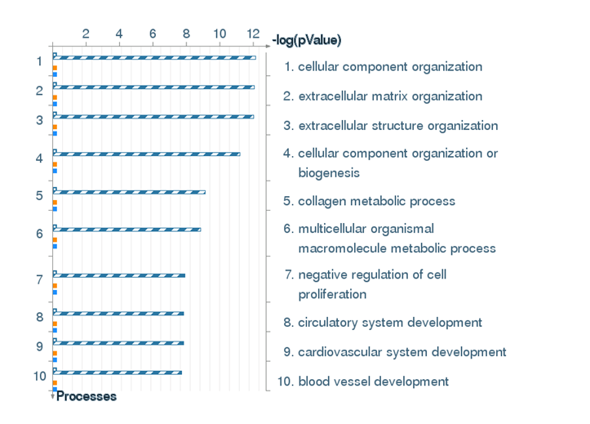
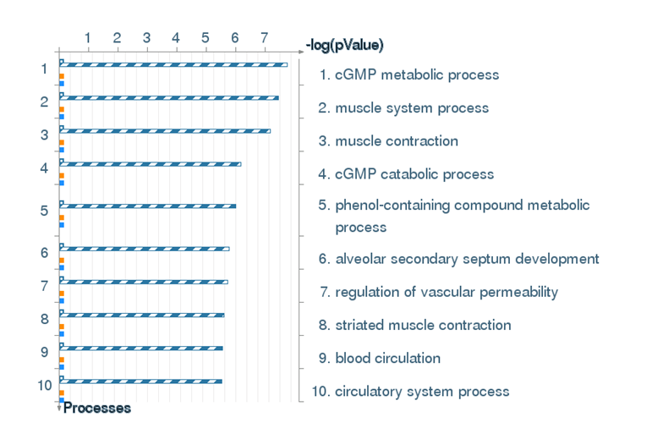
A
B
Commonly DOWNREGULATED genes
Commonly UPREGULATED genes
AS-miR-29a VS Pre-miR-29a
Downregulated GO processes
AS-miR-29a VS Pre-miR-29b-1
Upregulated GO processes
Common
Supplementary Figure 5: Pathway analysis GO processes. Differentially expressed genes were identified in pairwise comparisons: Anti-miR-29a vs. Pre-miR29a and Anti-miR-29a vs. Pre-miR-29b-1 using the tuxedo suite of programs including cufflink-cuff diff2. There were 357 commonly downregulated (A) and 181 commonly upregulated (B) genes. Gene Ontology (GO) cellular processes pathway analysis was performed using GeneGo Pathways Software (MetaCoreTM).

Slide 6
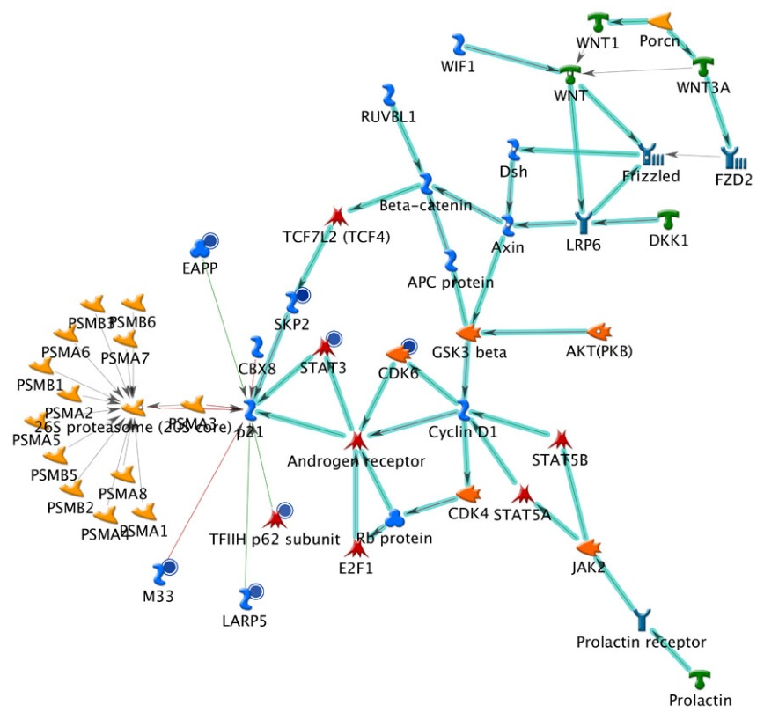
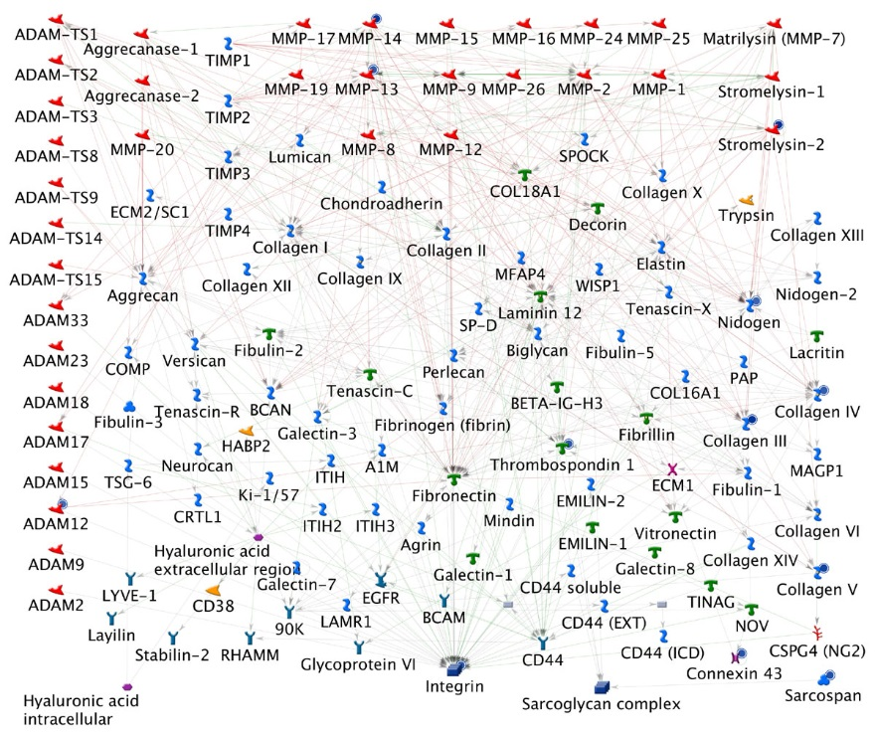
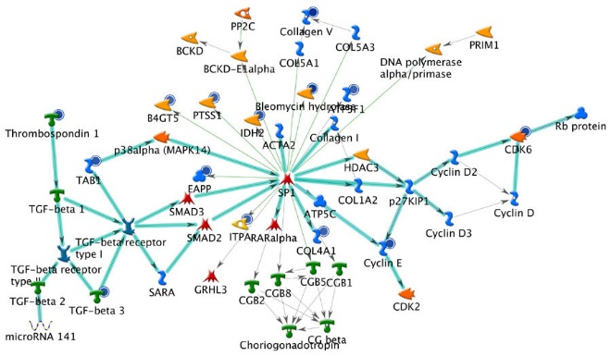
Commonly DOWNREGULATED genes
A
Network analysis: Cell Adhesion, Cell matrix interactions
B
Network: SKP2, STAT3, CDK6, LARP5, M33
Key
Downregulated
Receptor ligand
Transcription factor
Protein
Generic receptor
GPCR
Generic binding protein
Generic protease
Metalloprotease
Protein kinase
Generic phosphatase
Protein phosphatase
RNA
C
Network: Cyclin E, CDK6, TAB1, TGFbeta3, IDH2
Supplementary Figure 6: Network analysis of commonly downregulated genes by miR-29b-1 and miR-29a in CHO-K1 cells. Cellular processes pathway analysis was performed using GeneGo Pathways Software (MetaCoreTM) for the 357 commonly downregulated genes. A. The top pathways in Network analysis is Cell Adhesion, cell matrix interactions. B. The first network identified by MetaCoreTM is the SKP2, STAT3, CDK6, LARP5, M33 network. C. The second network identified by MetaCoreTM involves Cyclin E, CDK6, TAB1, TGFbeta3, IDH2. The aqua-highlighted pathways are canonical pathways.

Slide 7
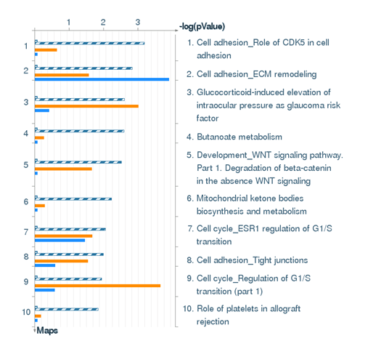
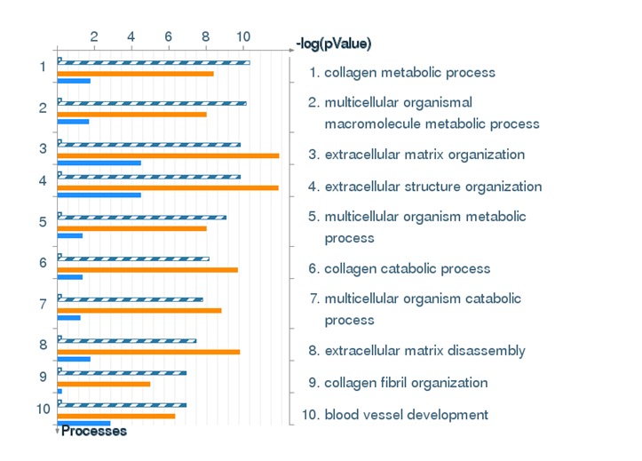
miR-29-3p targets Mus musculus
Downregulated by both miR-29b-1 AND miR-29a in CHO-K1 cells
Common miR-29 targets
A
Pathway maps
B
Gene Ontology (GO) cellular processes
Supplementary Figure 7. Comparison of 1079 miR-29-3p predicted Mus musculus targets (TargetScan ver. 7.1) and genes downregulated by both miR-29b-1 and miR-29a in our CHO-K1 transcriptome. Pathway network maps and Gene Ontology (GO) cellular processes pathway analysis was performed using GeneGo Pathways Software (MetaCoreTM).

Slide 8
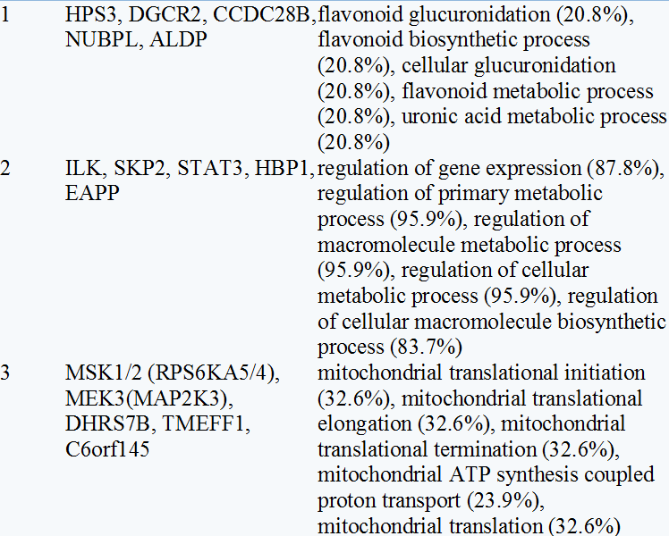
Supplementary Figure 8. Representative genes uniquely downregulated by both miR-29b-1 and miR-29a in the CHO-K1 transcriptome but that are not targets of Mus miR-29-3p in Target Scan. Pathway network maps and Gene Ontology (GO) cellular processes pathway analysis was performed using GeneGo Pathways Software (MetaCoreTM).

Slide 9
C:\Users\cmklin01\Documents\CMKdata\SeaHorse XF24 data\sum TAM-R cell lines
File = CHOK1sum
4
3
ECAR (mpH/min/µg protein)
2
1
0
EtOH
4-OHT
Supplementary Figure 9: Effect of 4-OHT on basal ECAR in the CHO-K1 cells. Cells were grown in hormone-depleted IMEM containing 5% DCC-FBS for 48 h prior to 24 h treatment with 100 nM 4-OHT. Extracellular flux assay was performed to measure baseline ECAR. Values were then normalized to protein/well.

