Slide 1
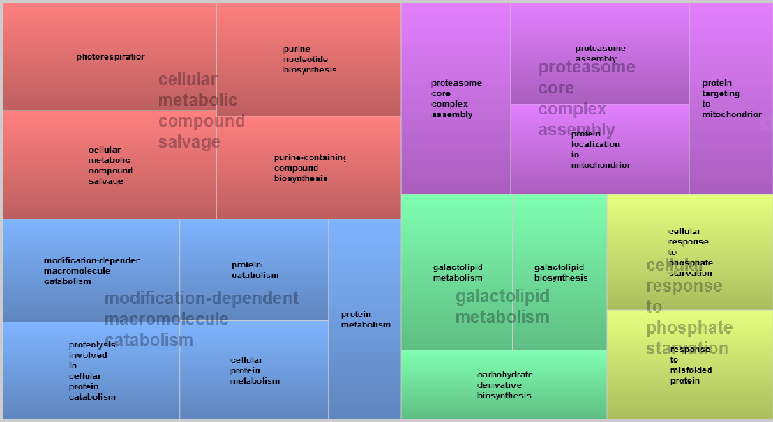
S1 Fig. Enriched GO terms in all modules visualized by REVIGO. The modules “Black”, “Purple”, “Red” and “Grey” did not contain significantly enriched GO terms wit p < 0.01 (Benjamini Hochberg corrected). GO terms were analysed with REVIGO (similarity 0.9 and with p values (log10 for size) Supek F, Bošnjak M, Škunca N, Šmuc T. "REVIGO summarizes and visualizes long lists of Gene Ontology terms" PLoS ONE 2011. doi:10.1371/journal.pone.0021800
Module: Green

Slide 2
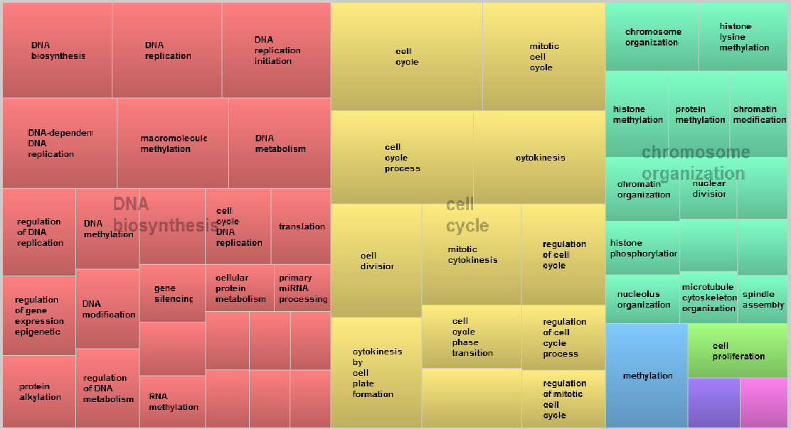
Module: Brown
Microtubuli, primary metabolism

Slide 3
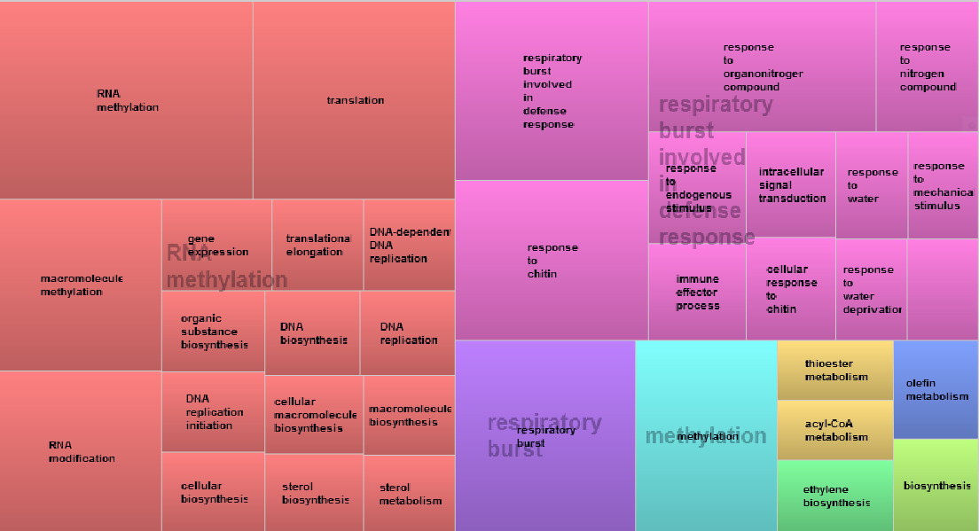
Module: Blue
Phosphorelay signal transduction system

Slide 4
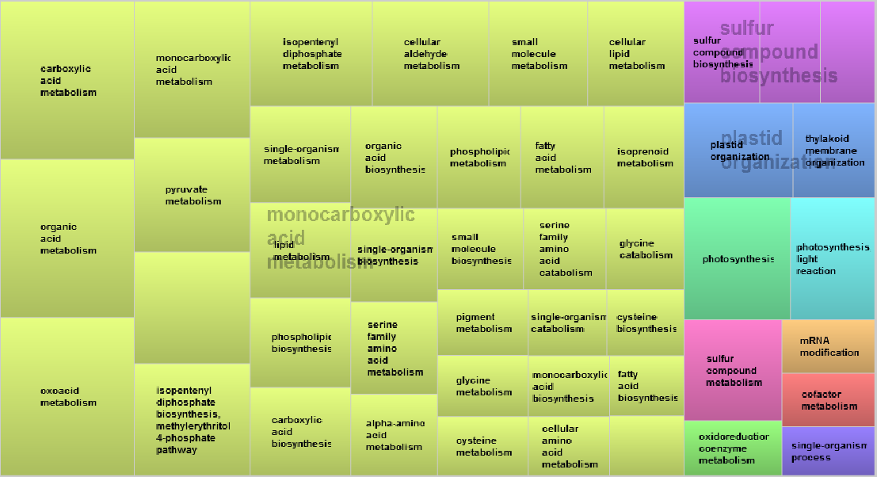
Module: Turquoise
Glyceraldehyde-3-phophate metabolism

Slide 5
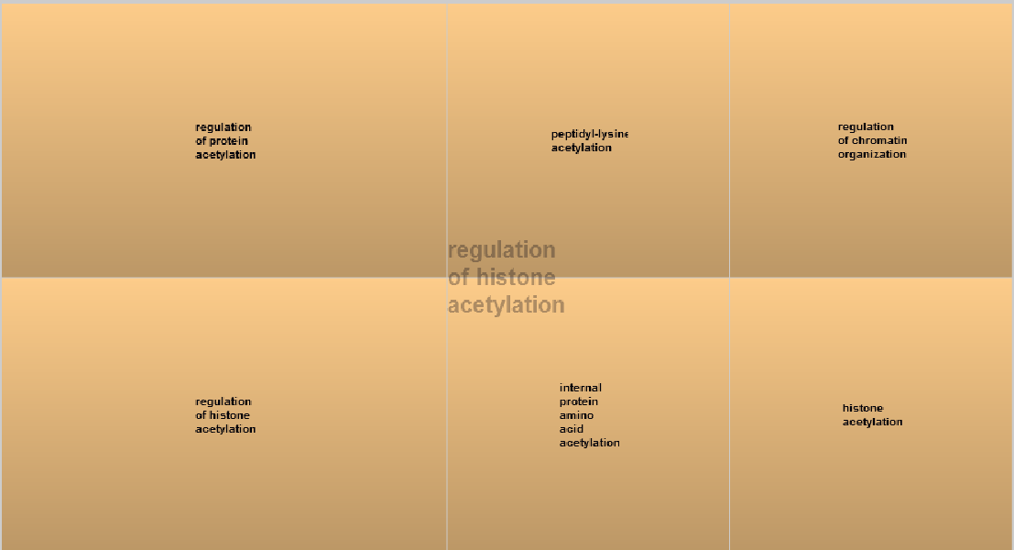
Module: Magenta

Slide 6
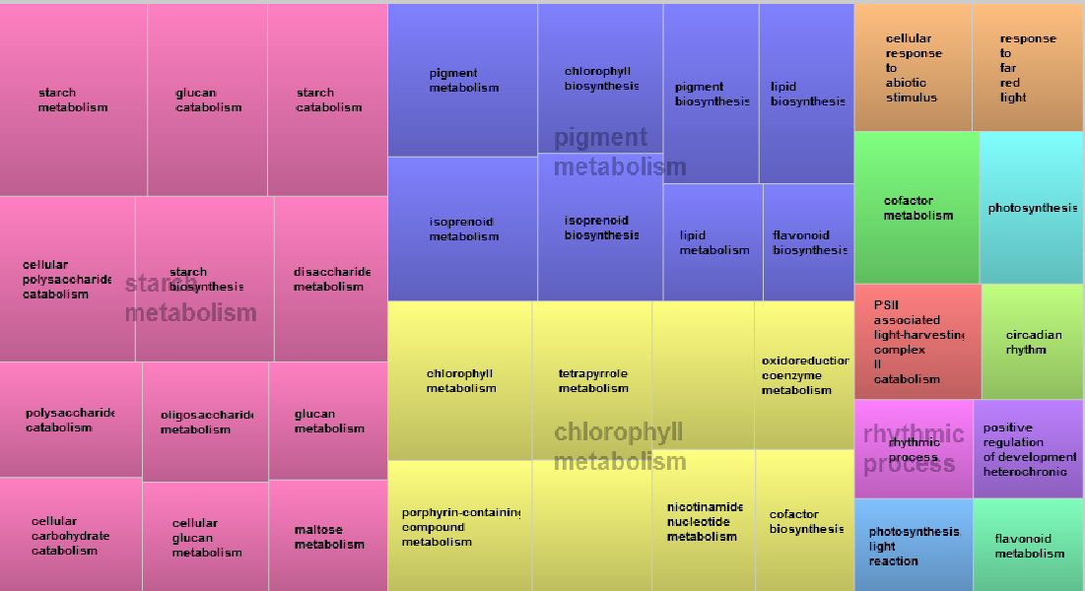
Module: Yellow
Pyridine containing metabolism
Porphyrine containing metabolism

Slide 7
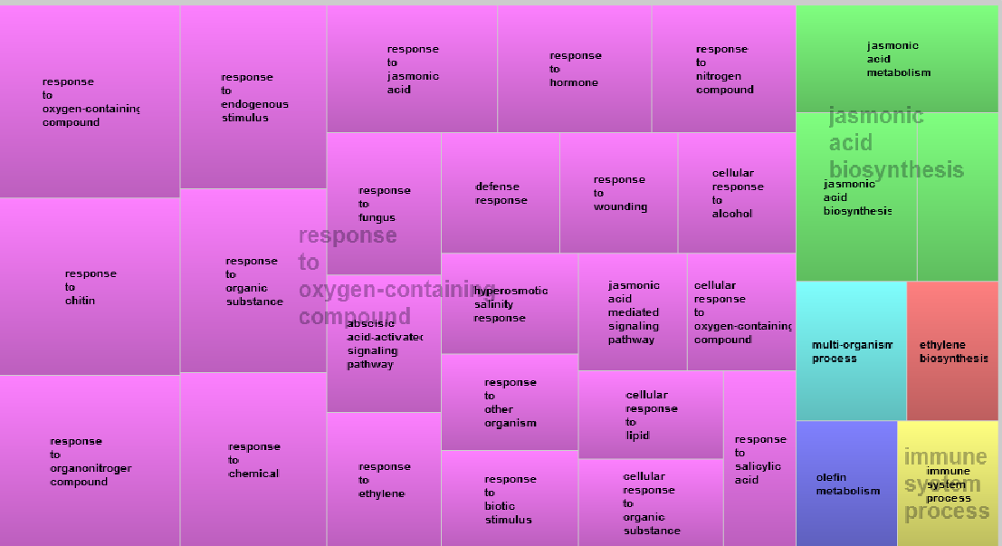
Module: Pink

