Slide 1

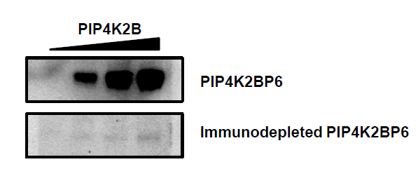
Supplementary Figure 1
A
B
shPIP4K2B
pLKO1
97
64
51
39
29
19
14

