Slide 1
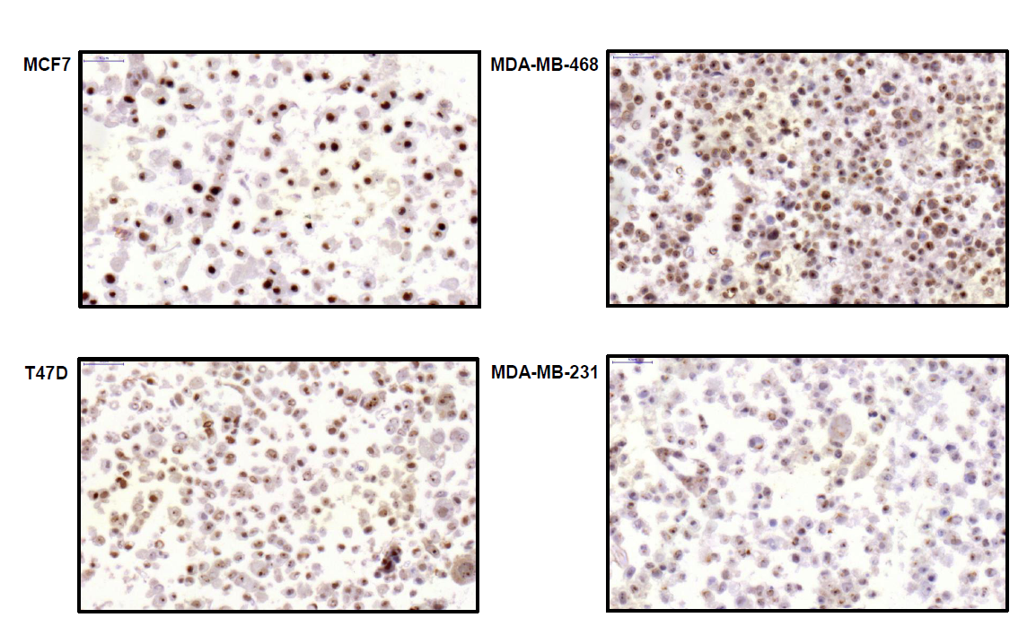
Supplementary figure 2

