Slide 1
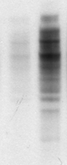

Supplementary Figure 6
A
B
Day 2
MG132
-
+
Day 4
P-473 AKT
WB: ubiquitin
Total AKT
ACTA

