Slide 1
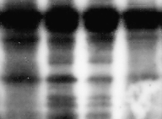

Glioblastoma
A172
LN18
U87MG
LN229
42
42
29
Dnajb6(S) 27 kDa
22
42
β actin 42 kDa
(a)
(b)
SUPPLEMENTARY FIGURE 1:
(a) Endogenous level of DNAJB6(S) protein in various cell lines. Dnajb6(S) levels were determined in the indicated human glioblastoma lines using a DNAJB6 antibody. Band intensities were quantified by densitometer and indicated as relative fold of Dnajb6/ß-actin (b). β-Actin served as an internal control. Bands represent specific DNAJB6(S) signal (27 kDa).

Slide 2
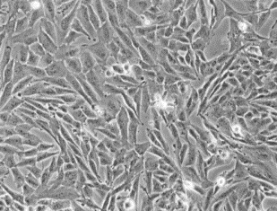
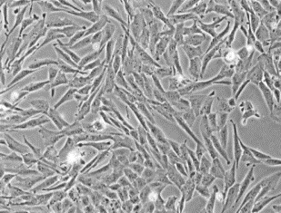
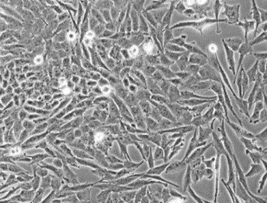
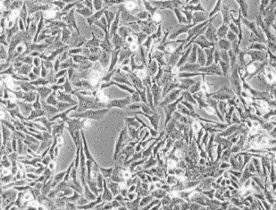
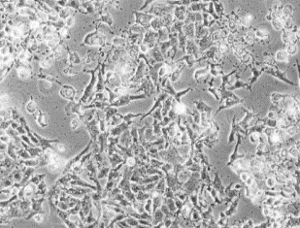
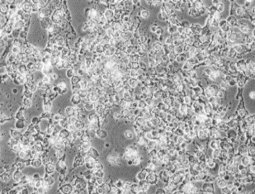
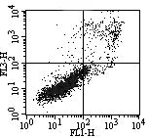
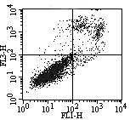
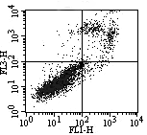
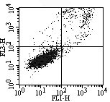
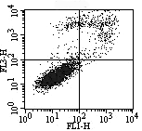
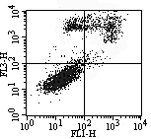




Ctrl 300 500 MPP⁺(µM)
Apoptosis (% cells)
48h 24h
(b) (c) (d)
MPP⁺(µM)
24h 48h
Ctrl 300 500 MPP⁺(µM)
(e) (f) (g)
48h 24h
N=3
10.38 12.49 16.46
#
#
*
*
Propidium Iodide
6.41 4.14 4.20
9.16 14.27 25.67
24h 48h
Ctrl
300
500
Ctrl
300
500
MPP⁺(µM)
1.05 0.77 0.81
(kDa)
27
Dnajb6(S)
Annexin V FITC
42
β actin
(a)
SUPPLEMENTARY FIGURE 2
(h)

Slide 3
SUPPLEMENTARY FIGURE 2:
MPP⁺ reduces the viability of LN18 cells. (a) LN18 cells were exposed to 300 or 500 µM MPP⁺ for 24 or 48 h, and apoptosis was analyzed using flow cytometry. The total number of early (Annexin V⁺/PI⁻) and late (Annexin V⁺/PI⁺) apoptotic cells are expressed as percentages. (b)-(g) Morphological changes were examined under a phase-contrast microscope. Bar, 100 µm. (h) DNAJB6(S) protein levels were measured by western blotting, and the data are presented as the mean relative to the expression of untreated cells. β-Actin was used as an internal control. (N=3, mean ± SEM, *p<0.05 and ^{n.s.}p>0.05 compared with control at 24 or 48 h)

Slide 4


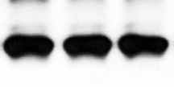







#1
#2
#3
pMOCK
Ctrl
300
500
Ctrl
300
500
Ctrl
300
500
MPP⁺(µM)
27
Dnajb6(S)
pDNAJB6(S)
42
β actin
27
Dnajb6(S)
42
β actin
SUPPLEMENTARY FIGURE 3:
Protein levels of DNAJB6(S) were evaluated by western blot assay after treatment with 500 µM MPP⁺ for 48 h. Results marked with dashed red lines are used in Fig. 4(h). #1, #2 and #3 indicate the sample number from the separated cell culture. Beta-actin was used as an internal control. Band of red boxes were used in Figure.

