Slide 1
Supplemental
Figures

Slide 2
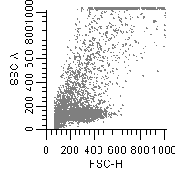
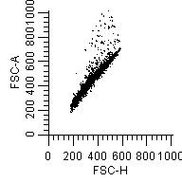
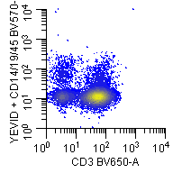
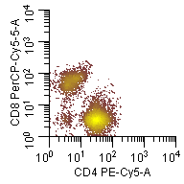
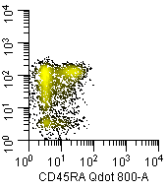
A. Lymphocyte gate
B. Doublets exclusion
C. Live CD3+
D. Live CD3+CD8-CD4+
E. CD4+ T cell memory
T_{CM}
_{(25±4%)}
T_{N}
_{(25±4%)}
T_{EM}
_{(30±3%)}
T_{EMRA}
_{(15±2%)}
SSC-A
FSC-A
Live dye+CD14+CD19
CD8-PerCp-Cy5.5
CD62- APCEF780
FSC-H
FSC-H
CD3-BV650
CD4-PE-Cy5
CD45RA-Qdot800
Figure S1: Sequential gating strategy to define of CD4+ T cell memory subsets. Lymphocytes were gated based on forward vs. side scatter (A) and doublets (B) were excluded from the analysis. Live CD3+ T cells were segregated from gated lymphocytes following exclusion of dead cells, CD14+ (monocytes) and CD19+ (B cells) (C) CD4+ T cells were defined as CD3+CD8-CD4+ cells and (D) further subdivided into effector/memory or naïve subsets as follows: T central/memory (T_{CM}: CD62L+CD45RA−), T effector/memory (T_{EM}: CD62L− CD45RA−), RA positive T effector/memory (T_{EMRA}: CD62L−CD45RA+), and T naive (T_{N}: CD62L+CD45RA+) subsets. Percentages (mean±SE) of each cell subsets shown in panel E were derived from the PBMC samples obtained from volunteers (n=16) on Pre- and Post-vaccination days.

Slide 3
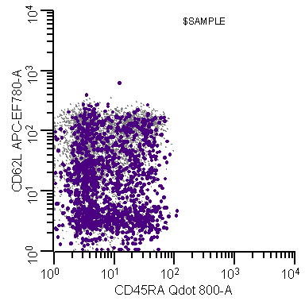
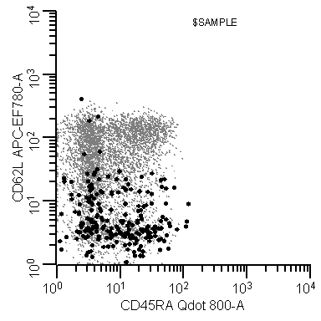
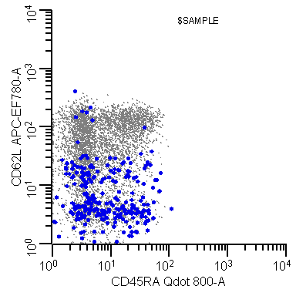
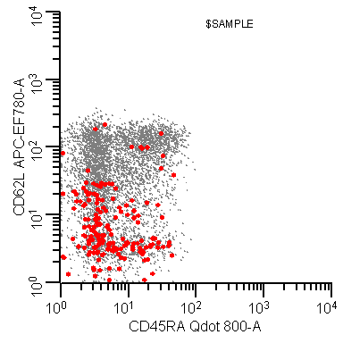
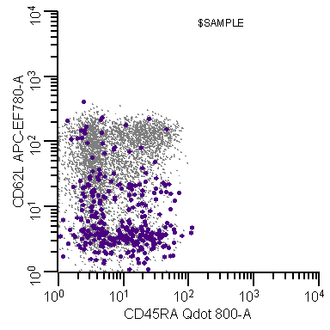
A. CD14-CD3+CD8-CD4+
T_{CM}
T_{N}
T_{EM}
T_{EMRA}
B. CD4+CD69+
C. CD4+CD69+IFN-γ+
D. CD4+CD69+TNF-α+
E. CD4+CD69+IL-2+
F. CD4+CD69+CD107a+
16.9
12.7
2.5
00.0
3.7
1.1
4.1
1.7
11.3
6.6
42.9
27.5
52.5
45.0
62.6
32.6
71.9
22.3
43.3
38.8
CD62- APCEF780
CD45RA-Qdot800
Figure S2. Ty21a elicited functional CD4+ T effector/memory subsets. PBMC collected from a representative volunteer 42 days after immunization with Ty21a were stimulated with S. Typhi-infected targets. CD4+ T cells (live CD14-CD3+CD8-CD4+) were subdivided into T_{EM}, T_{EMRA}, T_{CM} and T_{N} subsets as described in the legend to Fig. S1 (A) and also shown in representative histograms (B-F) depicted as gray dots. Superimposed (dark large dots) are CD4+ T cells back-gated as follows: CD69+ activated cells (B), CD69+IFN-γ+ cells (C), CD69+TNF-α+ cells (D) , CD69+IL-2+ cells (E), and CD69+CD107a+ cells (F). The numbers shown in boxes within histograms are the % of the superimposed gated populations into the different T effector/memory subsets.

Slide 4
A. Total IL-17A+
B. Multifunctionality of IL-17A+
0.80
0.80
0.60
0.60
0.40
0.40
0.35
0.35
p=0.06
p=0.06
0.30
0.30
% of CD4 T_{EM} cells
0.25
0.25
0.20
0.20
0.15
0.15
0.10
0.10
0.05
0.05
0.00
0.00
ST
PA
PB
S+
MF
S+
MF
S+
MF
ST
PA
PB
Figure S3. Post-vaccination increases in IL-17A producing CD4+ T_{EM} cells. Shown are the post vaccination increases in Total (A), as well as Single positive (S+) and Multifunctional (MF) (B) IL-17A producing CD4+ T_{EM} cell responses following stimulation with S. Typhi (ST)-, S. Paratyphi A (PA)- and S. Paratyphi B (PB)-infected targets in Ty21a vaccinees (n=8) .
The horizontal dashed line in (A) represents the cut-off of 0.05% post-vaccination increases.
Error bars represent mean±SEM.
Peak post-vaccination increases (days 42 or 84) for these Salmonella-specific IL17A+ responses in Total (A), and S+ and MF (B) cells in CD4+ T_{EM} subsets were calculated by subtracting the corresponding pre-vaccination (day 0) levels.
p values shown were determined by Wilcoxon signed rank test, 2-tail.

