Slide 1
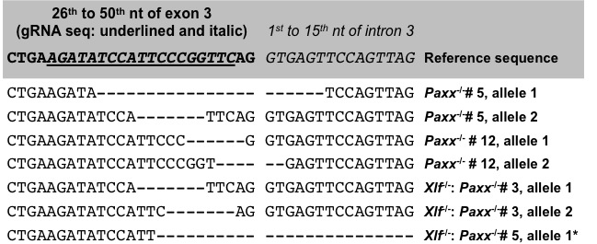
Figure S1. Sequencing analysis of CRISPR/Cas9-induced mutations in Paxx: Genomic DNA fragments surrounding Paxx exon 3 from two Paxx^{-/-} and two Xlf^{-/-}:Paxx^{-/-} mutant abl pre-B cell clones were amplified and their sequences determined. The resulting sequences were compared to reference sequence obtained from NCBI (NC_000068.7). Paxx exon 3 in the reference sequence is shown in bold letters with Paxx gRNA sequence underlined and italicized. Intron 3 is shown in italic letters. Deletions identified in each mutant cell line are represented as “–“. Two mutant alleles were identified in each mutant cell clone with the exception of Xlf^{-/-}:Paxx^{-/-} #5, in which only one mutant allele could be identified. * The deletion (~450 bps) mapped in Xlf^{-/-}:Paxx^{-/-} #5 spans from exon 3 to intron 5.
Figure S1

Slide 2
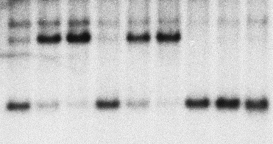
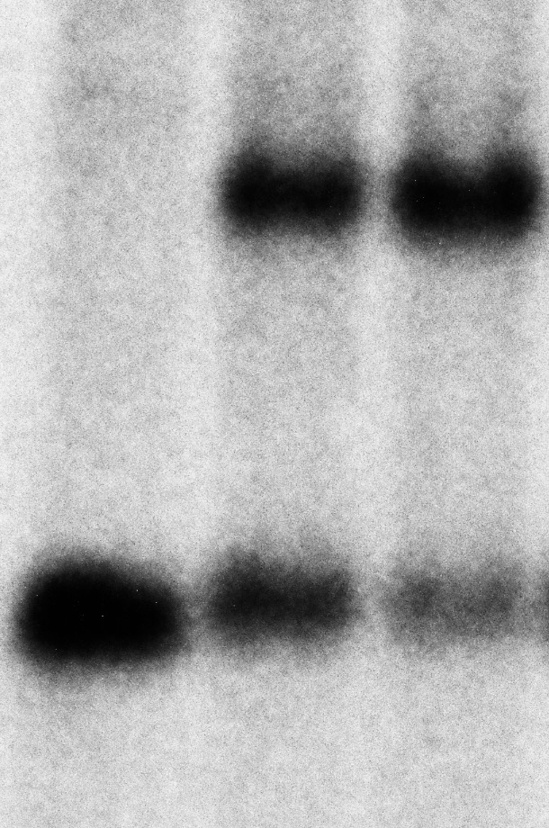
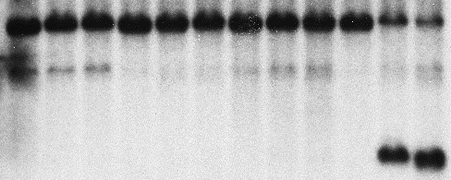
A
B
WT:
MGINV
Xlf^{-/-}:
MGINV
Xlf^{-/-}:
Paxx^{-/-}:
MGINV
Paxx^{-/-}:
MGINV
WT:
MGINV
Paxx^{-/-}:
MGINV
Xlf^{-/-}:
MGINV
Xlf^{-/-}:
Paxx^{-/-}:
MGINV
Imatinib (h):
0 48 96
0 48 96
0 48 96
0 48 96
Imatinib (h):
0 48 96
0 48 96
0 48 96
0 48 96
3
SJ
4
UR/SJ
2
3
1.5
UR/SE
2
SE
kb
1.5
Thy1 probe
NheI digest
kb
Thy1 probe
XbaI digest
Figure S2. RAG DSB repair in PAXX- and XLF-deficient abl pre-B cells (related to Figure 3): Independent clones of WT:MGINV, Xlf^{-/-}:MGINV, Paxx^{-/-}:MGINV, and Xlf^{-/-}:Paxx^{-/-}:MGINV abl pre-B cells distinct from those shown in Figure 3 were treated with imatinib for 0, 48, or 96 hours (h). Genomic DNA isolated from these cells were digested with NheI (A) or XbaI (B) and subjected to Southern blot analysis by hybridizing with the Thy1 probe. Hybridizing bands for different pMGINV rearrangements are indicated as described in Figure 1A. Molecular weight markers are also indicated (kb).
Figure S2

