Slide 1
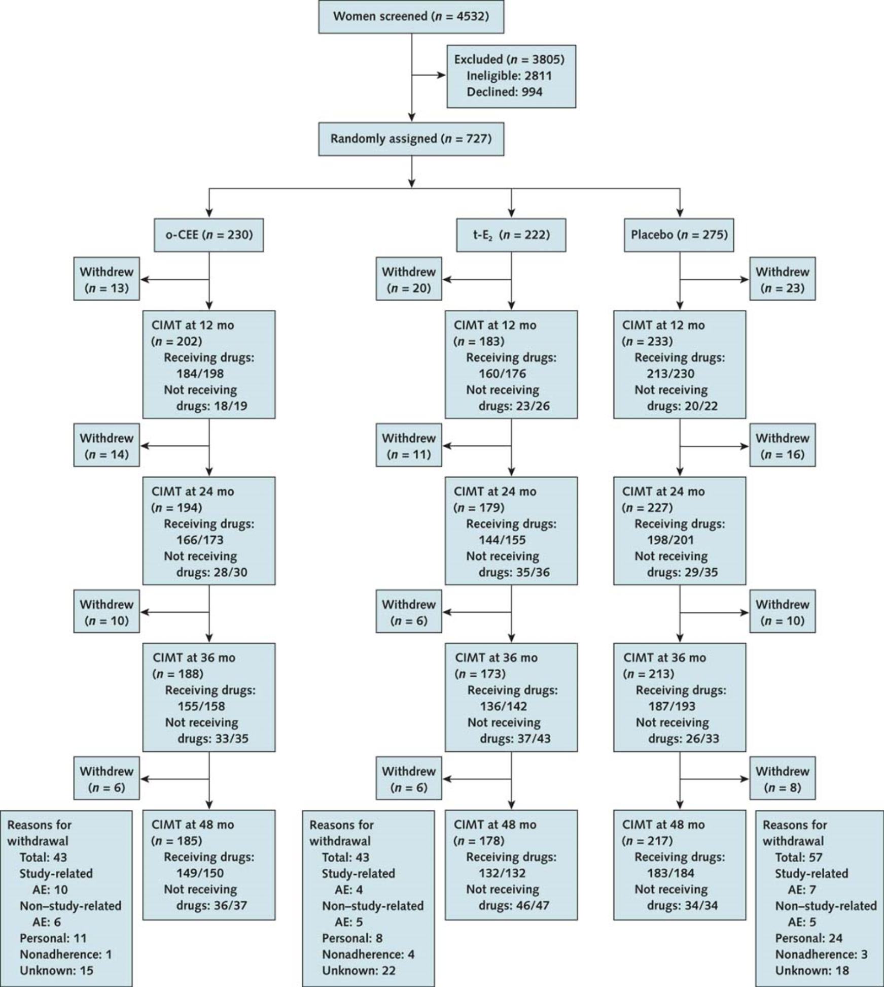
Notes:
Supplemental Figure. KEEPS Study Flow Diagram. The number of remaining active participants receiving and not receiving study medication is shown as a denominator, and the number of carotid intimal medial thickness (CIMT) scans—the primary study endpoint—is shown as a numerator. Personal reasons for withdrawal include logistical problems, family concerns, fear of cancer, and relocation. Adverse events (AEs) include serous and nonserious AEs. O-CEE= oral conjugated equine estrogens, t-E2=transdermal estradiol. Reprinted with permission from¹⁶.

