Slide 1
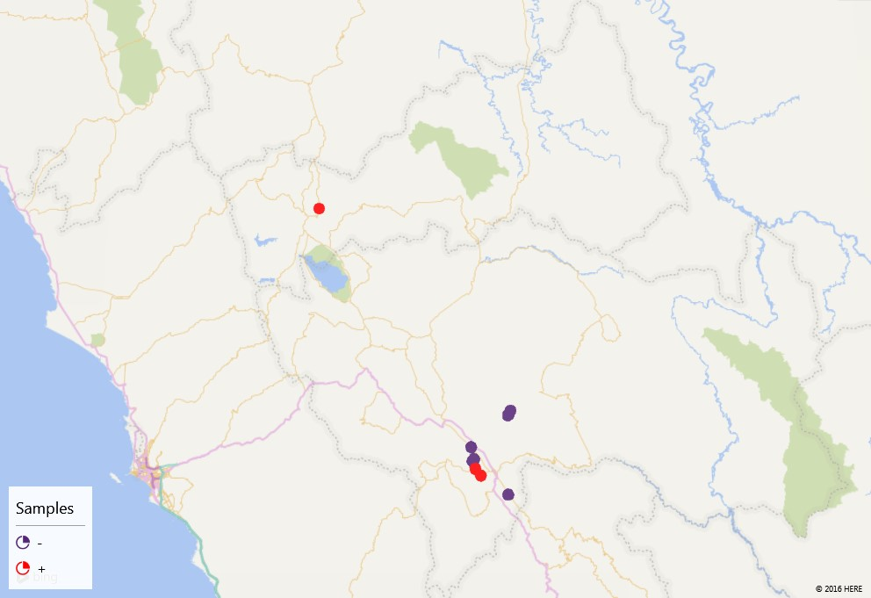
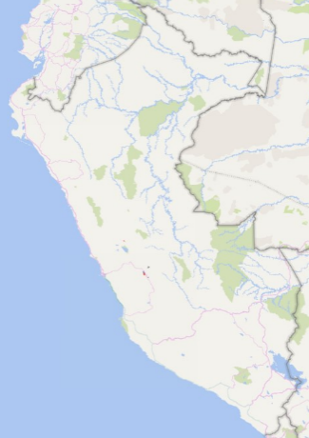
Ecuador
Colombia
Peru
Brazil
Pasco
Junín
Lima
100 km

