Slide 1
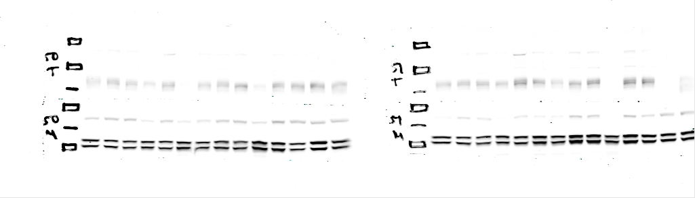
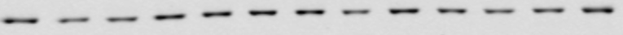
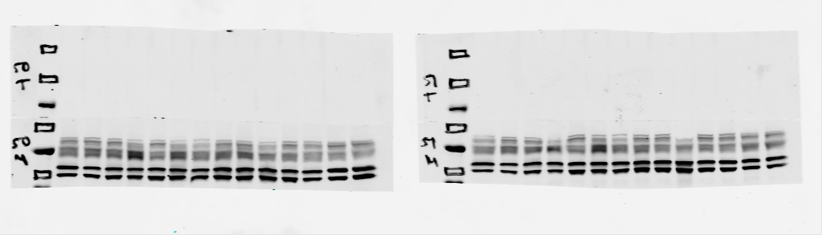
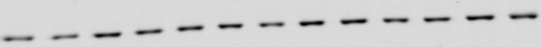
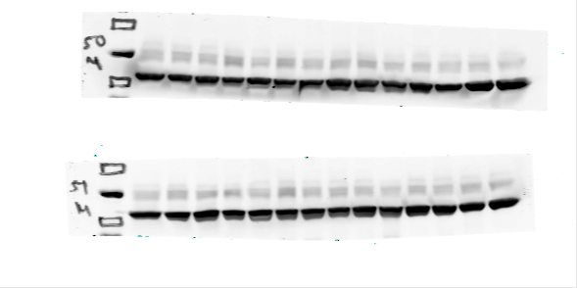
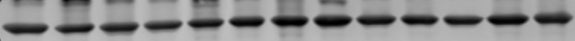
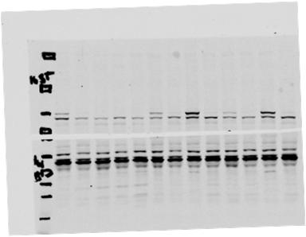
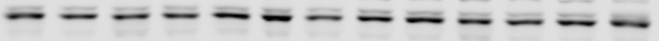
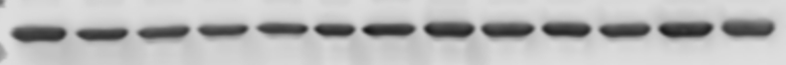
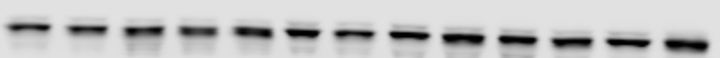
Figure S6
A
WT
MKR
B
WT
MKR
pERK
42,44kDa
p-p38
43kDa
ERK
42,44kDa
p38
43kDa
β-Actin
42kDa
β-Actin
42kDa
C
WT
MKR
D
WT
MKR
β-Catenin
92kDa
pGSK3β
46kDa
β-Actin
42kDa
GSK3β
46kDa
β-Actin
42kDa

