Slide 1
Supplemental Figure S1
A
B
C
D

Slide 2
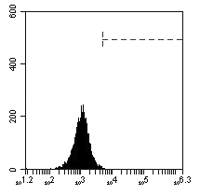
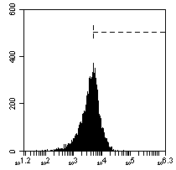
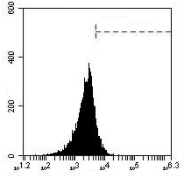
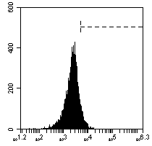
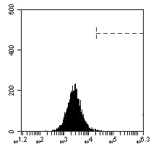
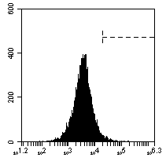
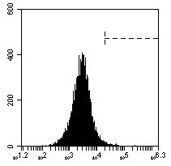
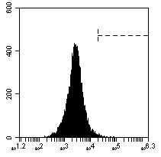
Supplemental Figure S2
A
IgG
isotype control
Control
500
1000 nM JQ1, 24 h
0.8%
40.4%
12.3%
9.9%
HEL92.1.7
Cell counts
(FL-2)
IL7R (FL-2)
IL7R (FL-2)
IL7R (FL-2)
1.0%
3.5%
2.2%
1.7%
Cell counts
SET2
(FL-2)
IL7R (FL-2)
IL7R (FL-2)
IL7R (FL-2)
B
*
*
**
**

Slide 3
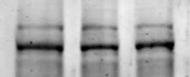






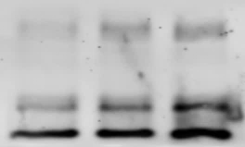

Supplemental Figure S3
B
A
MV4-11
0 250 1000 nM, OTX-015, 24 hr
p-STAT5
STAT5
c-Myc
CDK6
CDK4
HEXIM1
p21
BIM_{EL}
C
BIM_{L}
BIM_{s}
β-Actin

Slide 4
Supplemental Figure S4
A
*** = p< 0.005
B
***
***

Slide 5
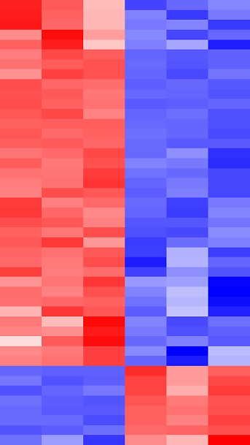


A
SET2
Supplemental Figure S5
Control
1 µM ruxolitinib
Protein Target | Log2 fold change (ruxolitinib/Control) | P-value
pS6 (S235/236) | -2.89 | 1.23E-06
pSTAT3 (Y705) | -1.96 | 8.28E-06
p4E-BP1(T37/46) | -0.68 | 1.14E-05
pPRAS40 (T246) | -0.55 | 0.00014
p4E-BP1 (S65) | -0.53 | 0.0035
Beta Catenin | -0.33 | 0.0068
Cl Caspase 7 | 1.14 | 7.26E-08
Cl Caspase 3 | 1.26 | 8.13E-07
H2AX pS140 | 1.79 | 4.04E-05
1 2 3
1 2 3
-1.6
0.0
1.6
37 proteins
downregulated
8 proteins
upregulated
SET2
B
Control
1 µM pacritinib
Protein Target | Log2 fold change (pacritinib/Control) | P-value
pS6 (S235/236) | -2.1 | 2.81E-06
pSTAT3 (Y705) | -0.81 | 0.0019
pPRAS40 (T246) | -0.67 | 5.38E-05
p4E-BP1 pS65 | -0.60 | 0.0016
p4E-BP1(T37/46) | -0.52 | 0.0015
pAKT (S473) | -0.38 | 0.0409
Cl Caspase 7 | 1.18 | 0.0003
Cl Caspase 3 | 1.29 | 8.66E-06
H2AX pS140 | 1.45 | 0.0001
1 2 3
1 2 3
28 proteins
downregulated
-1.6
0.0
1.6
14 proteins
upregulated

Slide 6





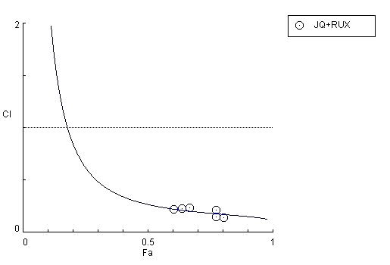



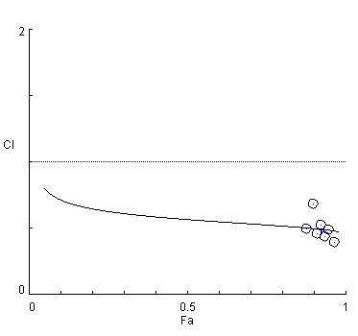
Supplemental Figure S6
A
HEL92.1.7 cells
JQ1 (nM) | ruxolitinib (nM) | Fa | CI Value
250 | 500 | 0.6806 | 0.153
300 | 600 | 0.7003 | 0.163
350 | 700 | 0.7259 | 0.163
400 | 800 | 0.6949 | 0.225
500 | 1000 | 0.722 | 0.238
C
SET2
+ 0.5 µM Rux
0 0.25 1.0 0 0.25 1.0 µM, JQ1, 24 h
p-STAT5
STAT5
p-STAT3
STAT3
B
c-MYC
2.0
SET2
JQ1 and ruxolitinib
PIM1
p21
1.0
Combination Index
β-Actin
0.5
0.0
D
0
0.5
1.0
Fractional effect
2.0
SET2
OTX-015 and ruxolitinib
OTX-015 (nM) | ruxolitinib (nM) | Fa | CI Value
125 | 250 | 0.876 | 0.4939
150 | 300 | 0.912 | 0.4603
175 | 350 | 0.934 | 0.4379
187.5 | 375 | 0.922 | 0.5278
200 | 400 | 0.898 | 0.6833
225 | 450 | 0.946 | 0.4899
250 | 500 | 0.966 | 0.3980
JQ1 (nM) | ruxolitinib (nM) | Fa | CI Value
200 | 200 | 0.604 | 0.21826
250 | 250 | 0.639 | 0.22694
300 | 300 | 0.668 | 0.23346
350 | 350 | 0.774 | 0.14877
400 | 400 | 0.804 | 0.13976
500 | 500 | 0.774 | 0.21253
1.0
Combination Index
0.5
0.0
0
0.5
1.0
Fractional effect

Slide 7
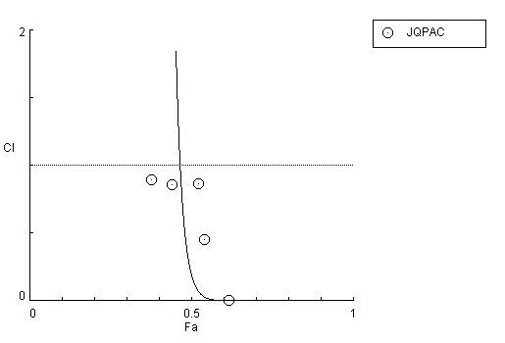
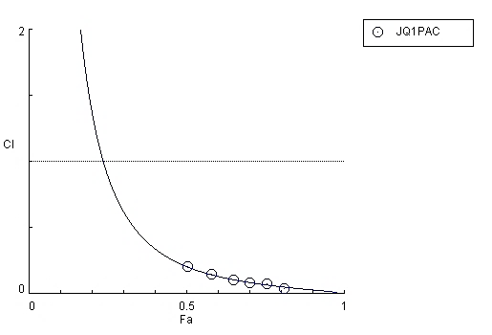












Supplemental Figure S6
E
F
G
HEL92.1.7
2.0
HEL92.1.7
JQ1 and pacritinib
2.0
SET2
+1 µM pacritinib
JQ1 and pacritinib
0 0.25 1.0 0 0.25 1.0 µM JQ1, 24 h
p-STAT5
1.0
1.0
Combination Index
Combination Index
STAT5
0.5
0.5
p-STAT3
0.0
0.0
STAT3
0
0.5
1.0
0
0.5
1.0
c-MYC
Fractional effect
Fractional effect
CDK4
HEL92.1.7 cells
JQ1 (nM) | pacritinib (nM) | Fa | CI Value
500 | 500 | 0.541 | 0.4558
600 | 600 | 0.378 | 0.8943
700 | 700 | 0.442 | 0.8571
900 | 900 | 0.523 | 0.8657
1000 | 1000 | 0.616 | 7.25E-4
SET2 cells
JQ1 (nM) | pacritinib (nM) | Fa | CI Value
200 | 200 | 0.505 | 0.2051
250 | 250 | 0.579 | 0.1495
300 | 300 | 0.650 | 0.1072
350 | 350 | 0.702 | 0.0847
400 | 400 | 0.810 | 0.0389
500 | 500 | 0.756 | 0.0786
CDK6
PIM1
Bcl-xL
BCL-2
Cl PARP
β-Actin

Slide 8
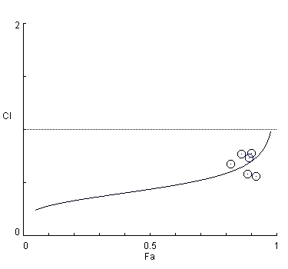
Supplemental Figure S6
H
I
2.0
1.5
HEL92.1.7
JQ1 + SAR302503
SET2
JQ1 + SAR302503
1.0
1.5
CI
1.0
Combination index
0.5
0.5
0
0
0.2
0.4
0.6
0.8
1.0
Fractional Effect
0
0
0.5
1.0
Fractional effect
HEL92.1.7
JQ1 (nM) | SAR302503 (nM) | Fa | CI Value
250 | 500 | 0.3959 | 0.823
300 | 600 | 0.4674 | 0.732
350 | 700 | 0.5491 | 0.637
400 | 800 | 0.6075 | 0.602
500 | 1000 | 0.6768 | 0.608
SET2
JQ1 (nM) | SAR302503 (nM) | Fa | CI Value
125 | 500 | 0.820 | 0.6777
150 | 600 | 0.885 | 0.5813
175 | 700 | 0.863 | 0.7709
187.5 | 750 | 0.920 | 0.5625
200 | 800 | 0.893 | 0.7360
225 | 900 | 0.902 | 0.7779

Slide 9
Supplemental Figure S7
% of Pts
With
mutation
Patient # | 1 | 2 | 3 | 4 | 5 | 6 | 7 | 8 | 9 | 10 | 11 | 12 | 13 | 14 | 15 | 16 | 17 | 18 | 19 | 20 | 21 | 22 | 23
BCR/ABL
ABL1
ASXL1
DNMT3
EZH2
FLT3
GATA1
HRAS
IDH1
IDH2
IKZF2
JAK2
KIT
KRAS
MLL
MPL
NOTCH1
NRAS
PTPN11
RUNX1
TET2
TP53
WT1
NPM1
BRAF
MYD88
CALR
CEBPA
0
0
30.4
8.7
13
0
0
0
4.3
13
4.3
65.2
4.3
17.4
0
4.3
0
13
0
17.4
26.1
4.3
0
0
0
0
4.3
0
Notes:
ASXL1 (blue) JAK2 (Green) TET2 (RED) RUNX1 (Purple) KRAS (Orange) CALR (light green)

Slide 10
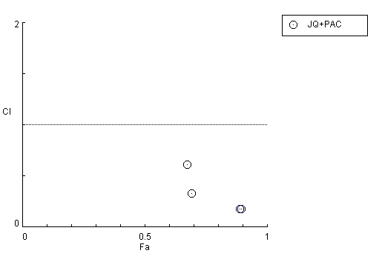
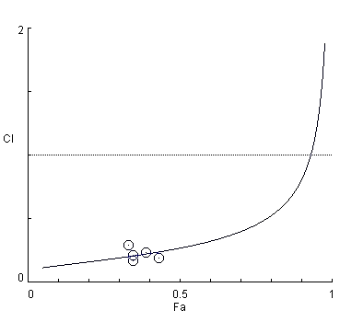
Supplemental Figure S8
C
2.0
PD CD34+ sAML
JQ1 and pacritinib
A
PD CD34+ sAML-1
JQ1 (nM) | ruxolitinib (nM) | FractionalEffect | CI
500.0 | 500.0 | 0.329 | 0.24729
1000.0 | 500.0 | 0.382 | 0.23628
2000.0 | 500.0 | 0.398 | 0.38133
500.0 | 1000.0 | 0.362 | 0.15523
1000.0 | 1000.0 | 0.395 | 0.19844
2000.0 | 1000.0 | 0.436 | 0.23158
1.0
Combination Index
0.5
0.0
0
0.5
1.0
Fractional effect
D
2.0
PD CD34+ sAML
JQ1 and pacritinib
B
PD CD34+ sAML-2
JQ1 (nM) | ruxolitinib (nM) | Fractional Effect | CI
500.0 | 500.0 | 0.782 | 0.0237
500.0 | 1000.0 | 0.912 | 0.00211
1000.0 | 500.0 | 0.9335 | 0.00211
1000.0 | 1000.0 | 0.952 | 9.59 E-4
1.0
Combination Index
Synergy
0.5
0.0
0
0.5
1.0
F
Fractional effect
PD CD34+ sAML
JQ1 (nM) | pacritinib (nM) | Fractional Effect | CI
400 | 200 | 0.347 | 0.1705
500 | 250 | 0.348 | 0.2112
600 | 300 | 0.331 | 0.2949
700 | 350 | 0.317 | 0.3911
800 | 400 | 0.389 | 0.2382
900 | 450 | 0.432 | 0.1889
E
PD CD34+ sAML
JQ1 (nM) | pacritinib (nM) | Fractional Effect | CI
500.0 | 500.0 | 0.691 | 0.3293
1000.0 | 1000.0 | 0.8905 | 0.1767
2000.0 | 500.0 | 0.6735 | 0.6144
2000.0 | 1000.0 | 0.895 | 0.1758

Slide 11
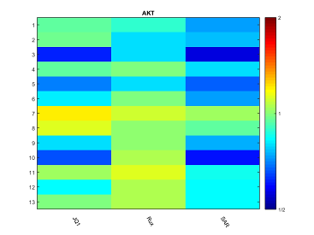
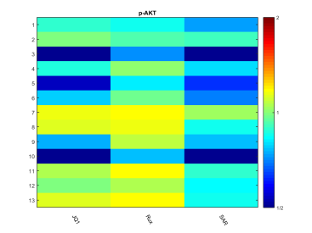
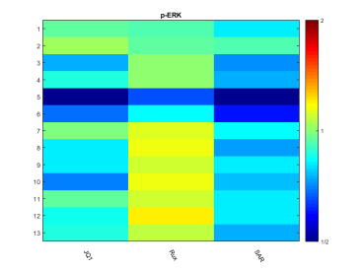
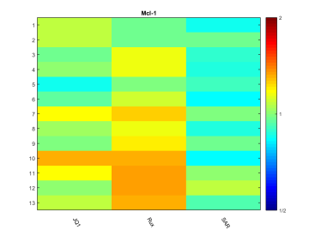
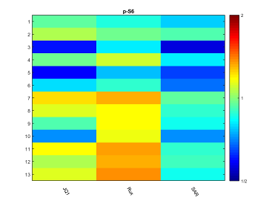
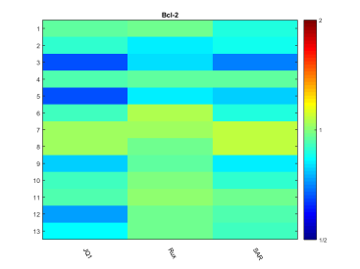
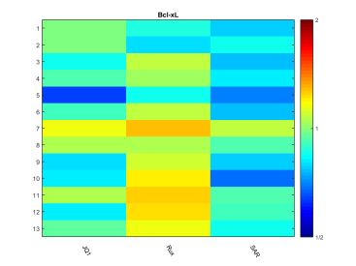
Supplemental Figure S9
AKT
p-AKT
p-ERK
Mcl-1
p-S6
1
2.0
2
3
4
5
6
7
1.0
8
9
10
11
12
13
JQ1
Rux
SAR
JQ1
Rux
SAR
JQ1
Rux
SAR
0.5
JQ1
Rux
SAR
JQ1
Rux
SAR
BCL-2
Bcl-xL
1
2.0
2
3
4
5
6
7
1.0
8
9
10
11
12
0.5
13
JQ1
Rux
SAR
JQ1
Rux
SAR

Slide 12




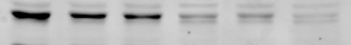





A
B
C
E
HEL/JIR
+ 20 nM AUY922
D
0 250 1000 0 250 1000 nM, JQ1, 24 h
HEL/JIR
JQ1 (nM) | AUY922 (nM) | Fa | CI Value
500 | 2.5 | 0.637 | 0.62348
600 | 3.0 | 0.749 | 0.52869
700 | 3.5 | 0.826 | 0.48278
800 | 4.0 | 0.845 | 0.51692
900 | 4.5 | 0.826 | 0.62072
1000 | 5.0 | 0.835 | 0.66896
p-STAT5
STAT5
STAT3
c-Myc
PIM1
CDK6
CDK4
Bcl-xL
hsp70
Supplemental Figure S10
β-Actin
Notes:
Panel C will lose HEL cells

Slide 13


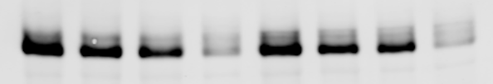

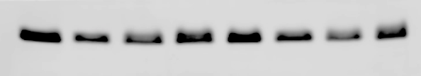


Supplemental Figure S11
A
B
HEL92.1.7
Parental
Persister
-
-
-
+
-
-
-
+
-
-
-
+
-
-
-
+
-
-
-
+
-
-
-
+
500 nM ruxolitinib
500 nM JQ1
*
*
500 nM AUY922
p-STAT5
1.0 0.49 0.44 0.01 1.0 0.81 0.43 0.01
STAT5
c-Myc
C
1.0 0.81 0.70 0.12 1.0 0.76 0.56 0.08
HEL/Persisters |  | 24 hr
JQ1 (nM) | AUY922 (nM) | Fa | CI Value
100 | 20 | 0.567 | 0.35056
125 | 25 | 0.522 | 0.53768
150 | 30 | 0.616 | 0.41968
175 | 35 | 0.662 | 0.39317
200 | 40 | 0.700 | 0.37117
225 | 45 | 0.728 | 0.35972
250 | 50 | 0.764 | 0.32524
PIM1
1.0 0.36 0.05 0.07 1.0 0.38 0.04 0.03
Bcl-xL
1.0 0.54 0.59 0.85 1.0 0.77 0.51 0.76
MCL1
1.0 1.07 0.39 0.40 1.0 0.67 0.54 0.24
β-Actin

