Slide 1









SF1
A (i)
(HPV+ve)
(HPV-ve)
N #1 #2 #3
#1 #2 #3
cJun
JunB
JunD
cFos
β-Actin
(ii)

Slide 2






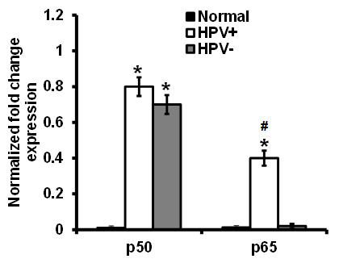
SF2
A (i)
(HPV+ve)
(HPV-ve)
N #1 #2 #3
#1 #2 #3
p50
p65
β-Actin
(ii)

Slide 3






SF3
A (i)
(HPV+ve)
(HPV-ve)
N #1 #2 #3
#1 #2 #3
STAT3
pSTAT3(Y705)
β-Actin
(ii)

Slide 4
SF4
6
5
4
3
Cumulative Expression of Transcription Factors
2
1
0
HPV+ve
HPV-ve

Slide 5






SF5
A (i)
(HPV+ve)
(HPV-ve)
N #1 #2 #3
#1 #2 #3
pEGFR^{1092h}
p16
β- Actin
(ii)

