Slide 1
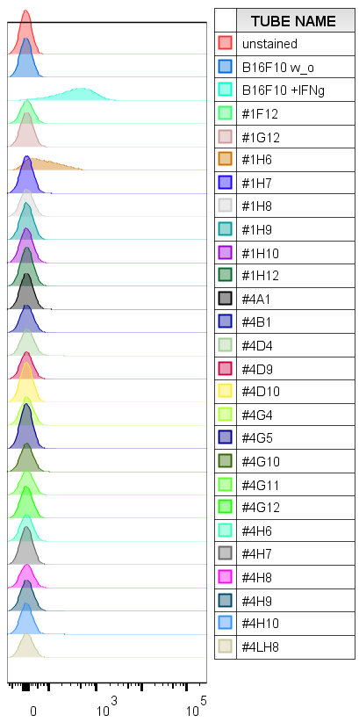
S5 Fig
count
IA^{b}

