Slide 1
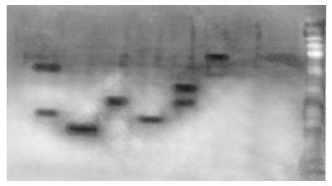
Uncut gel of Figure 6C
Calculated kDa:
61 24.5 36 26 51 88
YYY DDD 1-233 392-558 XXX 1-558
Actual kDa:
60 23 34 25 45 82

