Slide 1
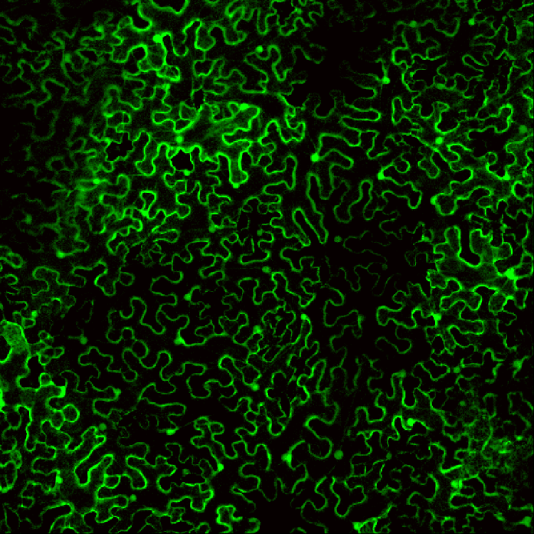

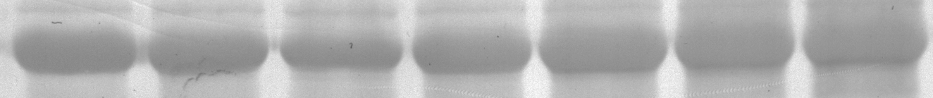
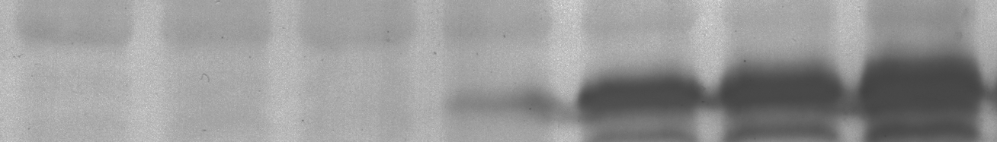
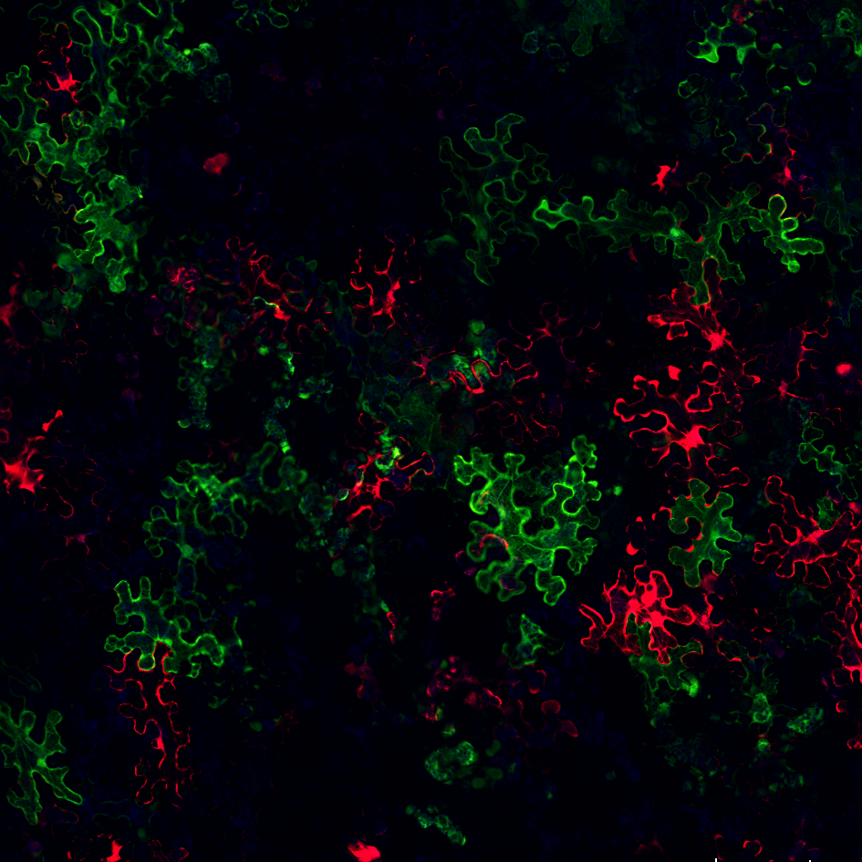
S1 Fig_Zhang2017
A
2X35S-GFP (GFP):
GFP
2X35S
T35S
ΔMP_sg2R:
2X35S
p28
p88
mCherry
T35S
B
GFP + ΔMP_sg2R + p19
24 hpi
36 hpi
48 hpi
G: 2.7±1.3%
R: 0
250 μm
G: 74.0±4.4%
R: 0
G: 83.3±5.7%
R: 3.0±1.2%
72 hpi
96 hpi
120 hpi
G: 84.3±5.5%
R: 10.0±1.5%
G: 75.7±2.7%
R: 23.0±3.6%
G: 76.3±3.2%
R: 33.3±2.6%
C
Hours post agro-infiltration
p19 + GFP:
12 24 36 48 72 96 120
WB
α-FP Ab
P19 + ΔMP_sg2R:
Loading
WB
α-FP Ab
Loading
D
Primary invader:
p19
Superinfector:
TCV_sg2G + TCV_sg2R
250 μm
G: 32.5±5.6%; R: 36.3±6.5%; G+R: 0

