Slide 1
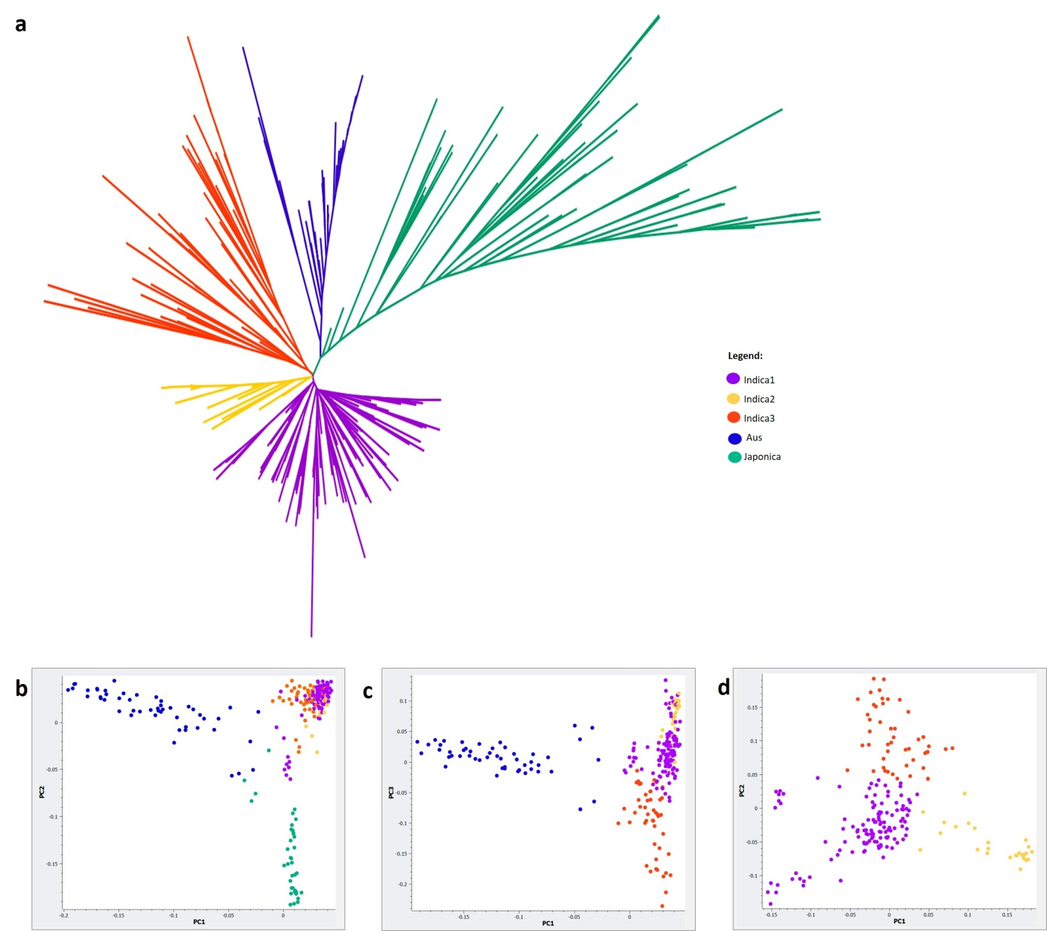
Figure S1. Phylogenetic and population structure of the 285 diverse panel. a) Radial tree of 285 diverse germplasm based on Tamura-Nei model (MEGA 6). Principal component analysis of b) 285 diverse germplasm c) 248 indica and aus genotypes, and d) 198 indica genotypes (Golden Helix SVS).

