Slide 1
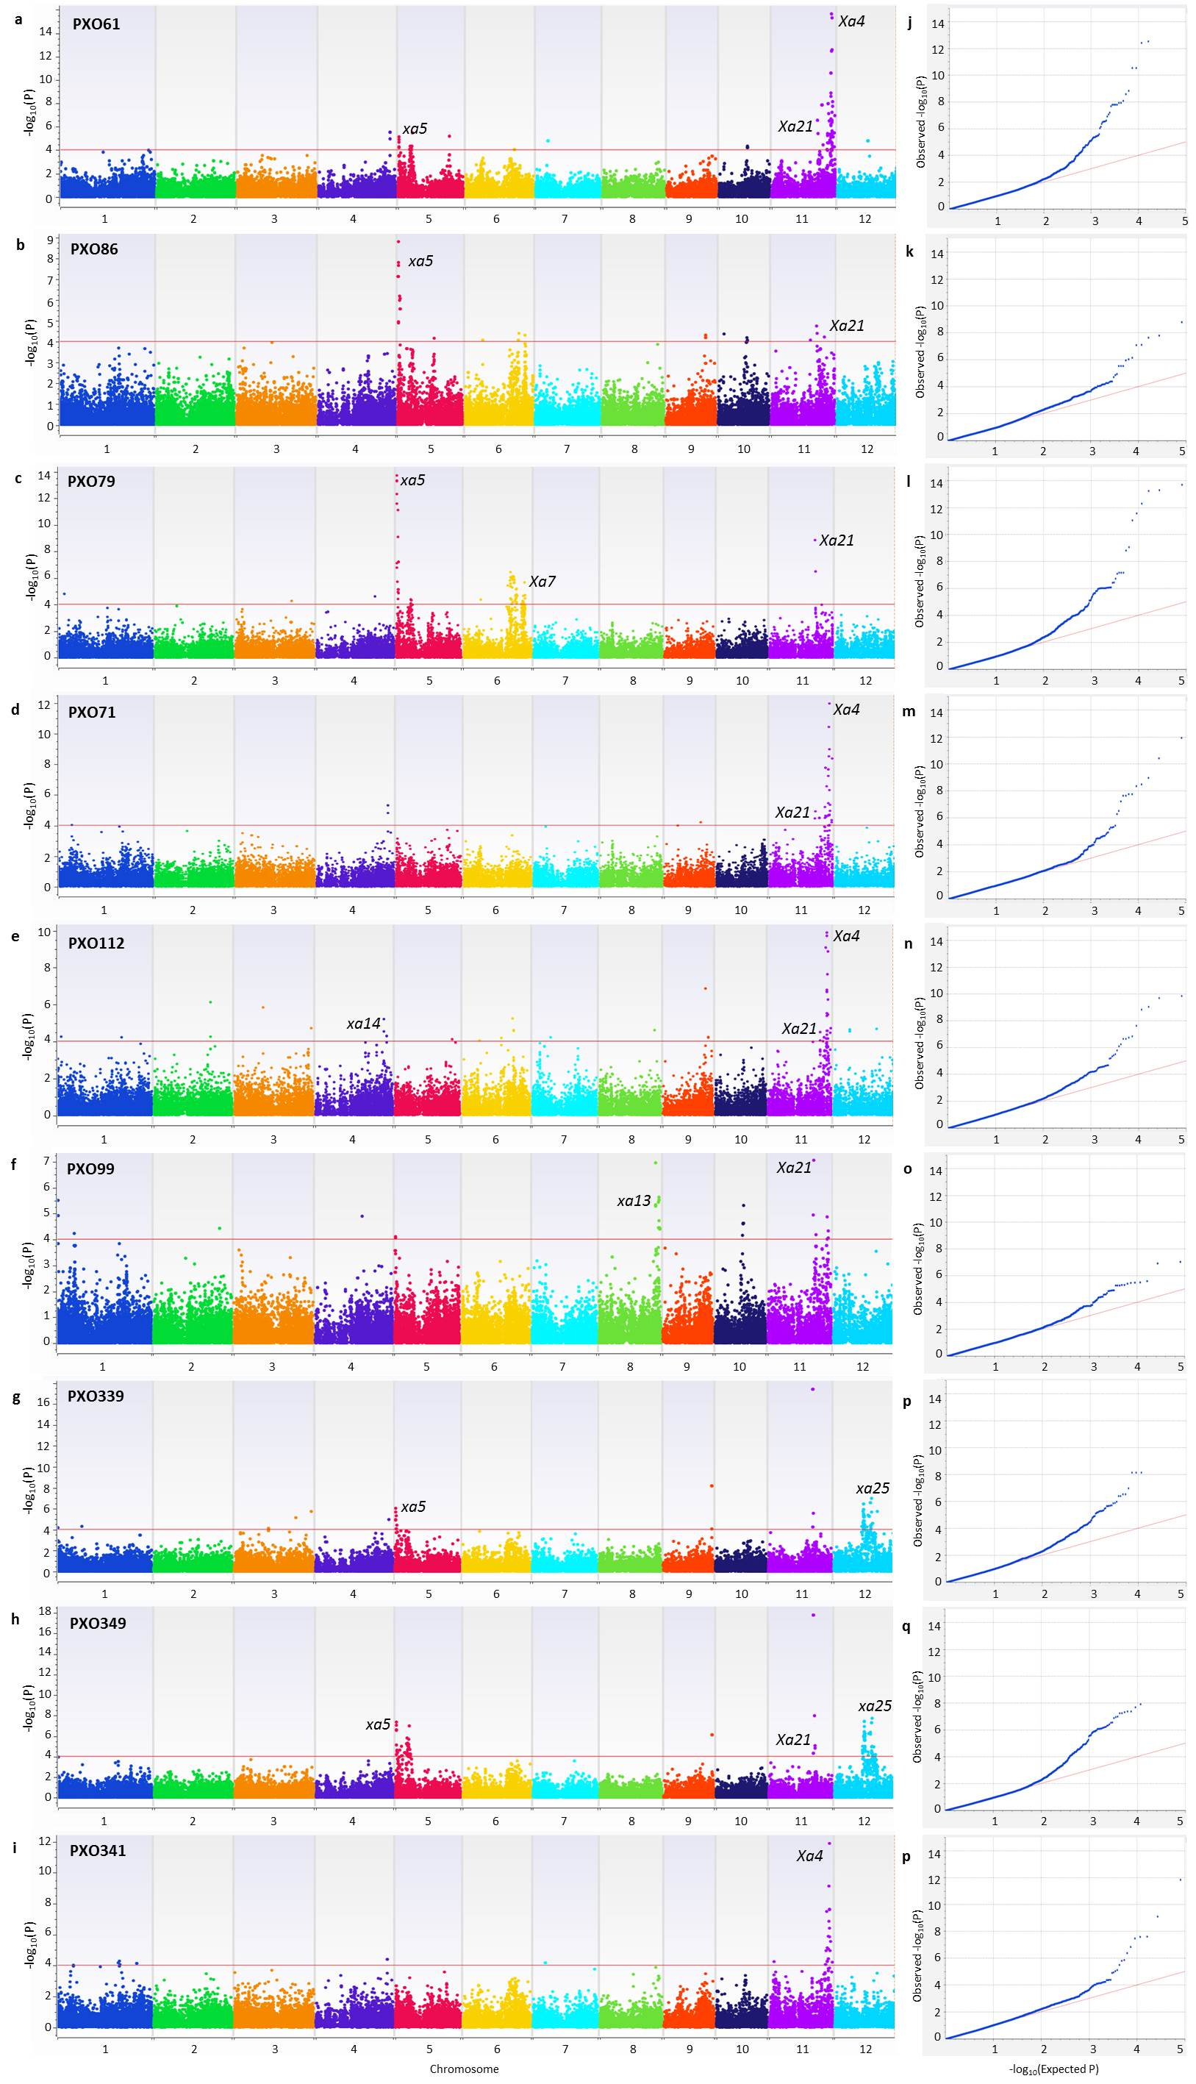
Figure S3. Genome-wide association analysis of bacterial blight resistance to nine Xoo strains in 198 indica genotypes based on Efficient Mixed-Model Association eXpedited Model (EMMAX). Manhattan plots for nine Xoo strains (a) PXO61, (b) PXO86, (c) PXO79, (d) PXO71, (e) PXO112, (f) PXO99, (g) PXO339, (h) PXO349, and (i) PXO341. X-axis shows the SNPs along each chromosome; y axis is the −log₁₀ (P-value) for the association. Significant SNPs are those beyond the red line having P-value < 1 × 10 ⁻⁵. Quantile-quantile plots for nine Xoo strains (j) PXO61, (k) PXO86, (l) PXO79, (m) PXO71, (n) PXO112, (o) PXO99, (p) PXO339, (q) PXO349, and (r) PXO341.

