Slide 1
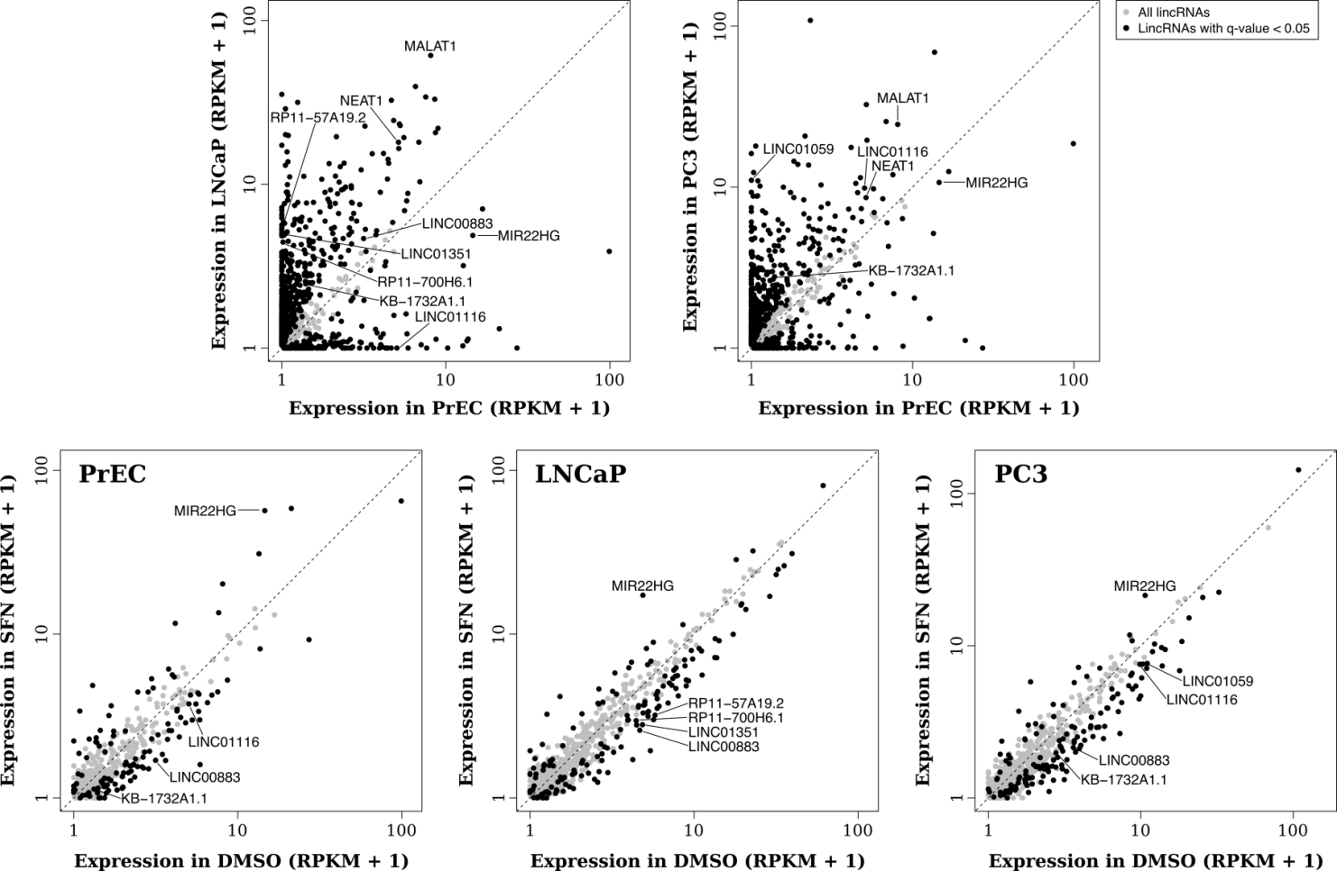
Supplemental Figure 1
A
B
Supplemental Figure 1: Significance and abundance of lncRNAs differentially expressed in prostate cancer cells and altered with SFN treatment. Genome wide expression of lncRNAs is shown for A) normal PREC cells compared to cancer cell lines to determine which lncRNAs may be differentially expressed because of a cancer effect. Neat1 and Malat1 were included as positive controls as they were previously known to be upregulated in cancer. B) Comparisons between SFN treated samples and DMSO (vehicle control) identified lncRNAs significantly altered by SFN treatment in each cell type. Expression is calculated as reads per kilobase of exon per million fragments mapped (RPKM). Black dots indicate lncRNAs that were significantly differentially expressed (as determined by GENE-counter) while grey dots indicate lncRNAs that were not significantly different between the two groups. All data are from the 6-hour time point.

Slide 2
Supplemental Figure 2
A
B
C
D
Supplemental Figure 2: Low dose SFN also significantly alters lncRNA expression. PC-3 cells were treated with 5 µM SFN or vehicle control (DMSO) for 6 or 24 hours, and qPCR was performed. Bars are representative of the mean expression levels of the indicated lncRNA normalized to GAPDH and expressed relative to the mean expression levels in cells treated with DMSO. Hemoxygenase-1 (HO1) was included as a positive control as it is induced by SFN treatment. Samples were collected in triplicate, in two independent experiments (n=6) and stars indicates significant differences between the control and treatment groups as calculated by an unpaired, two-tailed t test where * p < 0.05, ** p < 0.01, *** p < 0.001.

Slide 3
Supplemental Figure 3
Supplemental Figure 3: LncRNAs altered with SFN treatment correlate with genes that regulate cancer. Expression of each lncRNA of interest, indicated on the x-axis, was correlated with all other annotated genes in our RNA-seq data set. Genes whose mRNA expression levels significantly correlated, or anti-correlated, with each lncRNA were then compared against Reactome groups (y-axis). Reactome groups that were significantly enriched for with each lncRNA are shown as a heat map where purple indicates anti-correlated and green is correlated.

Slide 4
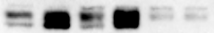
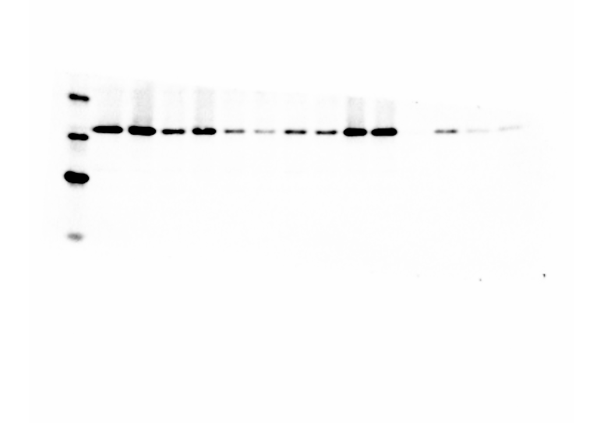
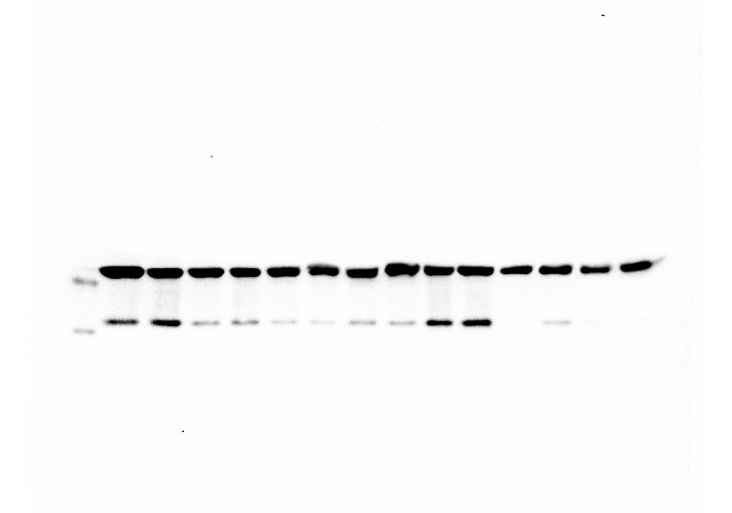
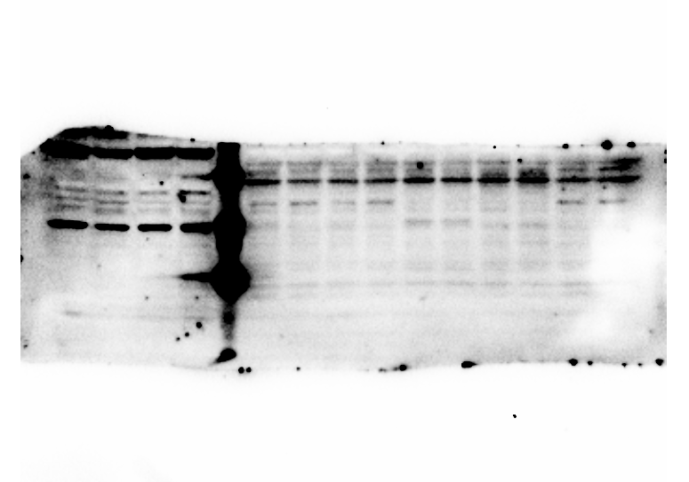
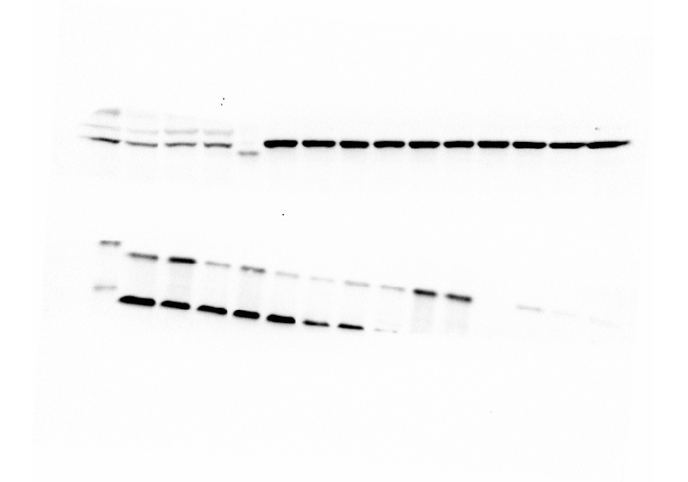
Supplemental Figure 4
A
B
PC-3
NC
Nrf2 mut
DMSO
SFN
DMSO
SFN
DMSO
SFN
Nrf2
Neg. Cont. Cells
NQO1
β-actin
HO-1
β-actin
Nrf2 mutant cells
Supplemental Figure 4: Generation of Nrf2 mutant. PC-3 cells were transfected with a plasmids that encoded GFP, Nickase Cas9 protein, and two guide RNAs that targeted DNA mutations specifically to the Nrf2 gene, or a negative control region in DNA on chromosome 13 where no genes are expressed. GFP positive cells were seeded into 96 well plates, and cell lines were generated from a single cell. A) Cellular appearance was recorded as Nrf2 mutant cells presented a phenotypes (10x magnification) (B) Negative control (NC) and Nrf2 mutant (Nrf2 mut) cell lines were also treated with 15 µM SFN or vehicle control (DMSO) for 48 h and protein was collected and separated by SDS-Page gel. PC-3 and NC cells had higher baseline levels of Nrf2, NQO1, and HO-1 protein than the Nrf2 mutant. Furthermore, the Nrf2 mutant did not upregulate the expression of Nrf2 and NQO1 in response to SFN treatment.

