Slide 1
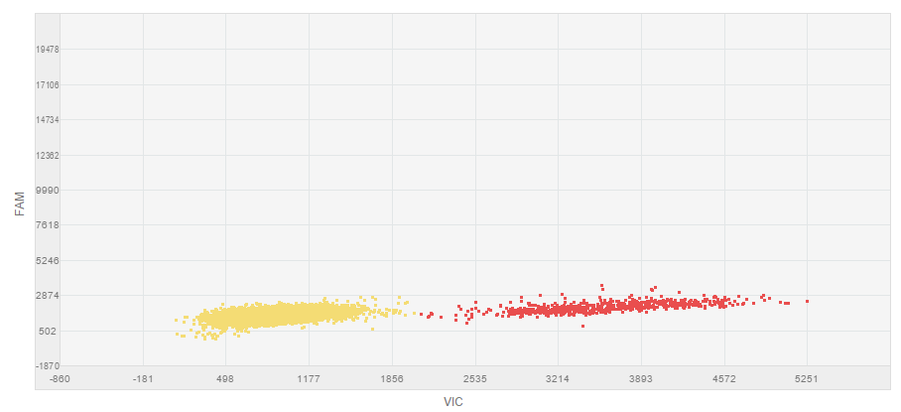
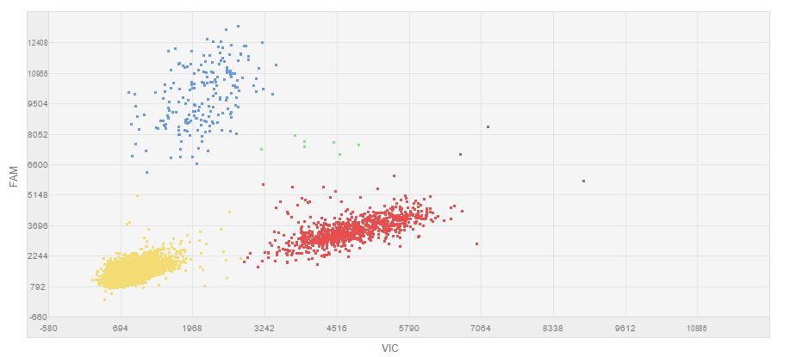
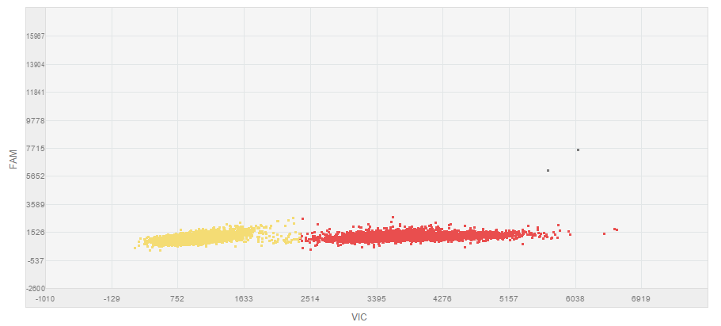
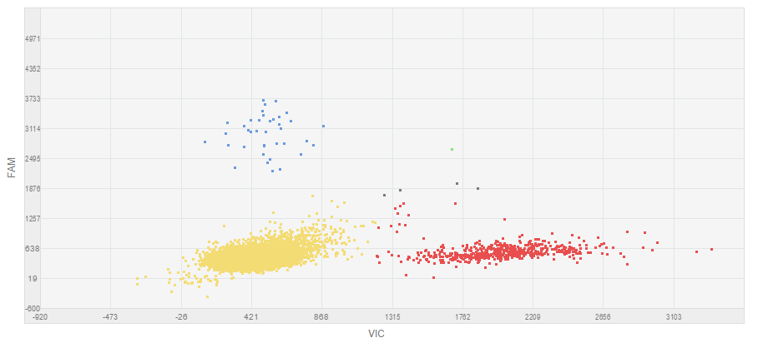
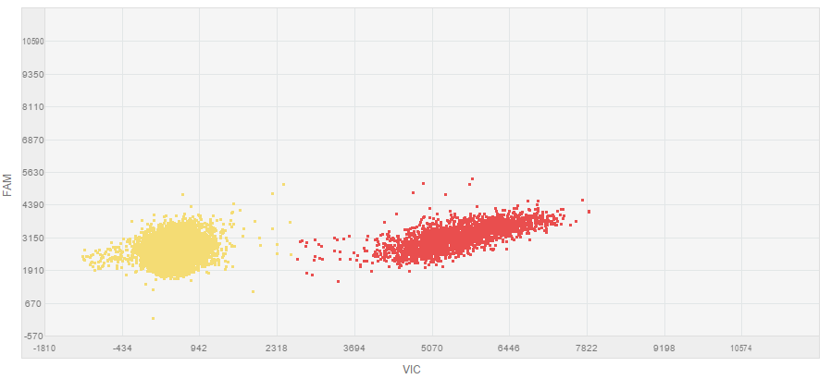
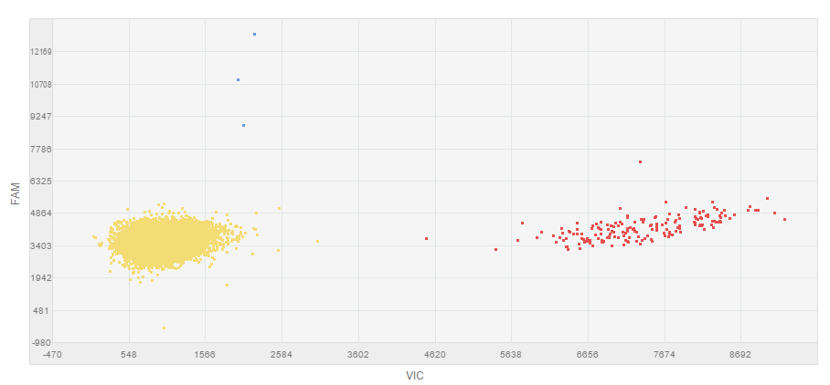
a
b
H1047R
A
B
d
c
E545K
e
f
E542K
Notes:
Supplemetal data 3. Performance of PIK3CA assays on cfDNA. Data from sample chips are displayed in a scatter plot based on color of FAM and VIC events. Plots A, C and E correspond to a negative samples. Plots B, D and F correspond to positive samples for the H1047R, E545K and E542K mutation respectively. The mutation is labeled with FAM (blue data points) whereas wild-type is labeled with VIC (red data points). Yellow cluster represent the no amplification cluster.

