Slide 1
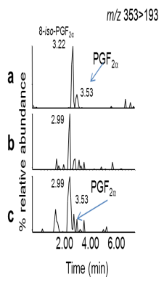
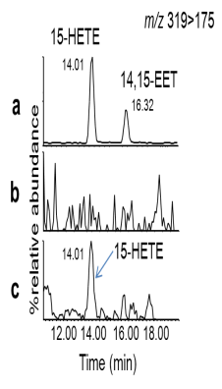
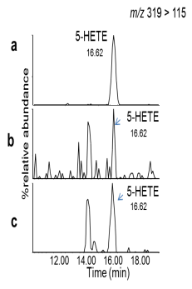
S Figure 1
a
b
c
d
0.3
7.5
2
12.5
10.0
0.2
5.0
7.5
TxB₂ (ng/ml)
9-HODE (ng/ml)
12-HETE (ng/ml)
13-HODE (ng/ml)
1
5.0
0.1
2.5
AD
plasma
AD
plasma
AD
plasma
2.5
AD
plasma
Healthy
plasma
Healthy
plasma
Healthy
plasma
Healthy
plasma
0
0
0
0
e
f
1.0
0.7
*
Standards
*
Standards
0.6
Healthy
plasma
0.5
15-HETE (ng/ml)
Healthy
plasma
PGF₂α (ng/ml)
0.4
AD
plasma
0.5
0.3
AD
plasma
0.2
0.1
AD
plasma
AD
plasma
Healthy
plasma
0
0
Healthy
plasma
g
0.6
*
0.5
Standards
0.4
Healthy
plasma
5-HETE (ng/ml)
0.3
AD
plasma
0.2
0.1
AD
plasma
0
Healthy
plasma

Slide 2
S Figure 2
a
25
**
b
20
***
***
4
*
**
IL-6 (ng/ml)
15
IL-10 (ng/ml)
*
10
2
5
0
0
Cells
LPS
SKF525A
L-NAME
Baicalein
Cells
LPS
SKF525A
L-NAME
Healthy plasma
+ LPS
Plasma (BDL)
Plasma (BDL)
Healthy plasma
+ LPS
Indomethacin
Indomethacin
BDL plasma (+ LPS)
BDL plasma (+ LPS)
c
(i)
*
(ii)
*
d
0.6
*
*
1.0
*
2.0
*
**
*
0.5
0.75
**
0.4
TNFα (ng/ml)
TNFα (ng/ml)
IL-10 (pg/ml)
0.5
0.3
1.0
0.2
0.25
0.1
f
0
0
0
Plasma (BDL)
Cells
LPS
PGE₂ (10ng/ml)
Cells
LPS
PGE₂ (10ng/ml)
Cells
LPS
Plasma (BDL)
+ AH6809
PGE₂ (1ng/ml)
PGE₂ (1ng/ml)
Healthy plasma
e
LPS
f
LPS
*
*
LPS
3
(i)
(ii)
(iii)
*
2.5
0.6
*
20
2
2.0
0.5
*
IL-10 (ng/ml)
0.4
1.5
TNFα (ng/ml)
IL-10 (ng/ml)
IL-6 (ng/ml)
1
1.0
*
0.3
10
0.2
0.5
0.1
0
Plasma (BDL)
0
0
0
Cells
LPS
Plasma (BDL)
+ AH6809
Normal plasma on
BDL mouse Mϕs
BDL plasma on
BDL mouse Mϕs
Normal plasma on
BDL mouse Mϕs
BDL plasma on
BDL mouse Mϕs
Healthy plasma on
BDL mouse Mϕs
BDL plasma on
BDL mouse Mϕs
Plasma (normal)
LPS
LPS
LPS
LPS

Slide 3
S Figure 3
a
2
b
12.5
c
12.5
d
10.0
10.0
15
PGD₂ (ng/ml)
7.5
7.5
10
1
PGF₂α (ng/ml)
5-HETE (ng/ml)
8-HETE (ng/ml)
5.0
5.0
5
2.5
2.5
0
BDL
0
BDL
0
BDL
0
BDL
Naive
Sham
Naive
Sham
Naive
Sham
Naive
Sham
e
f
*
g
h
5
600
*
7
20
*
*
4
500
6
3
400
5
11-HETE (ng/ml)
4
15-HETE (ng/ml)
TxB₂ (ng/ml)
300
10
2
12-HETE (ng/ml)
3
200
2
1
100
1
0
0
0
0
BDL
Naive
Sham
BDL
Naive
Sham
BDL
Naive
Sham
BDL
Naive
Sham
i
3.5
j
k
60
l
175
3.0
50
50
150
2.5
40
125
2.0
9-HODE (ng/ml)
12-HEPE (ng/ml)
100
15-HETrE (ng/ml)
25
30
13-HODE (ng/ml)
1.5
20
75
1.0
50
0.5
10
25
0
0
0
0
Naive
Sham
BDL
Naive
Sham
BDL
Naive
Sham
BDL
Naive
Sham
BDL
m
3.5
n
5
o
20
p
20
3.0
4
2.5
2.0
3
14 - HDOHA (ng/ml)
17-HDOHA (ng/ml)
10-HDOHA (ng/ml)
13-HDOHA (ng/ml)
10
10
1.5
2
1.0
1
0.5
0
0
0
0
Naive
Sham
BDL
Naive
Sham
BDL
Naive
Sham
BDL
Naive
Sham
BDL

Slide 4
S Figure 4
a
*
b
c
d
2
1.0
4
4
PGD₂ (ng/ml)
PGF₂α (ng/ml)
5-HETE (ng/ml)
2
8-HETE (ng/ml)
1
0.5
2
0
0.0
Sham
CCL4
0
Sham
CCL4
0
Sham
CCL4
Sham
CCL4
g
h
e
f
6
3
500
2
2
4
11-HETE (ng/ml)
12-HETE (ng/ml)
15-HETE (ng/ml)
TxB₂ (ng/ml)
250
1
1
2
0
Sham
CCL4
0
0
CCL4
0
Sham
CCL4
Sham
Sham
CCL4
i
j
20
k
5.0
l
0.6
30
0.4
20
10
12-HEPE (ng/ml)
13-HODE (ng/ml)
15-HETrE (ng/ml)
9-HODE (ng/ml)
2.5
0.2
10
0.0
Sham
CCL4
0
Sham
CCL4
0.0
Sham
CCL4
0
Sham
CCL4
m
n
o
25
p
5.0
0.8
2
0.6
20
13-HDOHA (ng/ml)
15
17-HDOHA (ng/ml)
10-HDOHA (ng/ml)
0.4
14 - HDOHA (ng/ml)
2.5
1
10
0.2
5
0
Sham
CCL4
0.0
CCL4
0
Sham
CCL4
0.0
Sham
CCL4
Sham

Slide 5
Figure S5
a
80
b
3.0
*
**
60
*
2.0
TNFα (ng/ml)
IL-10 (ng/ml)
40
1.0
20
0
0
Cells
AD plasma^{MIS}
+ AH6809 (50µM)
AD plasma^{LIS}
+ AH6809 (50µM)
LPS
AD plasma^{MIS}
AD plasma^{LIS}
Healthy plasma
Plasma (AD)
+ AH6809 (50µM)
Plasma (AD)
LPS
60
LPS
c
3.0
**
d
50
*
*
40
TNF α ng/ml
IL-10 (ng/ml)
30
2.0
20
10
1.0
0
AD plasma^{MIS}
AD plasma^{MIS}
+ AH6809 (50µM)
MIS Week 1
MIS Week 24
LIS Week 1
LIS Week 24
MIS Week 1+AH 6809
LIS Week 1+AH6809
MIS Week 24+AH6809
LIS Week 24+AH6809
LPS
***
e
70
LPS
60
SALINE
Day 1/3
50
40
TNF α ng/ml
30
20
10
0
Healthy
plasma
Baseline
10-20 days
30-60 days
LPS

