Slide 1
Additional File 1: Figures 1-10
Paul and Mondal et al., 2017

Slide 2
Figure S1
Paul and Mondal et al., 2017
A
B
C
PAM output for 14-CpG methylation signature to discriminate LGG IDH1 mutant from WT
S R No. | Threshold | No. of CpGs as signature | Errors
1 | 0 | 9554 | 3
2 | 0.728 | 9554 | 4
3 | 1.456 | 9554 | 4
4 | 2.185 | 9554 | 4
5 | 2.913 | 9554 | 5
6 | 3.641 | 9554 | 7
7 | 4.369 | 9554 | 7
8 | 5.098 | 9553 | 9
9 | 5.826 | 9547 | 10
10 | 6.554 | 9448 | 12
11 | 7.282 | 9148 | 12
12 | 8.01 | 8501 | 13
13 | 8.739 | 7510 | 13
14 | 9.467 | 6105 | 13
15 | 10.195 | 4580 | 13
16 | 10.923 | 3302 | 13
17 | 11.651 | 2279 | 13
18 | 12.38 | 1532 | 12
19 | 13.108 | 1028 | 12
20 | 13.836 | 686 | 12
21 | 14.564 | 454 | 12
22 | 15.293 | 271 | 11
23 | 16.021 | 163 | 11
24 | 16.749 | 102 | 10
25 | 17.477 | 54 | 7
26 | 18.205 | 33 | 3
27 | 18.934 | 14 | 0
28 | 19.662 | 6 | 13
29 | 20.39 | 3 | 46
30 | 21.118 | 0 | 47
PAM output for 14-CpG methylation signature to discriminate diffuse astrocytoma (DA) from oligodendroglioma (ODG)
S R No. | Threshold | No. of CpGs as signature | Errors
1 | 0 | 2817 | 3
2 | 0.431 | 2817 | 2
3 | 0.863 | 2817 | 2
4 | 1.294 | 2817 | 2
5 | 1.726 | 2817 | 2
6 | 2.157 | 2817 | 2
7 | 2.588 | 2816 | 2
8 | 3.02 | 2795 | 2
9 | 3.451 | 2689 | 2
10 | 3.883 | 2377 | 2
11 | 4.314 | 1861 | 2
12 | 4.745 | 1298 | 2
13 | 5.177 | 836 | 2
14 | 5.608 | 544 | 2
15 | 6.039 | 347 | 2
16 | 6.471 | 229 | 2
17 | 6.902 | 139 | 2
18 | 7.334 | 91 | 2
19 | 7.765 | 59 | 2
20 | 8.196 | 41 | 2
21 | 8.628 | 29 | 2
22 | 9.059 | 21 | 2
23 | 9.491 | 14 | 2
24 | 10.353 | 7 | 10
25 | 10.785 | 4 | 58
26 | 11.216 | 3 | 79
27 | 11.648 | 1 | 85
28 | 12.079 | 1 | 86
29 | 12.51 | 0 | 86
PAM output for 13-CpG methylation signature to discriminate GBM IDH1 mutant from WT
S R No. | Threshhold | No. of CpGs as signature | Errors
1 | 0 | 259 | 0
2 | 0.135 | 259 | 0
3 | 0.269 | 259 | 0
4 | 0.404 | 256 | 0
5 | 0.539 | 247 | 0
6 | 0.674 | 240 | 0
7 | 0.808 | 230 | 0
8 | 0.943 | 212 | 0
9 | 1.078 | 190 | 0
10 | 1.212 | 162 | 0
11 | 1.347 | 139 | 1
12 | 1.482 | 118 | 1
13 | 1.617 | 100 | 1
14 | 1.751 | 84 | 1
15 | 1.886 | 65 | 1
16 | 2.021 | 54 | 1
17 | 2.155 | 44 | 1
18 | 2.29 | 32 | 1
19 | 2.425 | 25 | 1
20 | 2.559 | 20 | 1
21 | 2.694 | 13 | 0
22 | 2.829 | 9 | 2
23 | 2.964 | 7 | 2
24 | 3.098 | 5 | 3
25 | 3.233 | 3 | 4
26 | 3.368 | 3 | 4
27 | 3.502 | 2 | 4
28 | 3.637 | 1 | 4
29 | 3.772 | 1 | 4
30 | 3.907 | 0 | 4
Notes:
Supplementary Figure 1: PAM output for diffuse glioma sub-types.
PAM analysis of 9,554 differentially methylated CpGs for LGG IDH1 Mutant versus WT in training set. The threshold value 18.9 corresponded to 14 discriminatory CpG probes which classified IDH1 mutant (n=217) and WT (n=49) LGG samples with classification error of 0% (yellow) was chosen for further validation.
PAM analysis of 2,817 differentially methylated CpGs for oligodendroglioma (1p/19q Codeletion) versus diffuse astrocytoma (Non-codeletion) in training set. The threshold value 9.491 corresponded to 14 discriminatory CpG probes which classified ODG (LGG IDH1 mutant with 1p/19q codel; n=86) and diffuse astrocytoma (LGG IDH1 mutant with intact 1p/19q; n=131) LGG samples with classification error of 0.93% (yellow) was chosen for further validation.
PAM analysis of 259 differentially methylated CpG probes for GBM IDH1 Mutant versus WT in training set. The threshold value 2.694 corresponded to 13 discriminatory CpG probes which classified IDH1 mutant (n=4) and WT (n=59) GBM samples with classification error of 0% (yellow) was chosen for further validation.

Slide 3
Figure S2
Paul and Mondal et al., 2017
A
B
Five-fold SVM for 14-CpG methylation signature to discriminate LGG IDH1 mutant from WT
No. | Training |  | Test |  | Prediction
 | Mut | WT | Mut | WT | Mut | WT | % Accuracy
Fold1 | 173 | 38 | 44 | 11 | 44 | 11 | 100
Fold2 | 174 | 40 | 43 | 9 | 43 | 9 | 100
Fold3 | 173 | 39 | 44 | 10 | 44 | 10 | 100
Fold4 | 174 | 40 | 43 | 9 | 43 | 9 | 100
Fold5 | 174 | 39 | 43 | 10 | 43 | 10 | 100
Five-fold subset analysis for 14-CpG methylation signature to discriminate LGG IDH1 mutant from WT
No. | Subset |  | Prediction
 | Mut | WT | Mut | WT | % Accuracy
Set1 | 129 | 29 | 129 | 29 | 100
Set2 | 129 | 29 | 129 | 29 | 100
Set3 | 129 | 29 | 129 | 29 | 100
Set4 | 129 | 29 | 129 | 29 | 100
Set5 | 129 | 29 | 129 | 29 | 100
C
Five-fold SVM for 14-CpG methylation signature to discriminate diffuse astrocytoma (DA) from oligodendroglioma (ODG)
No. | Training |  | Test |  | Prediction
 | ODG | DA | ODG | DA | ODG | DA | % Accuracy
Fold1 | 104 | 68 | 27 | 18 | 27 | 18 | 100
Fold2 | 105 | 69 | 26 | 17 | 25 | 17 | 97.67
Fold3 | 105 | 69 | 26 | 17 | 26 | 17 | 100
Fold4 | 105 | 69 | 26 | 17 | 26 | 17 | 100
Fold5 | 105 | 69 | 26 | 17 | 25 | 17 | 97.67
D
Five-fold subset analysis for 14-CpG methylation signature to discriminate diffuse astrocytoma (DA) from oligodendroglioma (ODG)
No. | Subset |  | Prediction
 | ODG | DA | ODG | DA | % Accuracy
Set1 | 52 | 79 | 52 | 79 | 100
Set2 | 52 | 79 | 52 | 78 | 99.24
Set3 | 52 | 79 | 52 | 78 | 99.24
Set4 | 52 | 79 | 52 | 79 | 100
Set5 | 52 | 79 | 52 | 78 | 99.24
E
Five-fold SVM for 13-CpG methylation signature to discriminate GBM IDH1 mutant from WT
No. | Training |  | Test |  | Prediction
 | Mut | WT | Mut | WT | Mut | WT | % Accuracy
Fold1 | 4 | 47 | 4 | 12 | 4 | 12 | 100
Fold2 | 4 | 47 | 4 | 12 | 4 | 12 | 100
Fold3 | 4 | 47 | 4 | 12 | 4 | 12 | 100
Fold4 | 4 | 47 | 4 | 12 | 4 | 12 | 100
Fold5 | 4 | 48 | 4 | 11 | 4 | 11 | 100
F
Five-fold subset analysis for 13-CpG methylation signature to discriminate GBM IDH1 mutant from WT
No. | Subset |  | Prediction
 | Mut | WT | Mut | WT | % Accuracy
Set1 | 4 | 35 | 4 | 35 | 100
Set2 | 4 | 35 | 4 | 35 | 100
Set3 | 4 | 35 | 4 | 35 | 100
Set4 | 4 | 35 | 4 | 35 | 100
Set5 | 4 | 35 | 4 | 35 | 100
Notes:
Supplementary Figure 2: Internal cross validation using Support Vector Machine (SVM) and Subset analysis for the methylation based signatures.
Internal cross validation of the training set for LGG IDH1 Mutant (n=217) and WT (n=49) patient samples using SVM five-fold cross validation methodology.
Internal cross validation of the training set for LGG IDH1 Mutant (n=217) and WT (n=49) patient samples using subset analysis five-fold cross validation methodology.
Internal cross validation of the training set for oligodendroglioma (ODG; n=86) and diffuse astrocytoma (DA; n=131) patient samples using SVM five-fold cross validation methodology.
Internal cross validation of the training set for oligodendroglioma (ODG; n=86) and diffuse astrocytoma (DA; n=131) patient samples using subset analysis five-fold cross validation methodology.
Internal cross validation of the training set for GBM IDH1 Mutant (n=4) and WT (n=59) patient samples using SVM five-fold cross validation methodology.
Internal cross validation of the training set for GBM IDH1 Mutant (n=4) and WT (n=59) patient samples using subset analysis five-fold cross validation methodology.

Slide 4
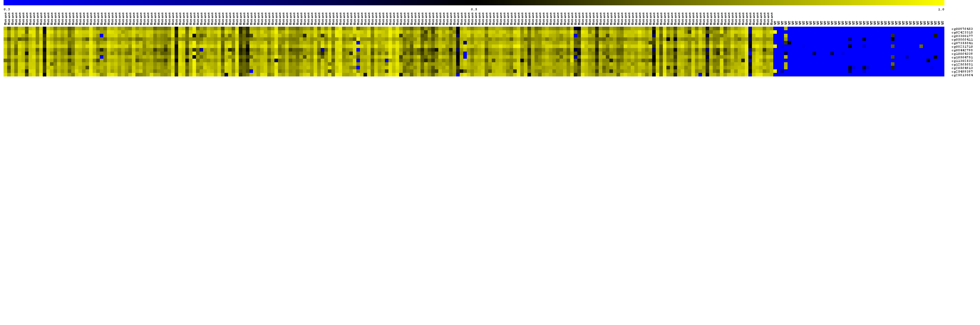
Figure S3
Paul and Mondal et al., 2017
A
cg00976453
LGG IDH Mutant
LGG IDH WT
cg02423318
cg03300177
cg05866411
cg07355841
cg08231710
cg08442798
cg10064339
cg10504751
cg11302533
cg12565681
cg20564913
cg25499397
cg25813864
0.0
0.5
1.0
B
C
LGG IDH Mutant
LGG IDH WT
2
LGG IDH Mutant
LGG IDH wild type
1.0
1.0
1
0.8
0.8
Principal Component 2
0.6
0.6
0
cross-validated probabilities
0.4
0.4
-1
0.2
0.2
-2
0.0
0.0
-4
-2
0
2
4
6
8
Principal Component 1
0
50
100
150
200
250
sample
Notes:
Supplementary Figure 3: PCA and cross validated probabilities of IDH1 Mut and WT in LGG samples of test set (TCGA).
(A) Heat map of the 14 CpG discriminatory probes identified in PAM analysis in IDH1 Mut (n=216) and WT (n=48) LGG patient samples in the test set (TCGA). A dual color-code was used where yellow indicates more methylation (hypermethylation) and blue indicates less methylation (hypomethylation).
(B) PCA was performed using beta (methylation) values of 14- PAM identified CpG probes between IDH1 Mut (n=215) and WT (n=48) LGG samples in test set. A scatter plot is generated using the first two principal components for each sample. The color code of the samples is as indicated.
(C) The detailed probabilities of 10-fold cross-validation for the samples of training set based on the beta values of 14 CpG probes are shown. For each sample, its probability as IDH1 Mut (red color) and WT (green color) of LGG samples are shown and it was predicted by the PAM program as either LGG IDH1 Mut or WT based on which grade’s probability is higher. The original histological grade of the samples is shown on the top.

Slide 5
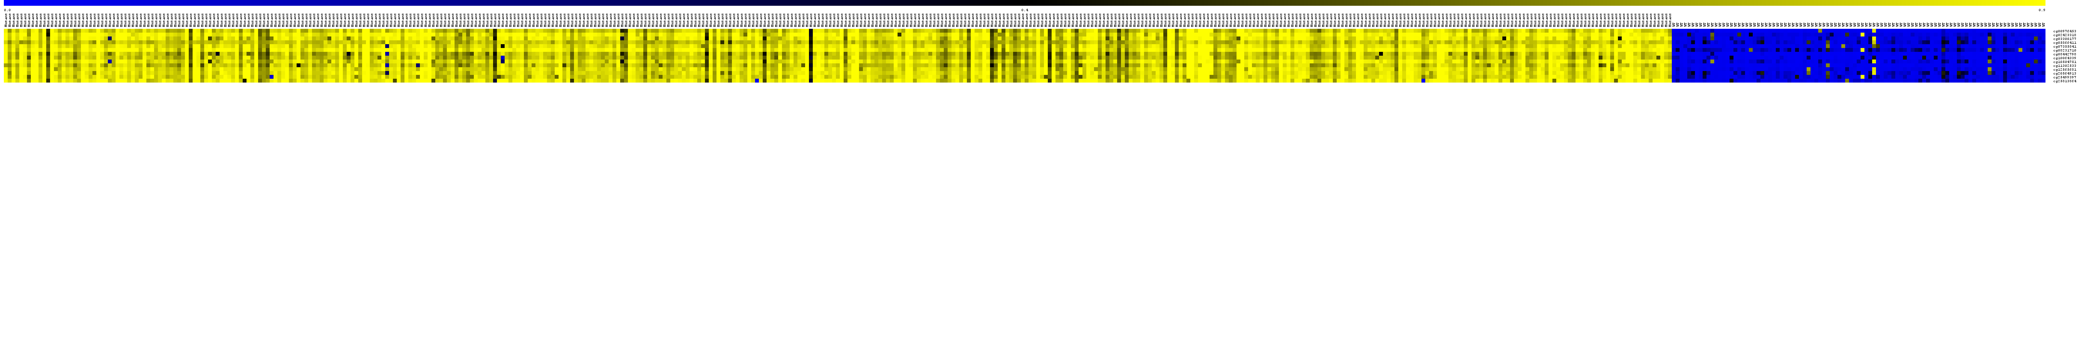
Figure S4
Paul and Mondal et al., 2017
cg00976453
cg02423318
cg03300177
cg05866411
cg07355841
cg08231710
cg08442798
cg10064339
cg10504751
cg11302533
cg12565681
cg20564913
cg25499397
cg25813864
0.0
0.5
1.0
LGG IDH Mutant
LGG IDH WT
1.0
1.0
0.8
0.8
0.6
0.6
cross-validated probabilities
0.4
0.4
0.2
0.2
0.0
0.0
0
100
200
300
400
500
sample
Notes:
Supplementary Figure 4: PCA and cross validated probabilities of IDH1 Mut and WT in LGG samples of the entire TCGA dataset.
(A) Heat map of the 14 CpG discriminatory probes identified in PAM analysis in IDH1 Mut (n=433) and WT (n=97) LGG patient samples in the entire TCGA dataset. A dual color-code was used where yellow indicates more methylation (hypermethylation) and blue indicates less methylation (hypomethylation).
(B) PCA was performed using beta (methylation) values of 14- PAM identified CpG probes between IDH1 Mut (n=433) and WT (n=97) LGG patient samples in the entire TCGA dataset. A scatter plot is generated using the first two principal components for each sample. The color code of the samples is as indicated.
(C) The detailed probabilities of 10-fold cross-validation for the samples of training set based on the beta values of 14 CpG probes are shown. For each sample, its probability as IDH1 Mut (red color) and WT (green color) of LGG patient samples are shown and it was predicted by the PAM program as either LGG IDH1 Mut or WT based on which grade’s probability is higher. The original histological grade of the samples is shown on the top.

Slide 6
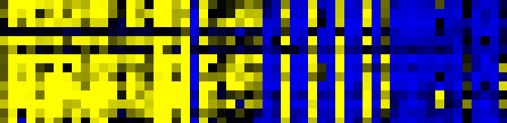
Figure S5
Paul and Mondal et al., 2017
A
cg00976453
LGG IDH Mutant
LGG IDH WT
cg02423318
cg03300177
cg05866411
cg07355841
cg08231710
cg08442798
cg10064339
cg10504751
cg11302533
cg12565681
cg20564913
cg25499397
cg25813864
0.0
0.5
1.0
B
C
3
LGG IDH1 Mutant
LGG IDH1 mutant
LGG IDH1 WT
LGG IDH1 WT
1.0
1.0
2
0.8
0.8
1
Principal Component 2
0.6
0.6
0
cross-validated probabilities
0.4
0.4
-1
0.2
0.2
-2
0.0
0.0
-3
0
10
20
30
40
50
-6
-4
-2
0
2
4
6
sample
Principal Component 1
Notes:
Supplementary Figure 5: Validation of the 14-CpG methylation signature of LGG IDH1 mutant versus WT in an independent validation dataset GSE48462.
(A) Heat map of the 14 CpG discriminatory probes identified in PAM analysis in IDH1 mutant (n=29) and WT (n=27) LGG patient samples in the entire TCGA dataset. A dual color-code was used where yellow indicates more methylation (hypermethylation) and blue indicates less methylation (hypomethylation).
(B) PCA was performed using β(methylation) values of 14- PAM identified CpG probes between IDH1 mutant (n=29) and WT (n=27) LGG patient samples in the entire TCGA dataset. A scatter plot is generated using the first two principal components for each sample. The color code of the samples is as indicated.
(C) The detailed probabilities of 10-fold cross-validation for the samples of training set based on the βvalues of 14 CpG probes are shown. For each sample, its probability as IDH1 mutant (red color) and WT (green color) of LGG patient samples are shown and it was predicted by the PAM program as either LGG IDH1 mutant or WT based on which grade’s probability is higher. The original histological grade of the samples is shown on the top.

Slide 7
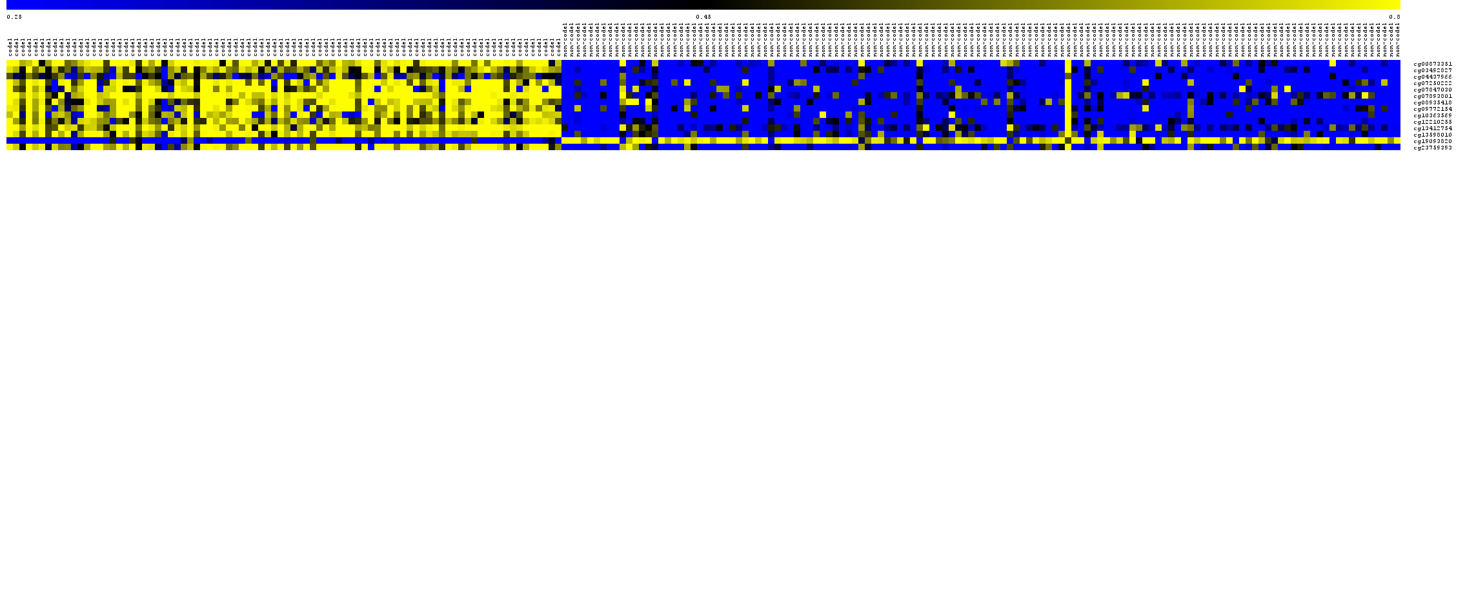
Figure S6
Paul and Mondal et al., 2017
A
ODG
DA
cg00873351
cg03492827
cg04437966
cg07250222
cg07847030
cg07893801
cg08935418
cg09772154
cg10363569
cg12210255
cg13412754
cg13598010
cg19093820
cg23759393
0.0
0.5
1.0
B
C
4
DA
ODG
2
ODG
DA
1.0
1.0
Principal Component 2
0.8
0.8
0
0.6
0.6
-2
0.4
0.4
cross-validated probabilities
0.2
0.2
-4
0.0
0.0
0
50
100
150
200
-4
-2
0
2
4
6
sample
Principal Component 1
Notes:
Supplementary Figure 6: PCA and cross validated probabilities of Diffuse Astrocytoma (DA) and Oligodendroglioma (ODG) IDH1 Mut in LGG samples of test set (TCGA).
(A) Heat map of the 14 CpG discriminatory probes identified in PAM analysis in DA (n=130) and ODG (n=86) LGG patient samples in the test set (TCGA). A dual color-code was used where yellow indicates more methylation (hypermethylation) and blue indicates less methylation (hypomethylation).
(B) PCA was performed using beta (methylation) values of 14- PAM identified CpG probes between DA (n=130) and ODG (n=86) LGG samples in test set. A scatter plot is generated using the first two principal components for each sample. The color code of the samples is as indicated.
(C) The detailed probabilities of 10-fold cross-validation for the samples of training set based on the beta values of 14 CpG probes are shown. For each sample, its probability as ODG (red color) and DA (green color) of LGG samples are shown and it was predicted by the PAM program as either ODG or DA based on which grade’s probability is higher. The original histological grade of the samples is shown on the top.

Slide 8
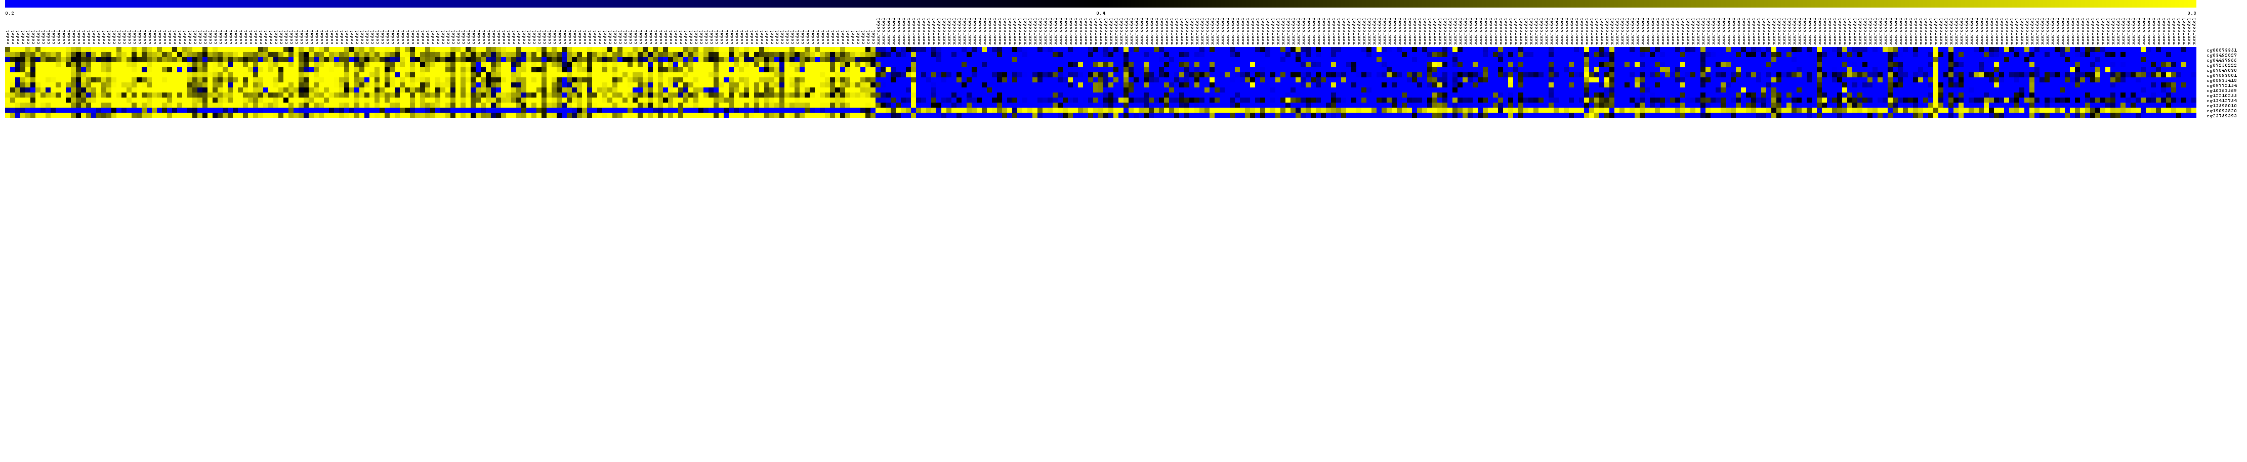
Figure S7
Paul and Mondal et al., 2017
A
ODG
DA
cg00873351
cg03492827
cg04437966
cg07250222
cg07847030
cg07893801
cg08935418
cg09772154
cg10363569
cg12210255
cg13412754
cg13598010
cg19093820
cg23759393
0.0
0.5
1.0
C
B
ODG
DA
3
DA
1.0
1.0
2
ODG
0.8
0.8
1
0.6
0.6
0
Principal Component 2
0.4
0.4
-1
cross-validated probabilities
0.2
0.2
-2
0.0
0.0
-3
0
100
200
300
400
-5
0
5
10
sample
Principal Component 1
Notes:
Supplementary Figure 7: PCA and cross validated probabilities of DA and ODG samples of the entire TCGA dataset.
(A) Heat map of the 14 CpG discriminatory probes identified in PAM analysis in DA (n=261) and ODG (n=172) LGG patient samples in the entire TCGA dataset. A dual color-code was used where yellow indicates more methylation (hypermethylation) and blue indicates less methylation (hypomethylation).
(B) PCA was performed using beta (methylation) values of 14- PAM identified CpG probes between DA (n=261) and ODG (n=172) LGG patient samples in the entire TCGA dataset. A scatter plot is generated using the first two principal components for each sample. The color code of the samples is as indicated.
(C) The detailed probabilities of 10-fold cross-validation for the samples of training set based on the beta values of 14 CpG probes are shown. For each sample, its probability as ODG (red color) and DA (green color) of LGG patient samples are shown and it was predicted by the PAM program as either LGG DA or ODG based on which grade’s probability is higher. The original histological grade of the samples is shown on the top.

Slide 9
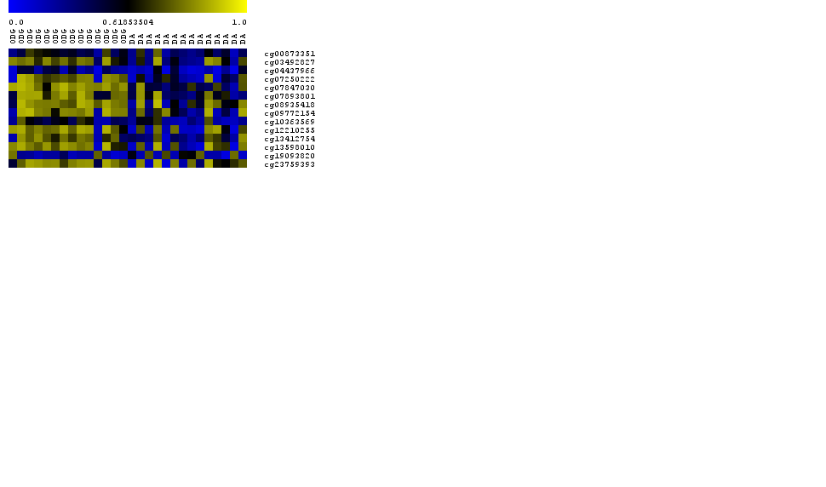
Figure S8
Paul and Mondal et al., 2017
A
cg00873351
ODG
DA
cg03492827
cg04437966
cg07250222
cg07847030
cg07893801
cg08935418
cg09772154
cg10363569
cg12210255
cg13412754
cg13598010
cg19093820
cg23759393
0.0
0.5
1.0
B
C
3
DA
ODG
DA
ODG
1.0
1.0
2
0.8
0.8
1
0.6
0.6
Principal Component 2
0
cross-validated probabilities
0.4
0.4
-1
-2
0.2
0.2
-3
0.0
0.0
0
5
10
15
20
25
-4
-2
0
2
4
sample
Principal Component 1
Notes:
Supplementary Figure 8: Validation of the 14-CpG methylation signature of Oligodendroglioma (ODG) versus Diffuse Astrocytoma (DA) in an independent validation dataset GSE48462.
(A) Heat map of the 14 CpG discriminatory probes identified in PAM analysis in ODG (n=14) and DA (n=14) LGG patient samples in the entire TCGA dataset. A dual color-code was used where yellow indicates more methylation (hypermethylation) and blue indicates less methylation (hypomethylation).
(B) PCA was performed using β(methylation) values of 14- PAM identified CpG probes between ODG (n=14) and DA (n=14) LGG patient samples in the entire TCGA dataset. A scatter plot is generated using the first two principal components for each sample. The color code of the samples is as indicated.
(C) The detailed probabilities of 10-fold cross-validation for the samples of training set based on the βvalues of 14 CpG probes are shown. For each sample, its probability as ODG (red color) and DA (green color) of LGG patient samples are shown and it was predicted by the PAM program as either LGG DA or ODG based on which grade’s probability is higher. The original histological grade of the samples is shown on the top.

Slide 10
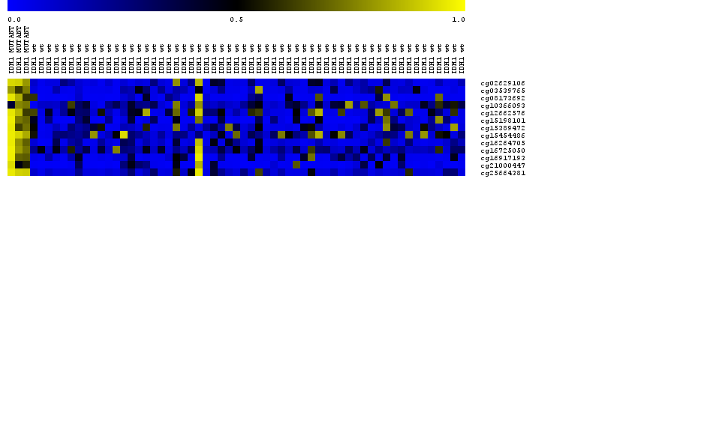
A
Figure S9
Paul and Mondal et al., 2017
GBM IDH Mutant
GBM IDH WT
cg02629106
cg03539765
cg08173692
cg10366093
cg12662576
cg15198101
cg15389472
cg15454486
cg16264705
cg16725050
cg16917193
cg21000447
cg25664381
0.0
0.5
1.0
B
C
GBM IDH Mutant
GBM IDH WT
3
GBM IDH Mutant
2
GBM IDH WT
1.0
1.0
1
0.8
0.8
Principal Component 2
0.6
0.6
0
0.4
0.4
-1
cross-validated probabilities
0.2
0.2
-2
0.0
0.0
-3
0
10
20
30
40
50
60
-5
0
5
10
sample
Principal Component 1
Notes:
Supplementary Figure 9: PCA and cross validated probabilities of IDH1 Mut and WT in GBM samples of test set (TCGA).
(A) Heat map of the 13 CpG discriminatory probes identified in PAM analysis in IDH1 Mut (n=3) and WT (n=58) GBM patient samples in the test set (TCGA). A dual color-code was used where yellow indicates more methylation (hypermethylation) and blue indicates less methylation (hypomethylation).
(B) PCA was performed using beta (methylation) values of 13- PAM identified CpG probes between IDH1 Mut (n=3) and WT (n=58) GBM patient samples in test set. A scatter plot is generated using the first two principal components for each sample. The color code of the samples is as indicated.
(C) The detailed probabilities of 10-fold cross-validation for the samples of training set based on the beta values of 13 CpG probes are shown. For each sample, its probability as IDH1 Mut (red color) and WT (green color) of GBM patient samples are shown and it was predicted by the PAM program as either GBM IDH1 Mut or WT based on which grade’s probability is higher. The original histological grade of the samples is shown on the top.

Slide 11
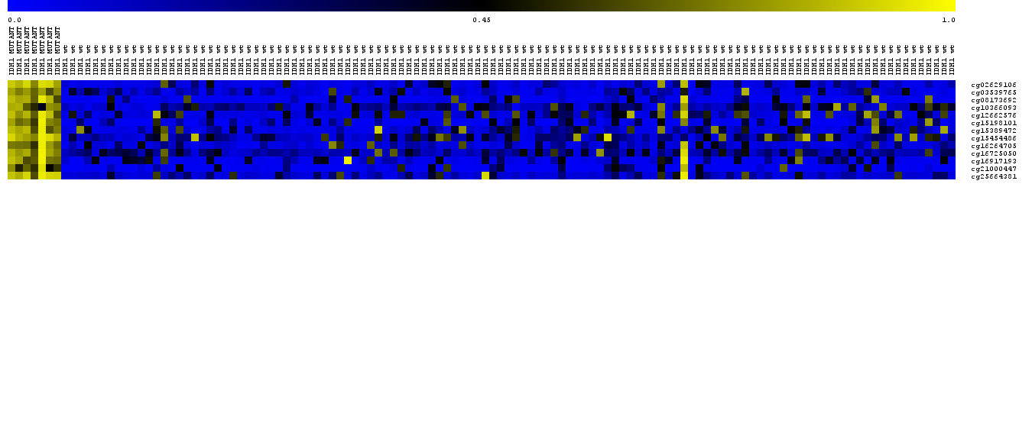
Figure S10
Paul and Mondal et al., 2017
GBM IDH Mutant
GBM IDH WT
A
cg02629106
cg03539765
cg08173692
cg10366093
cg12662576
cg15198101
cg15389472
cg15454486
cg16264705
cg16725050
cg16917193
cg21000447
cg25664381
0.0
0.5
1.0
C
B
3
GBM IDH Mutant
GBM IDH WT
GBM IDH Mutant
2
GBM IDH WT
1.0
1.0
1
0.8
0.8
Principal Component 2
0.6
0
0.6
-1
0.4
0.4
cross-validated probabilities
-2
0.2
0.2
-3
0.0
0.0
0
20
40
60
80
100
120
-5
0
5
10
15
sample
Principal Component 1
Notes:
Supplementary Figure 10: PCA and cross validated probabilities of IDH1 Mut and WT in GBM samples of the entire TCGA dataset.
(A) Heat map of the 13 CpG discriminatory probes identified in PAM analysis in IDH1 Mut (n=7) and WT (n=117) GBM patient samples in the entire TCGA dataset. A dual color-code was used where yellow indicates more methylation (hypermethylation) and blue indicates less methylation (hypomethylation).
(B) PCA was performed using beta (methylation) values of 13- PAM identified CpG probes between IDH1 Mut (n=7) and WT (n=117) GBM patient samples in the entire TCGA dataset. A scatter plot is generated using the first two principal components for each sample. The color code of the samples is as indicated.
(C) The detailed probabilities of 10-fold cross-validation for the samples of training set based on the beta values of 13 CpG probes are shown. For each sample, its probability as IDH1 Mut (red color) and WT (green color) of GBM patient samples are shown and it was predicted by the PAM program as either GBM IDH1 Mut or WT based on which grade’s probability is higher. The original histological grade of the samples is shown on the top.

