Slide 1
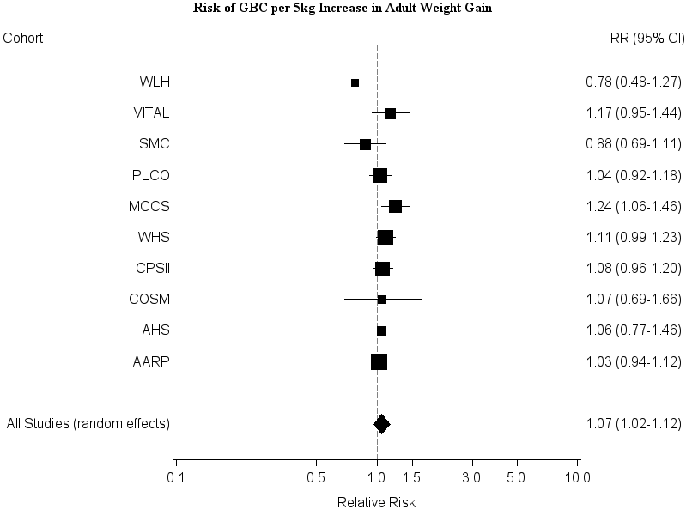
Supplemental Figure 4

