Slide 1
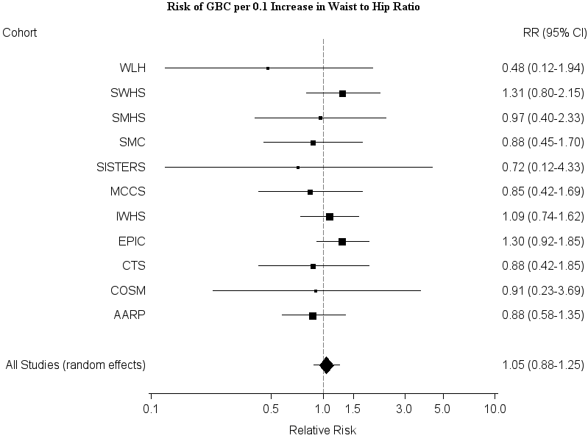
Supplemental Figure 8

