Slide 1
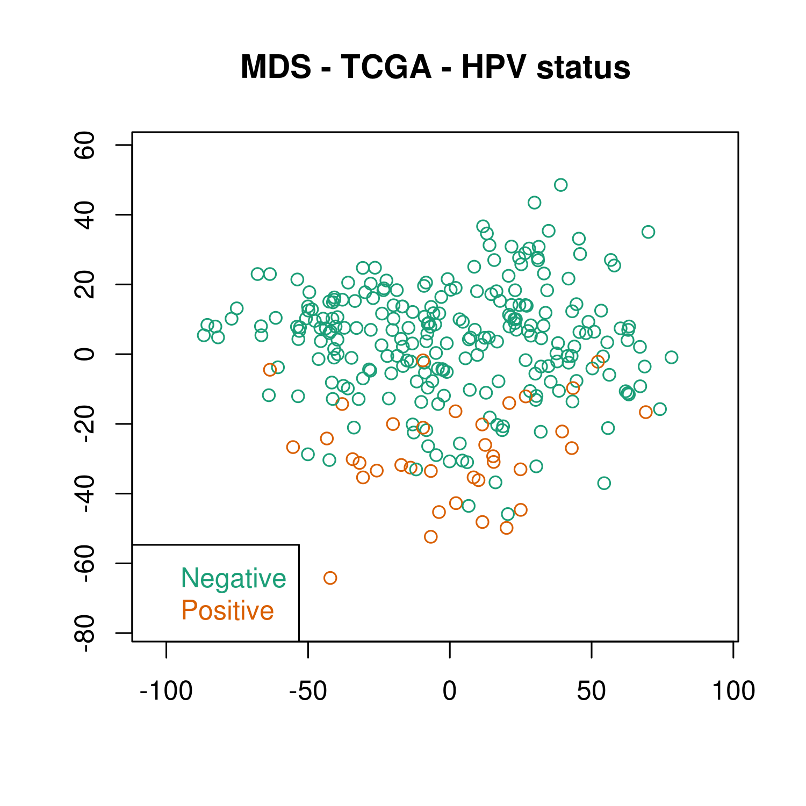
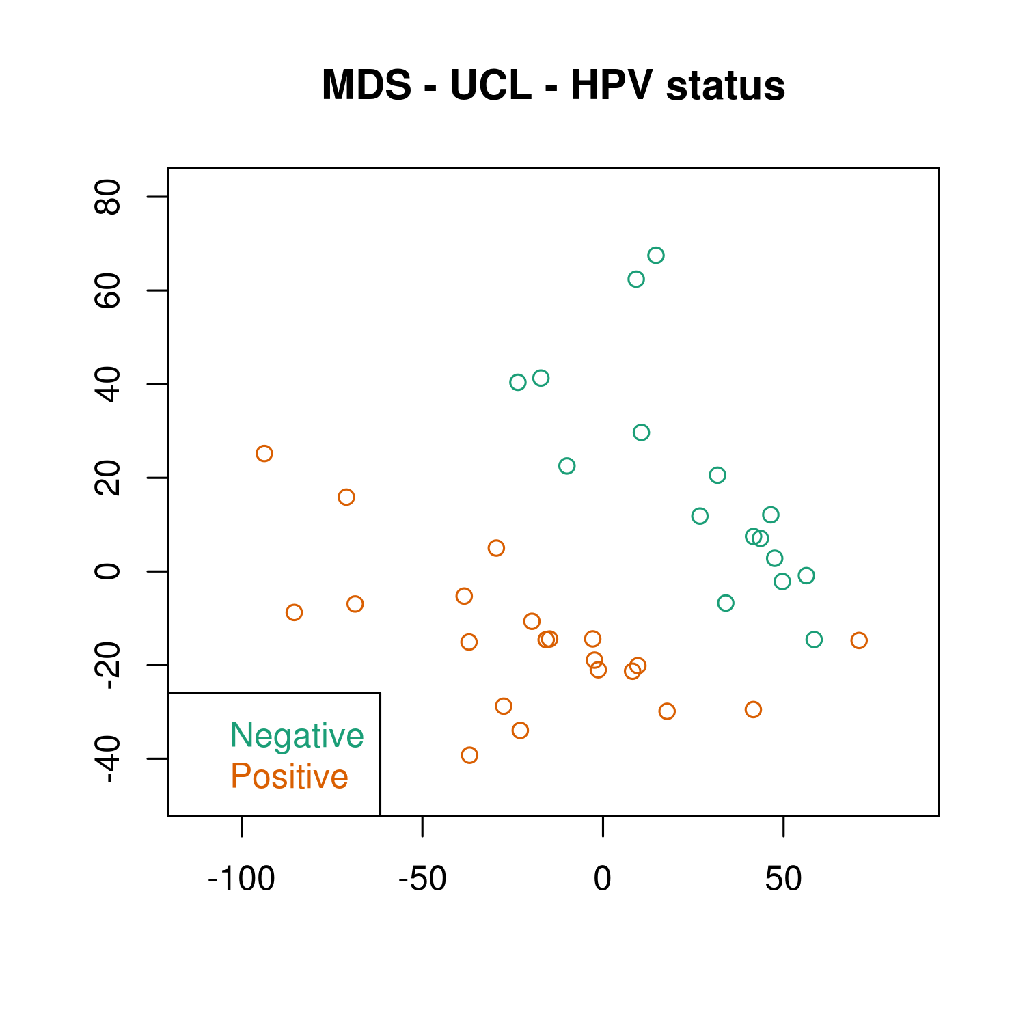
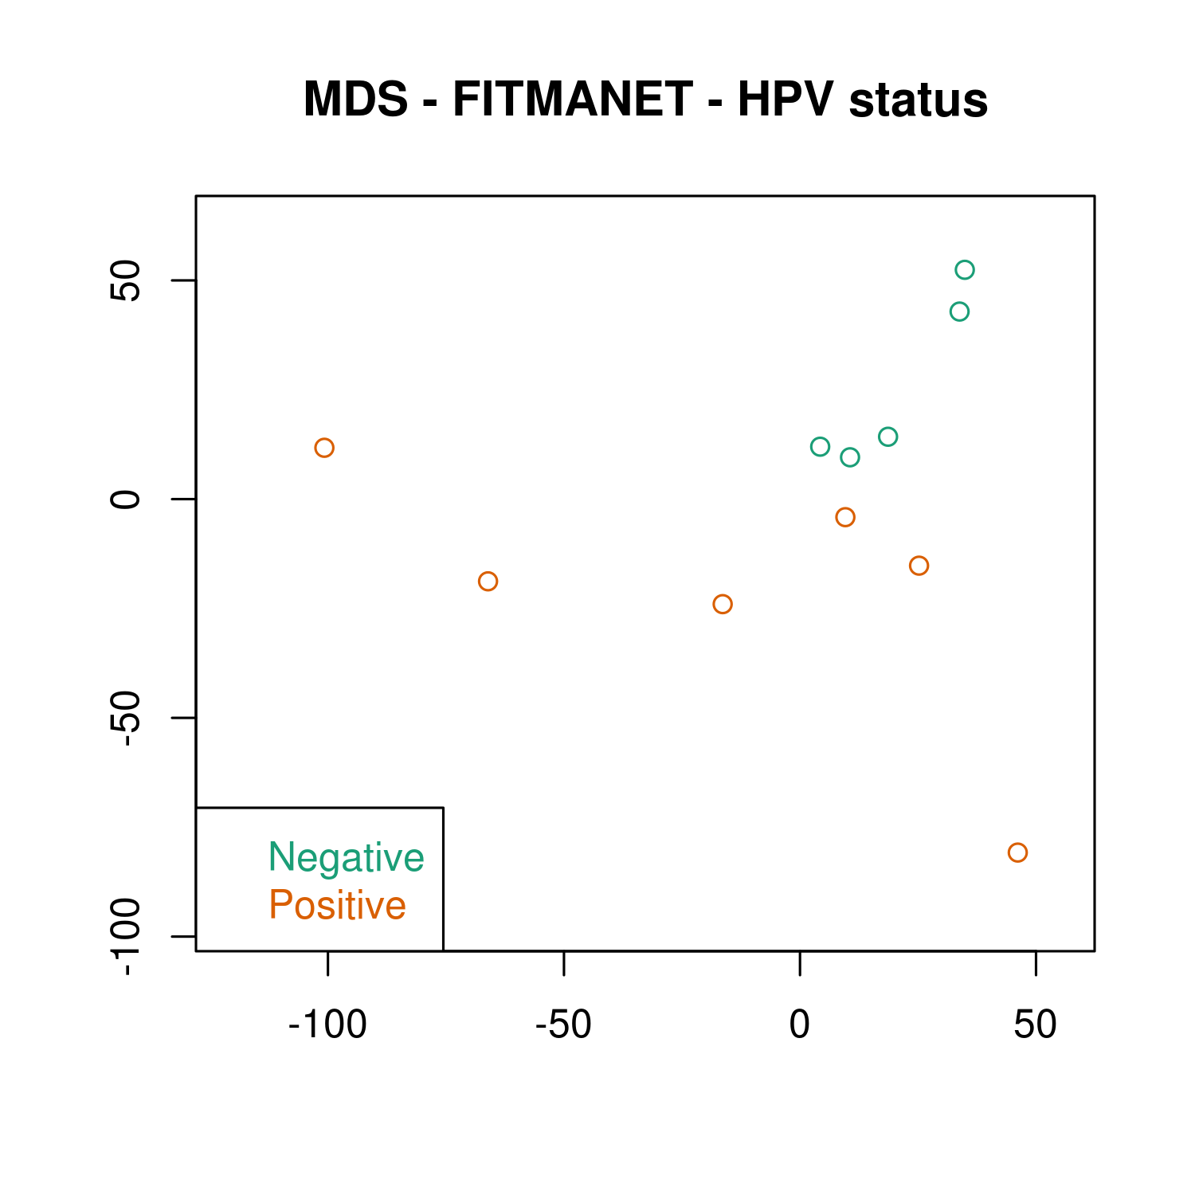
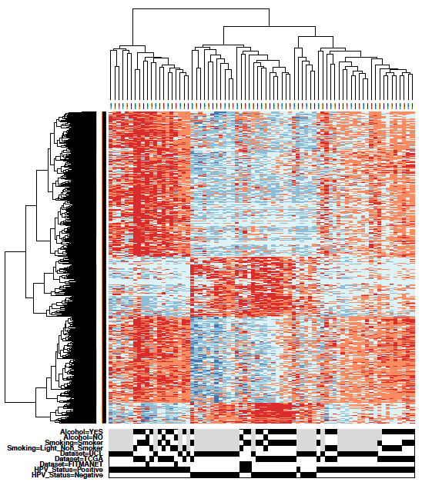
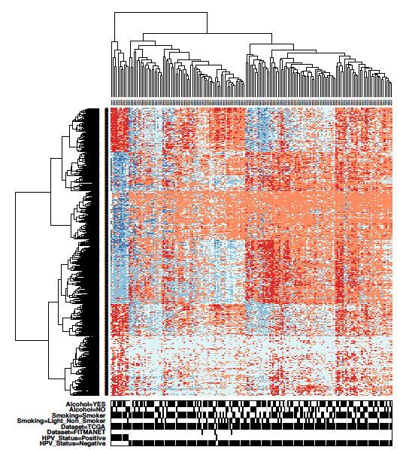
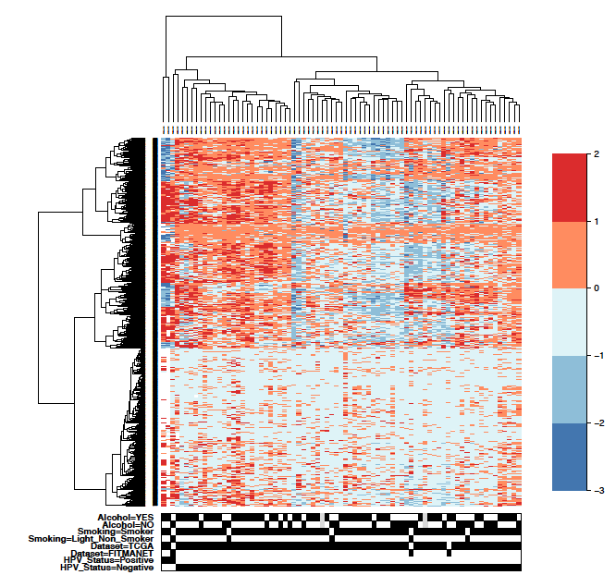
Supplementary Figure 1
A
B
C
D
E
F
Alcohol Consumption
YES
Alcohol Consumption
YES
Alcohol Consumption
YES
Smoking
NO
NO
Smoking
NO
YES
Smoking
YES
YES
Cohort
NO
NO
NO
UCL
Cohort
Cohort
TCGA
TCGA
TCGA
FITMANET
FITMANET
FITMANET
HPV
HPV
Positive
Positive
HPV
Negative
Negative
Positive
Negative

Slide 2
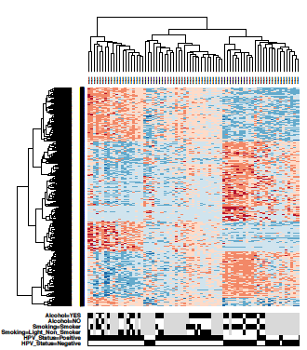
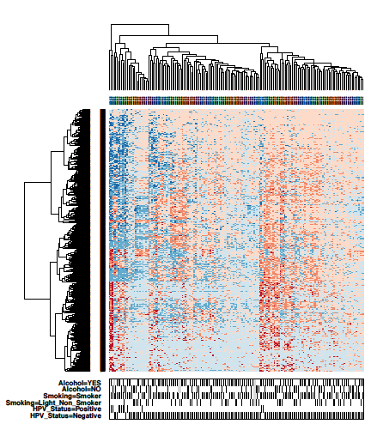
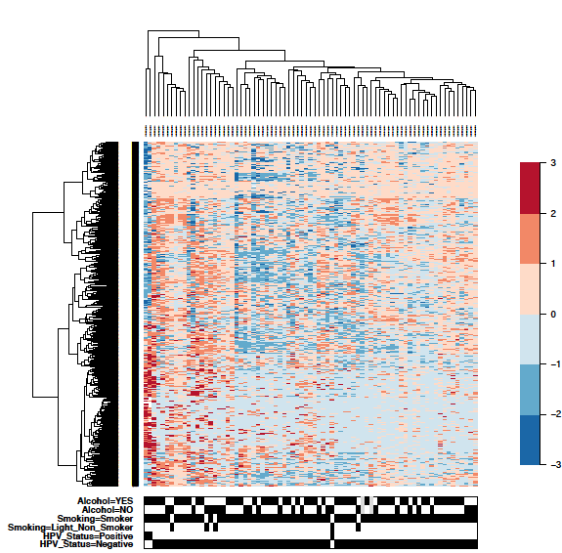
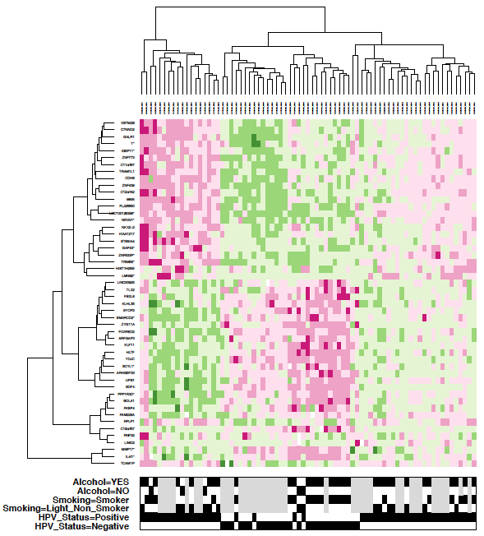
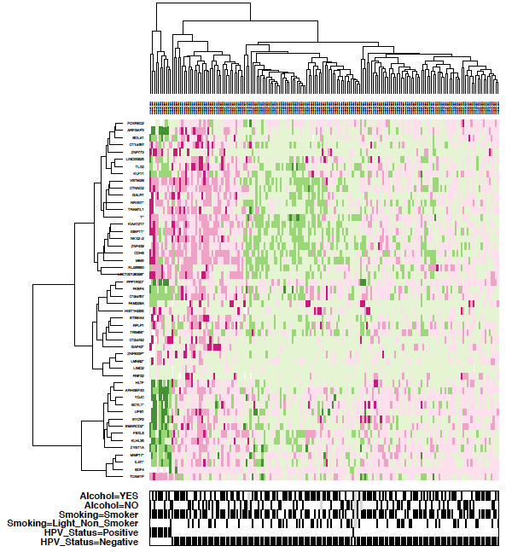
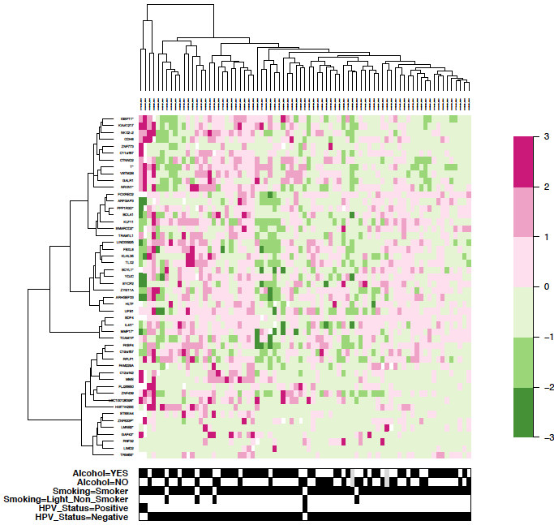
A
B
C
Supplementary Figure 2
Alcohol Consumption
YES
Alcohol Consumption
YES
Alcohol Consumption
YES
Smoking
NO
Smoking
NO
NO
YES
YES
Smoking
YES
HPV
NO
HPV
NO
NO
Positive
Positive
HPV
Negative
Negative
Positive
Negative
D
E
F
Alcohol Consumption
YES
Alcohol Consumption
YES
Alcohol Consumption
YES
Smoking
NO
NO
NO
YES
Smoking
YES
Smoking
YES
HPV
NO
NO
NO
Positive
HPV
HPV
Positive
Negative
Positive
Negative
Negative

Slide 3
Supplementary Figure 1 MDS plots for each dataset showin the clustering of the HNSCCs depending on HPV status. A) MDS plot representing the cases in the TCGA cohort. B) MDS plot representing the cases in the UCL cohort. C) MDS plot representing the cases in the FITMANET cohort. Heatmaps showing DMPs (FDR<0.05, Db>20%) for HPV status, after stratification for anatomic site and gender adjustment. D) Oropharynx: 3,629 DMPs (hypo= 933, hyper=2,696). E) Oral cavity: 1,055 DMPs (hypo=556, hyper= 499). F) Neck : 1,501 DMPs (hypo= 381, hyper=1,120).
Supplementary Figure 2 Heatmaps showing the 2,410 DMPs (see text and Figure 1E) (A-C) or the top 50 DMRs (D-F) stratified for organ sites: oropharynx (A,D), oral cavity (B,E) and neck (C,F).
Supplementary Figure Legends.

