Slide 1
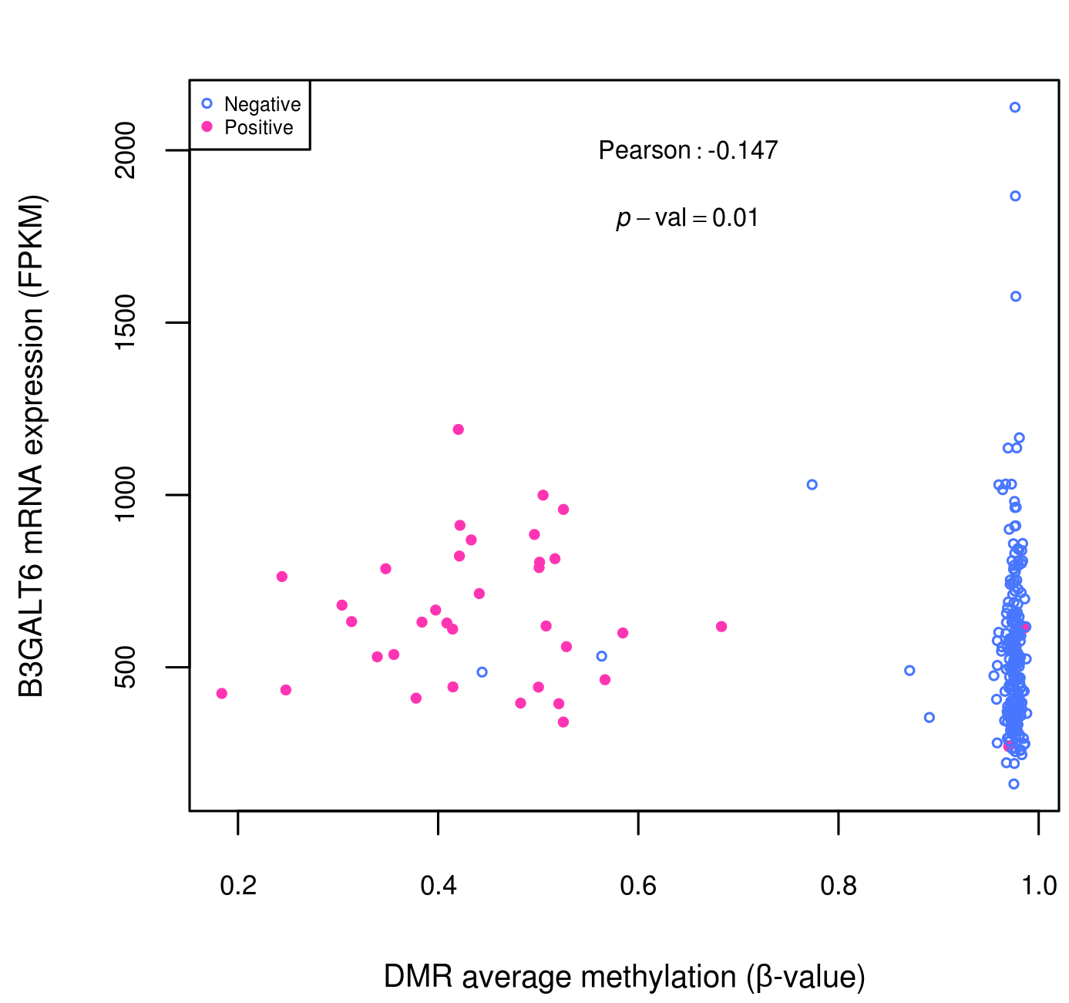
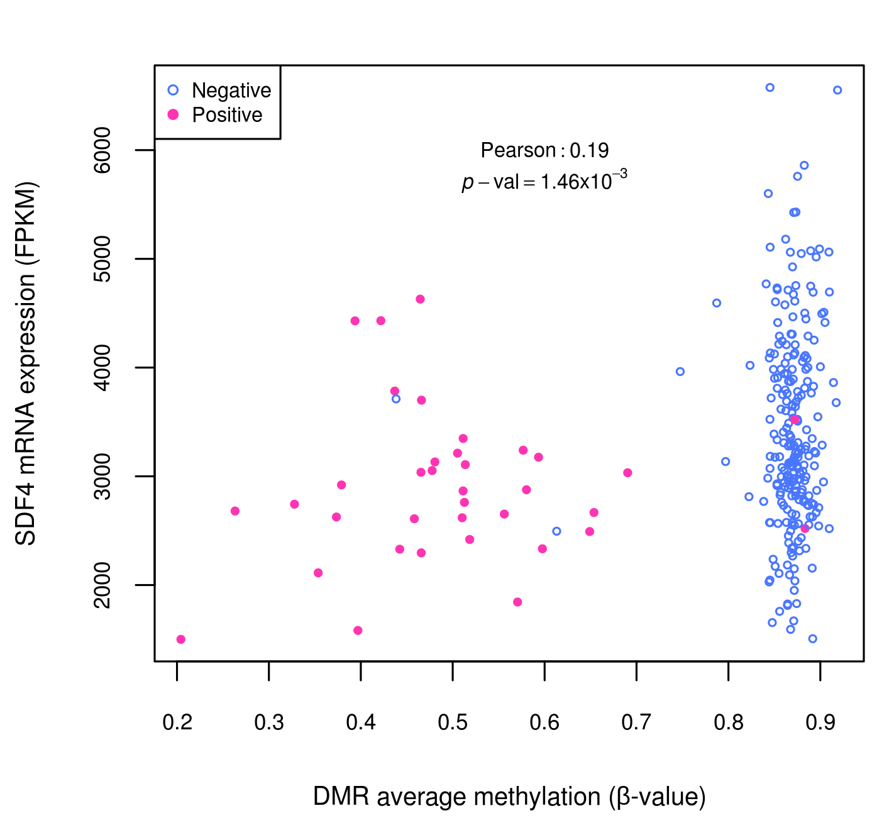
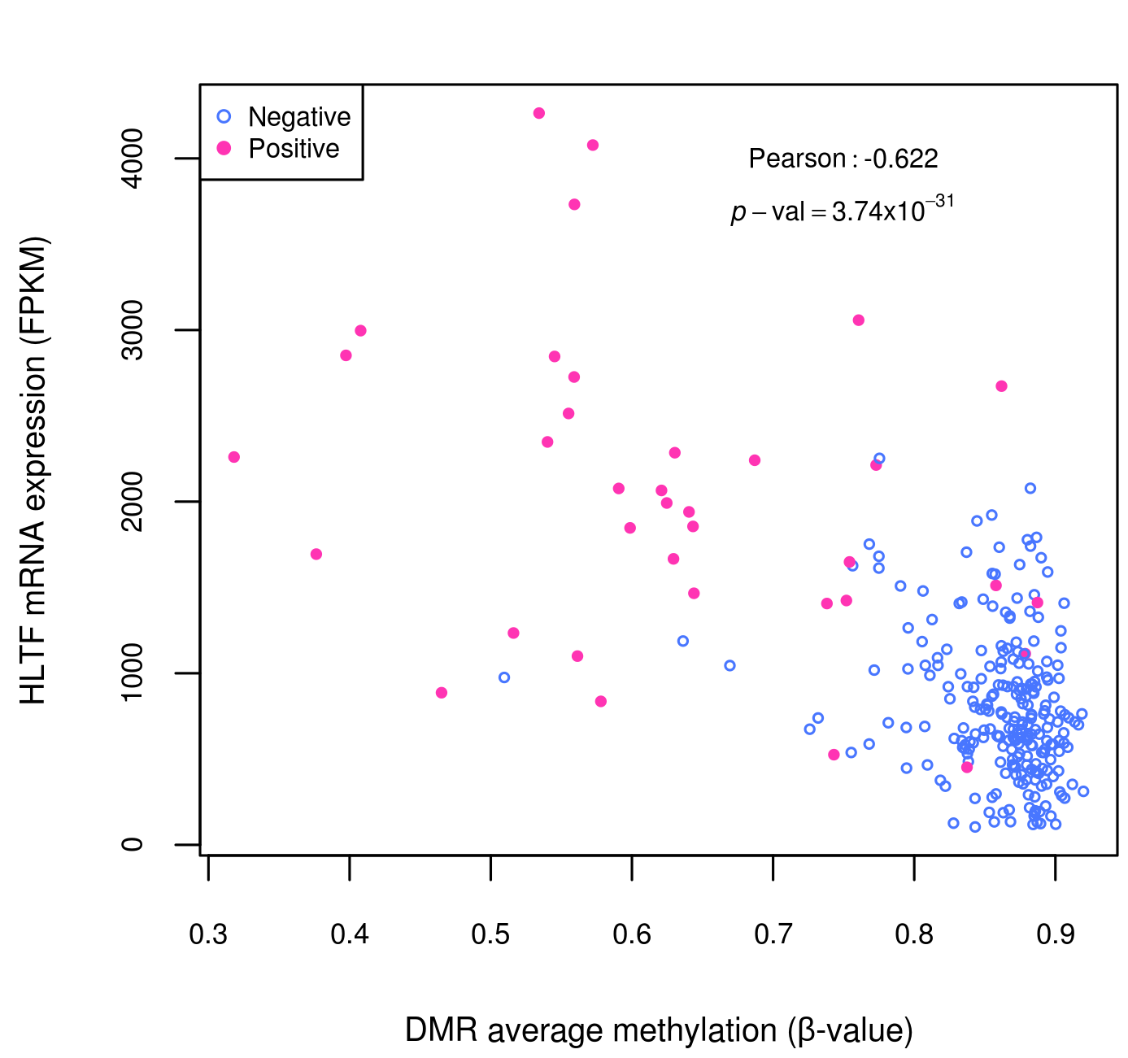
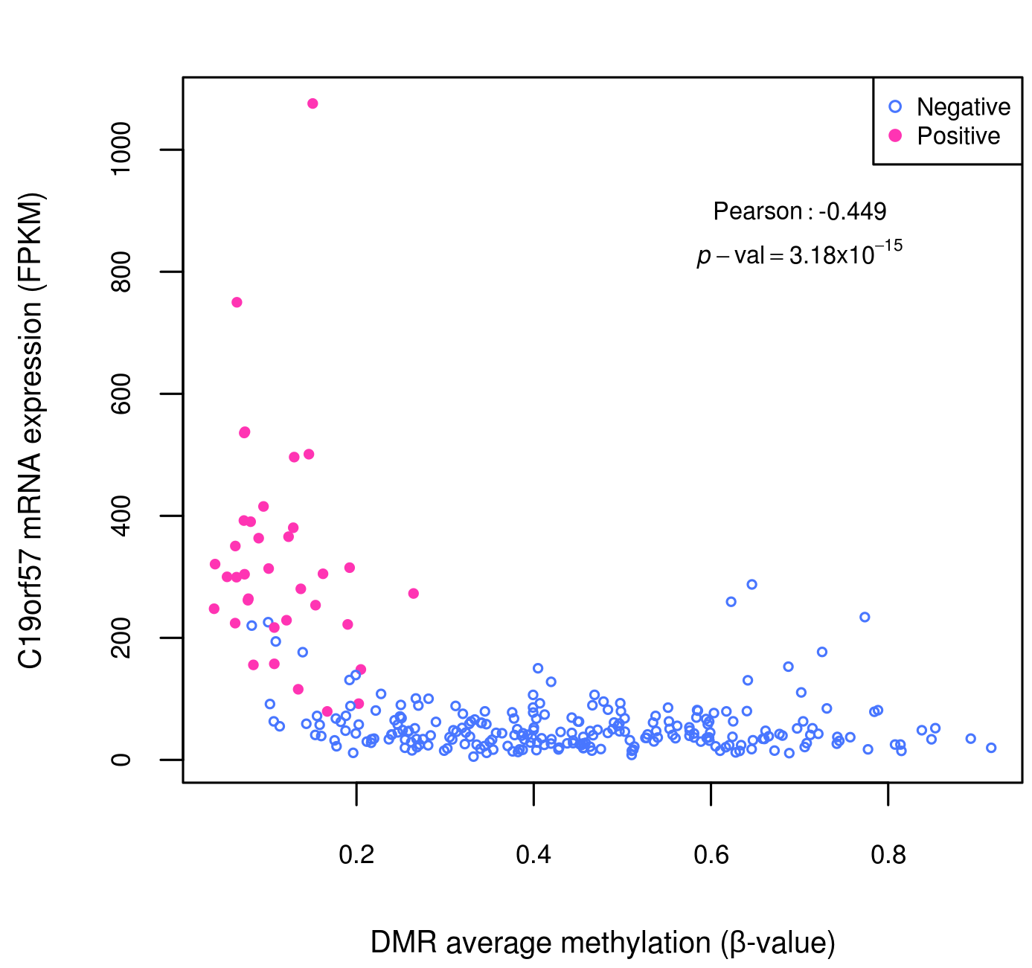
Correlation among CpGs methylation and gene expression for selected hypomethylated DMRs 1

Slide 2
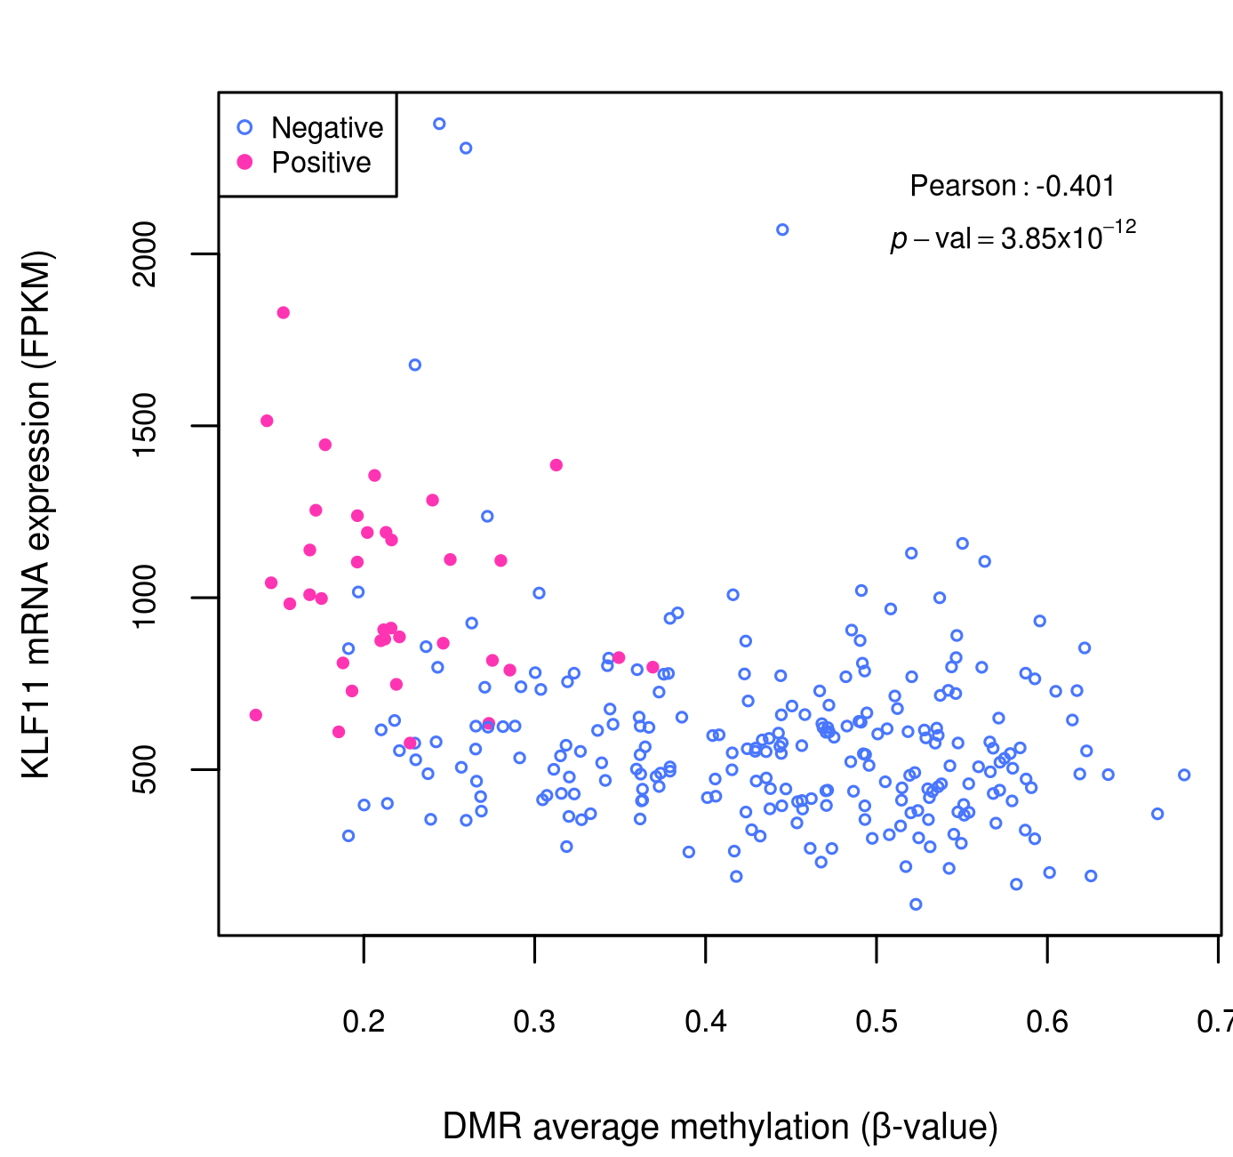
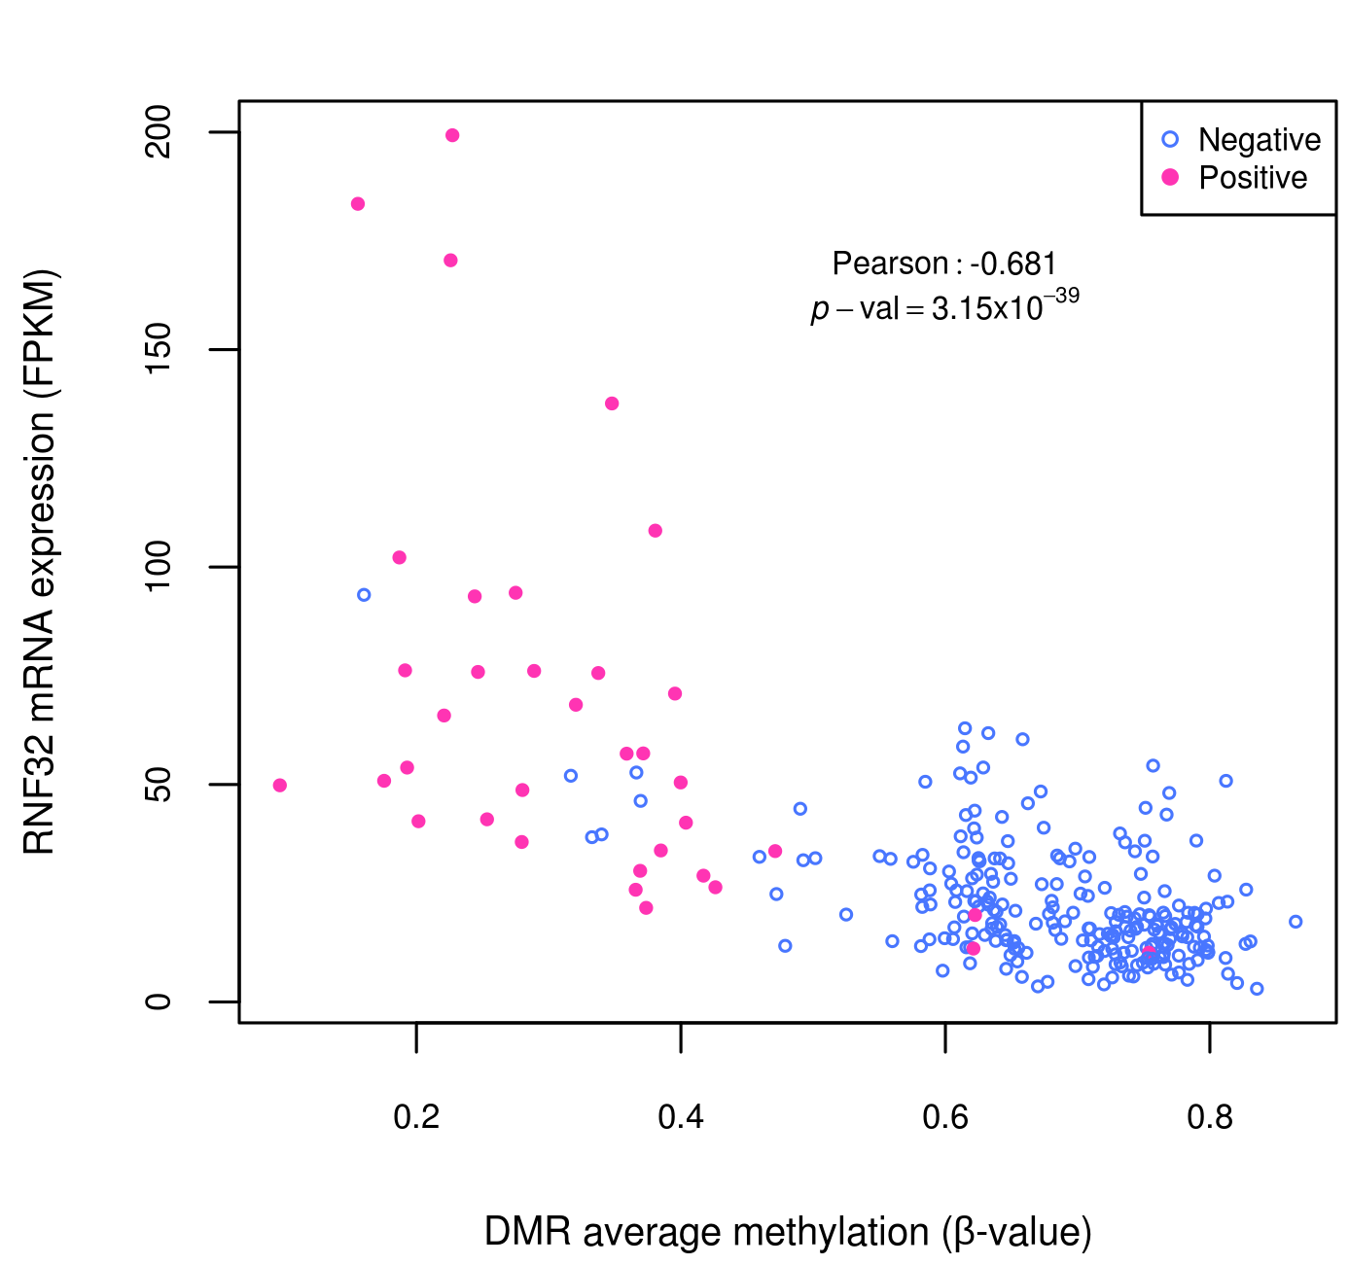
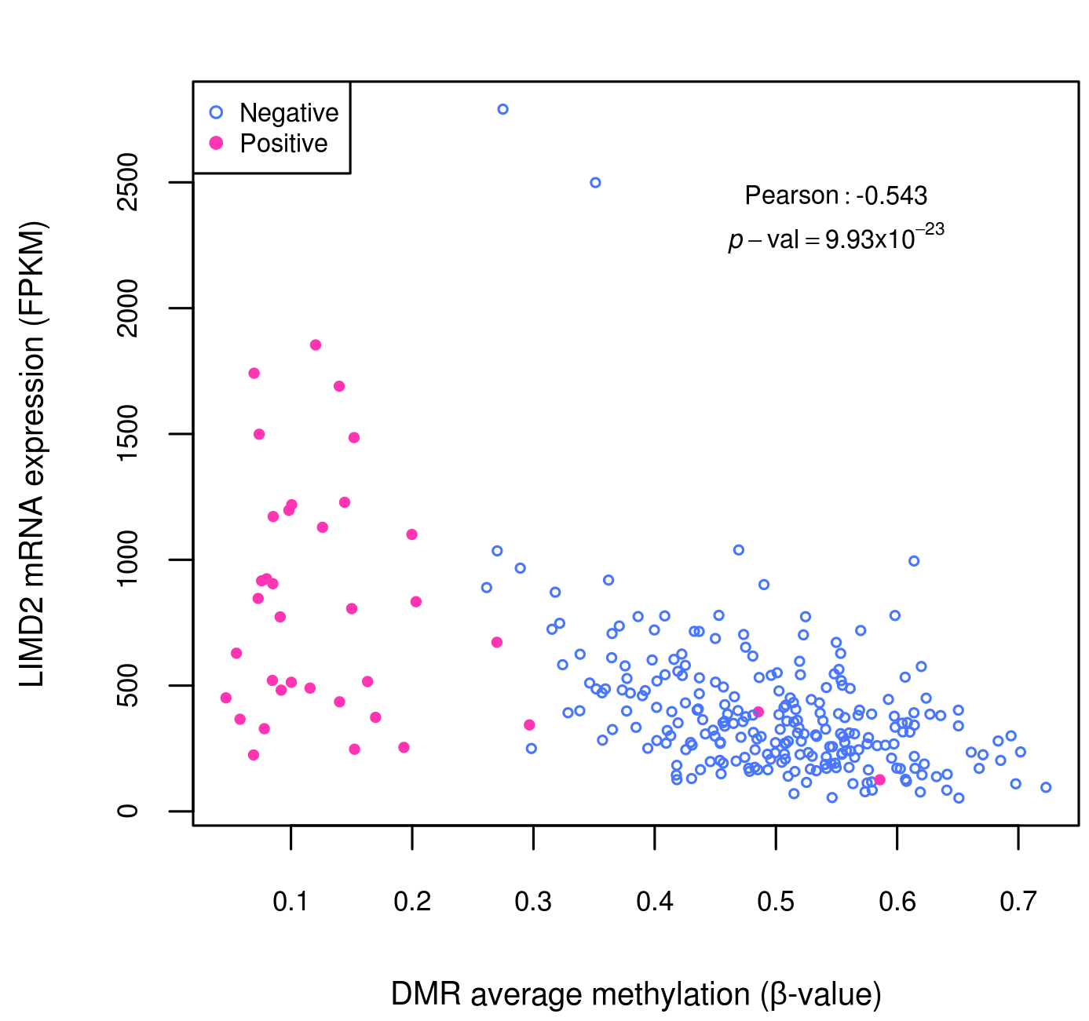
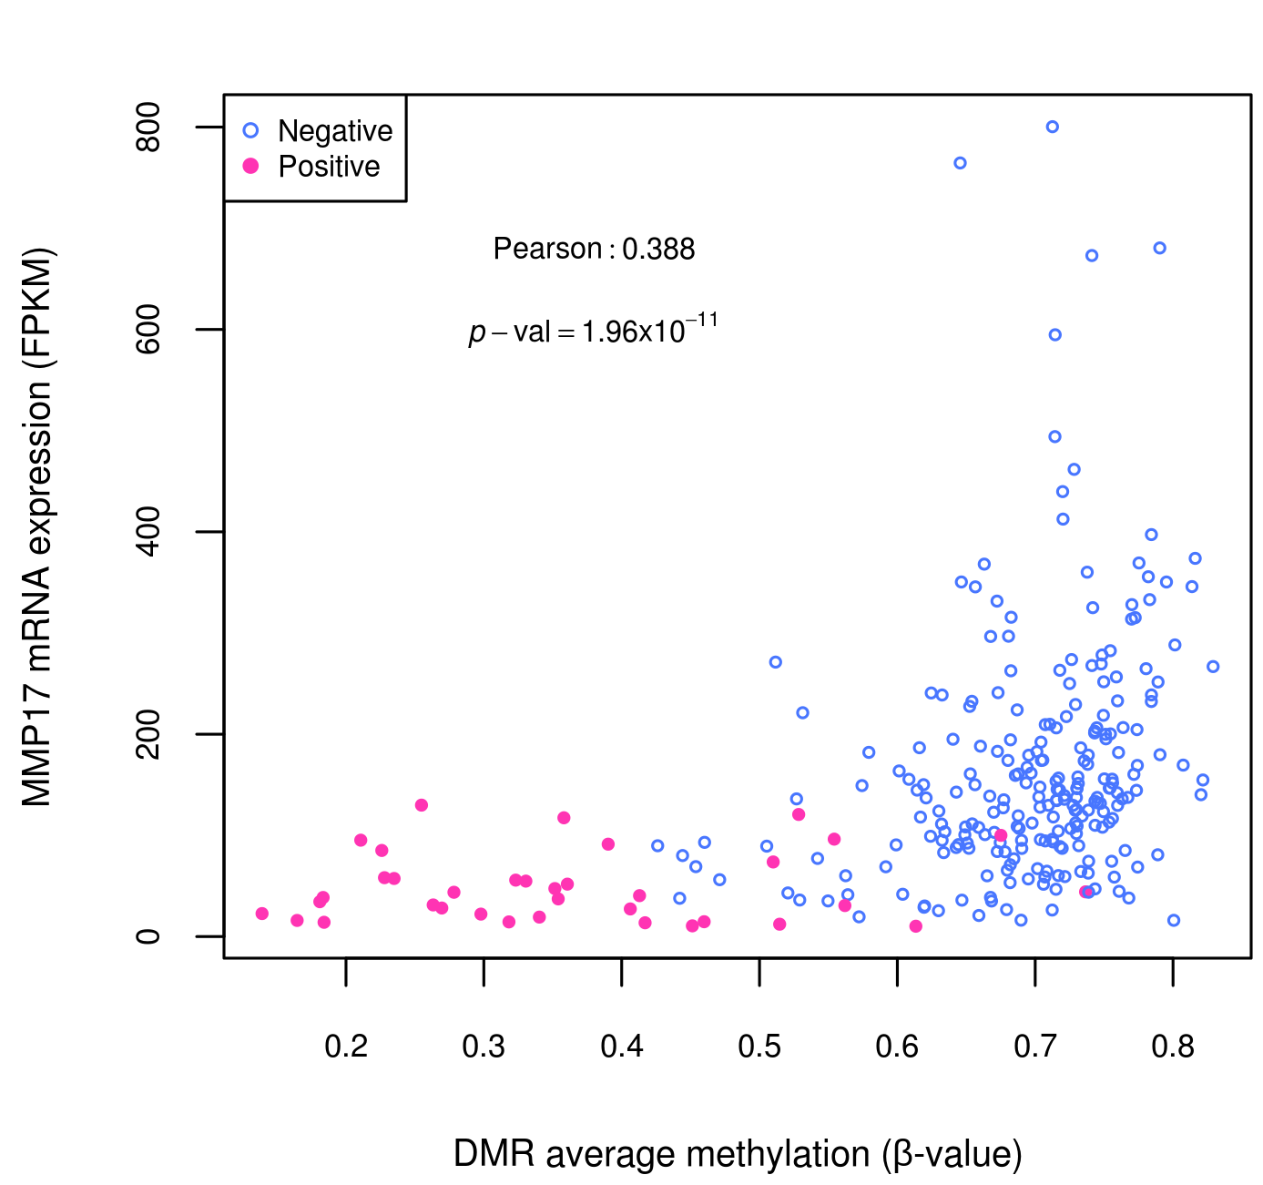
Correlation among CpGs methylation and gene expression for selected hypomethylated DMRs 2

Slide 3
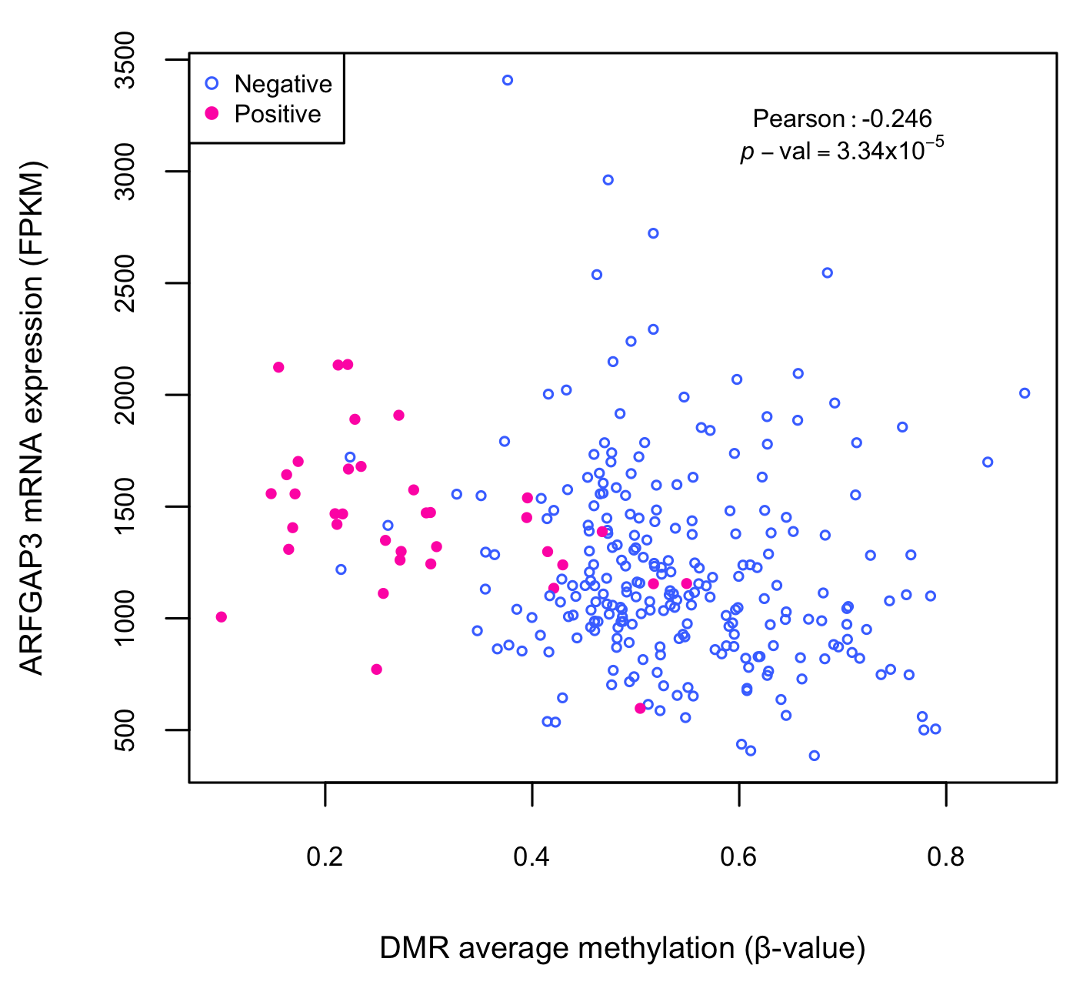
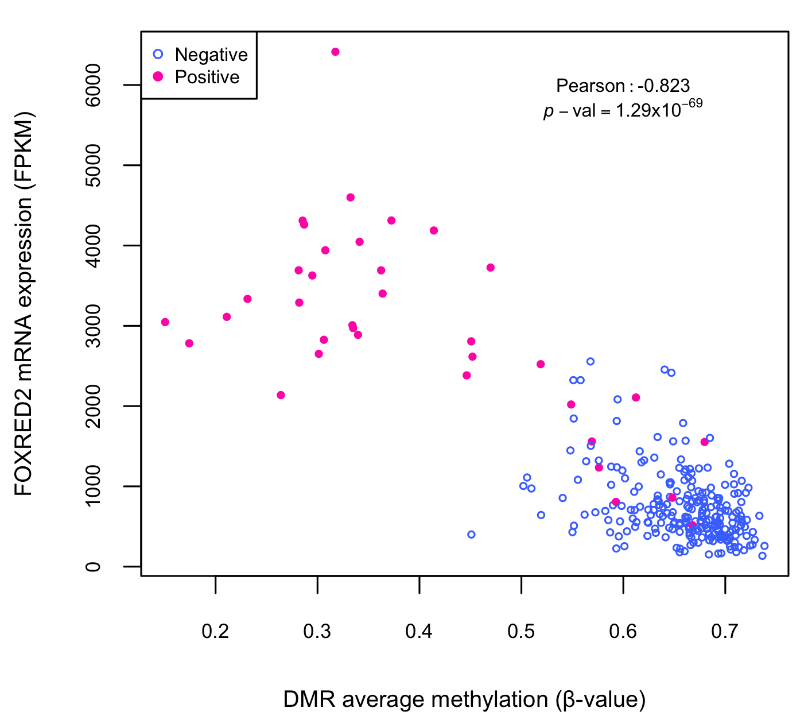
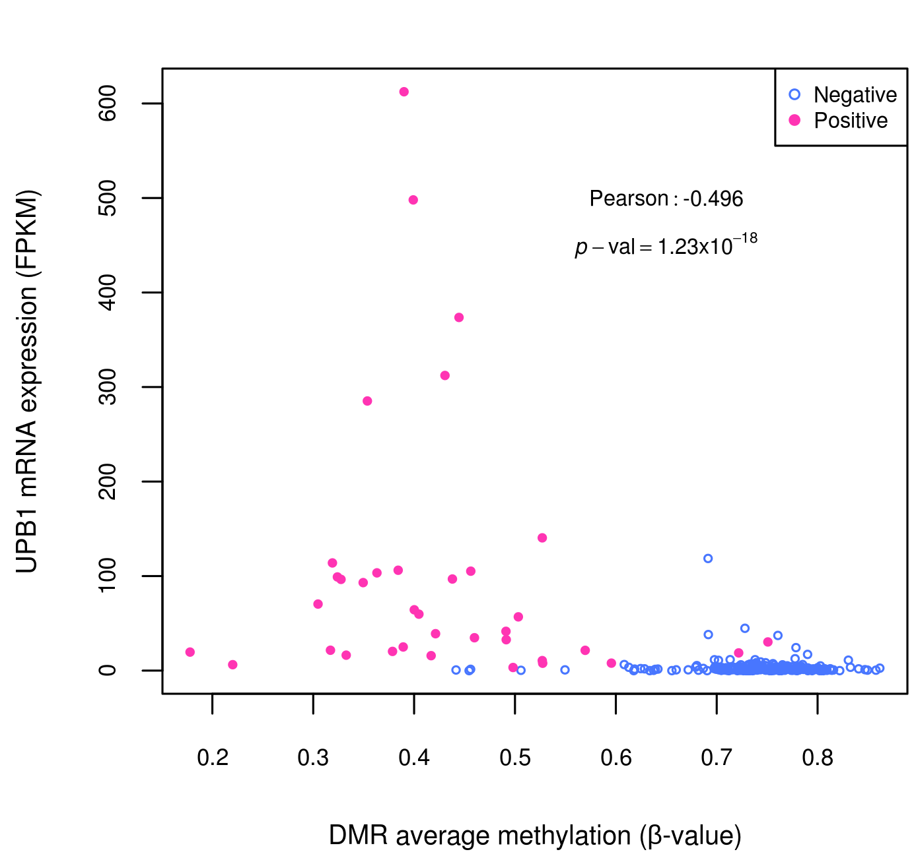
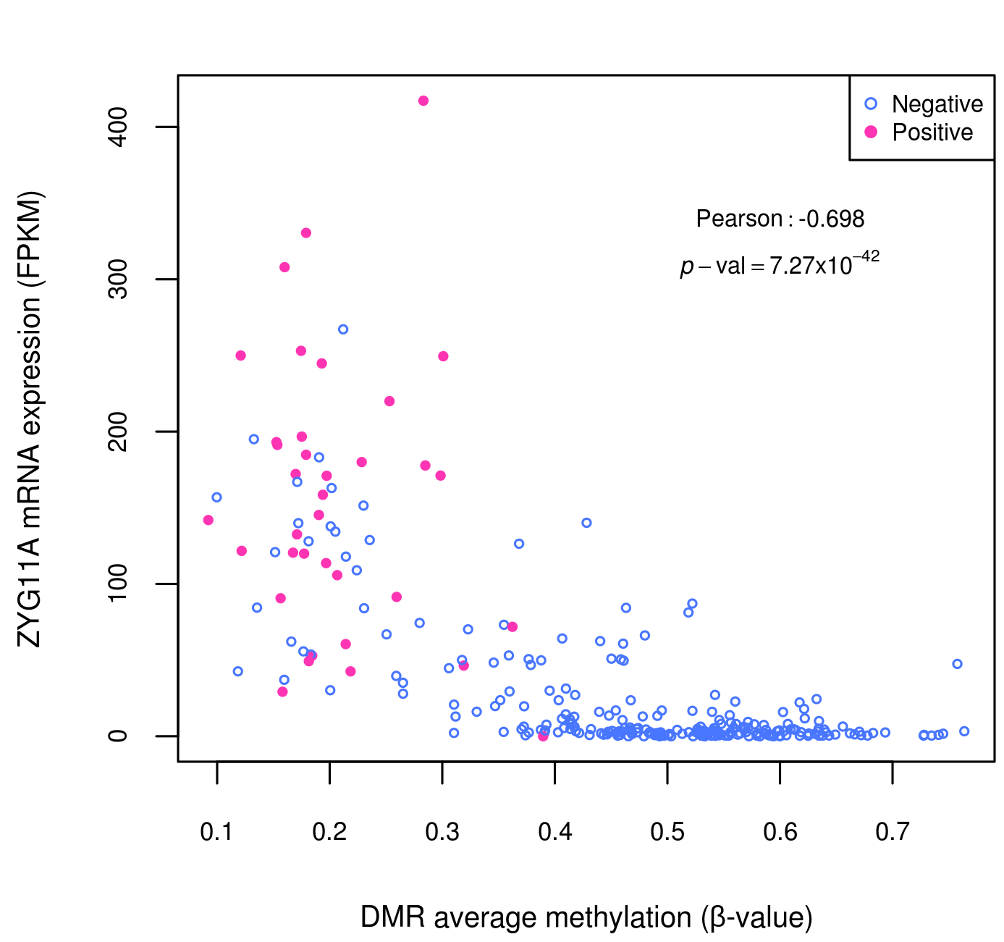
Correlation among CpGs methylation and gene expression for selected hypomethylated DMRs 3

Slide 4
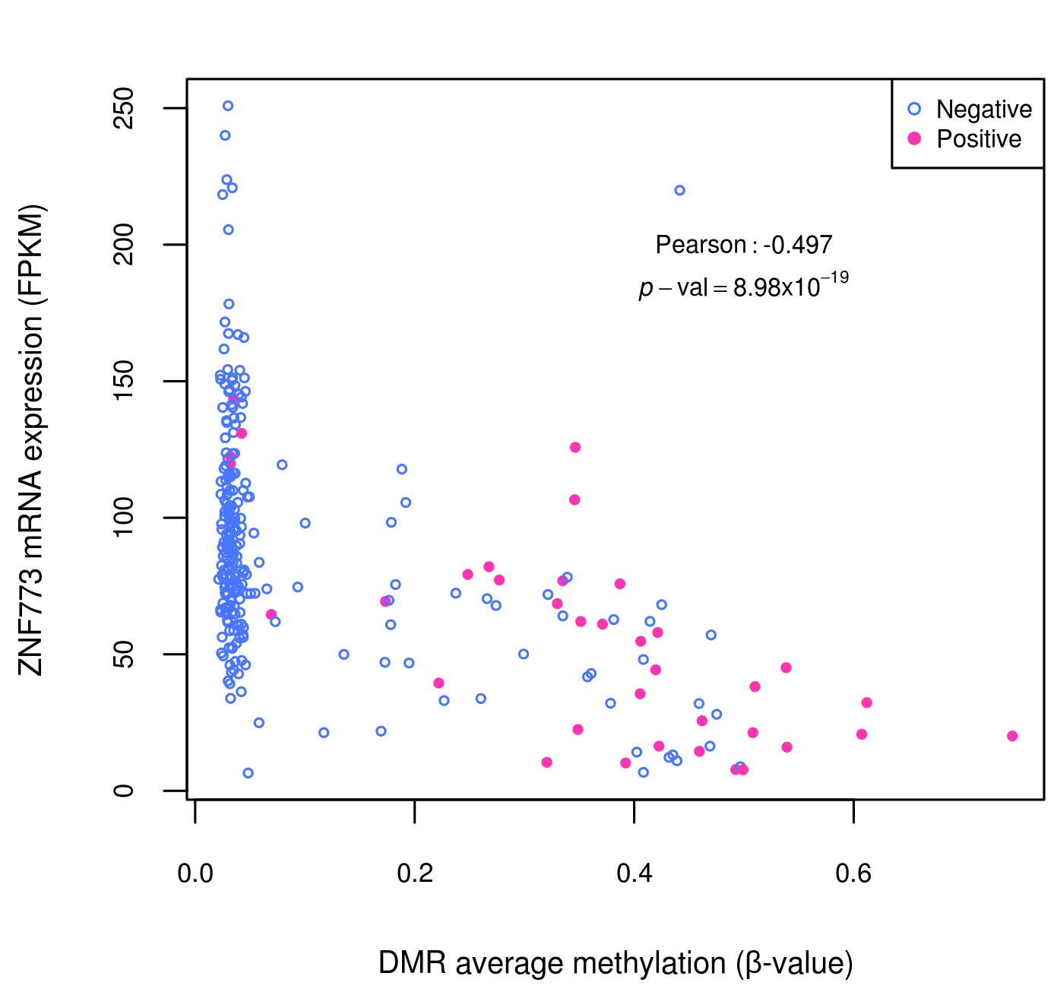
Correlation among CpGs methylation and gene expression for selected top 25 hypermethylated DMRs

Slide 5
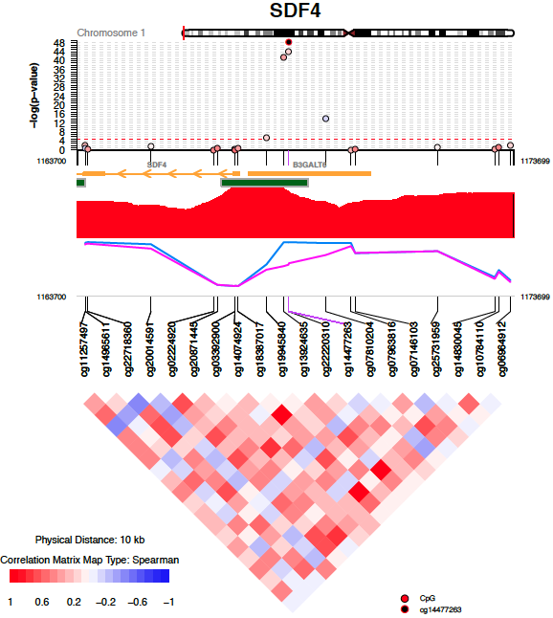
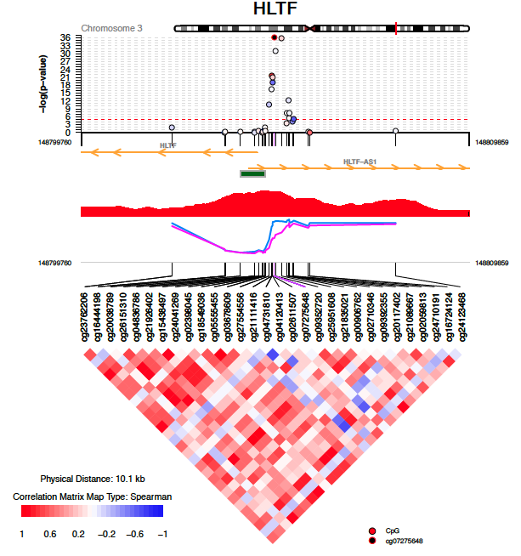
CoMET plots of hypoDMRs associated with gene expression correlation 1

Slide 6
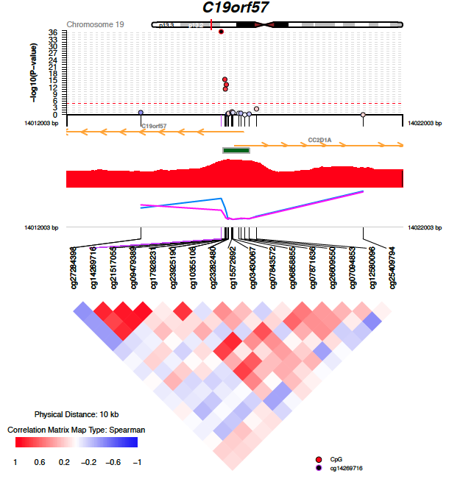
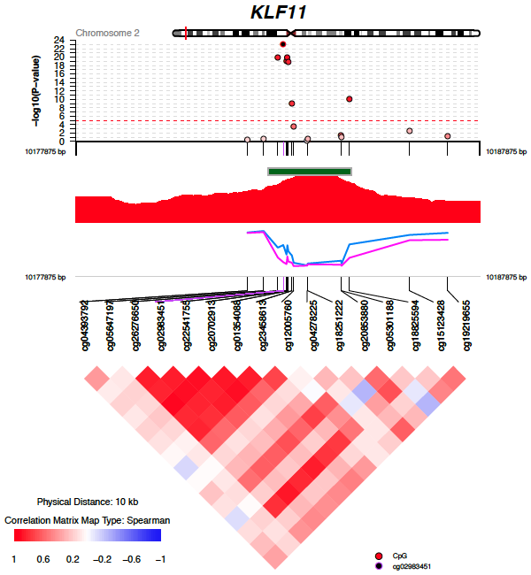
CoMET plots of hypoDMRs associated with gene expression correlation 2

Slide 7
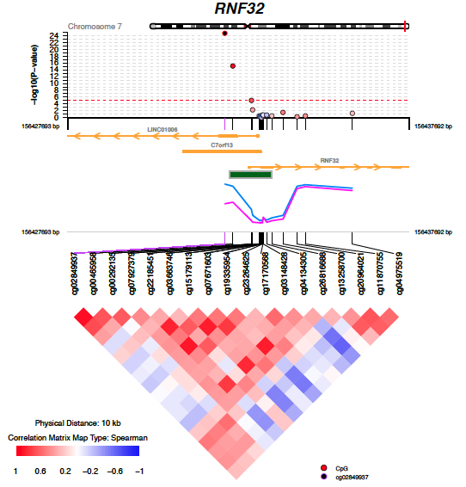
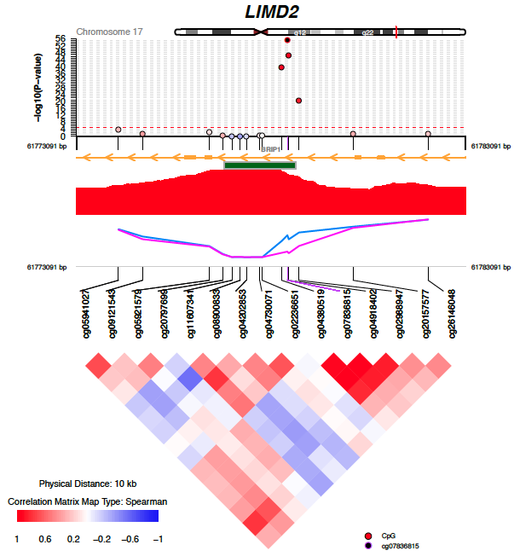
CoMET plots of hypoDMRs associated with gene expression correlation 3

Slide 8
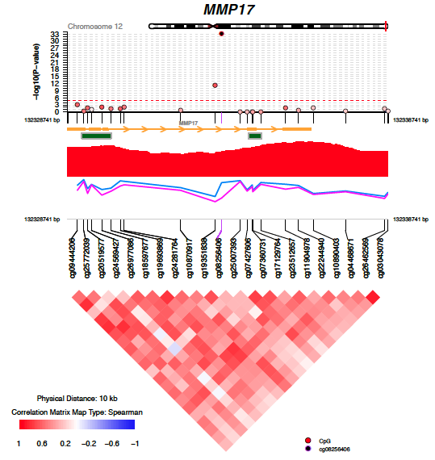
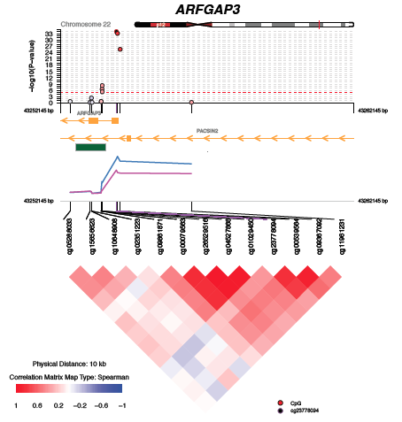
CoMET plots of hypoDMRs associated with gene expression correlation 4

Slide 9
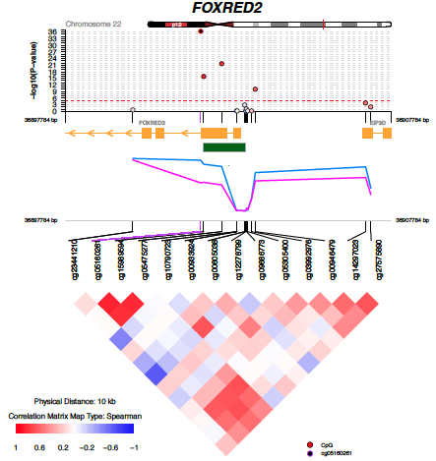
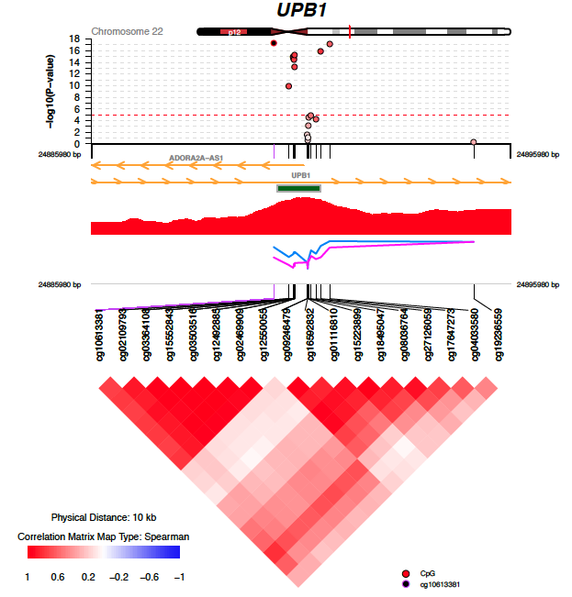
CoMET plots of hypoDMRs associated with gene expression correlation 5

Slide 10
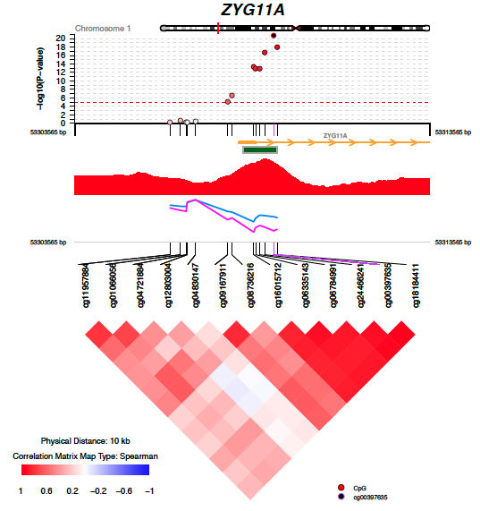
CoMET plots of hypoDMRs associated with gene expression correlation 6

Slide 11
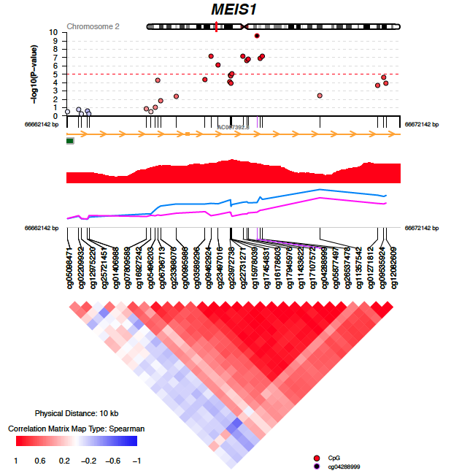
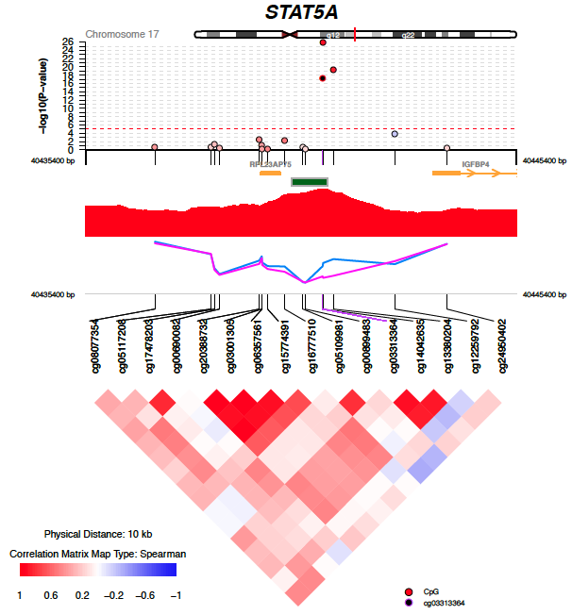
CoMET plots of hypoDMRs having 15%<Δβ<25% associated with gene expression correlation 1

