Slide 1
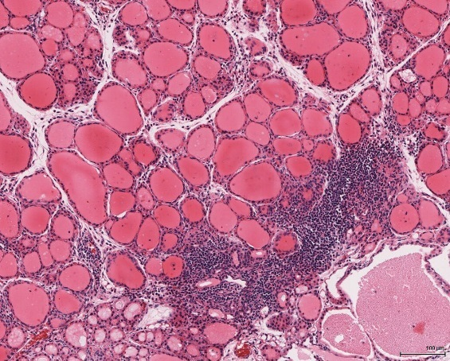
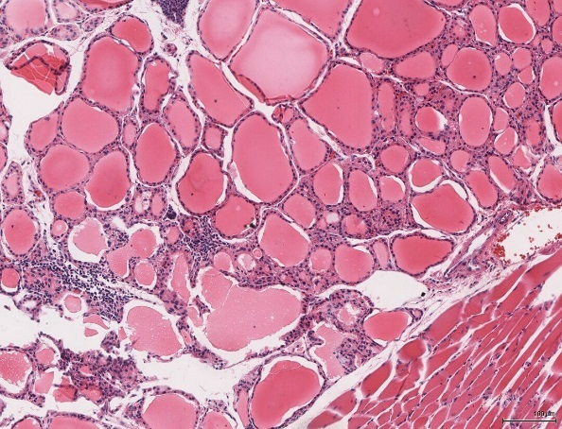
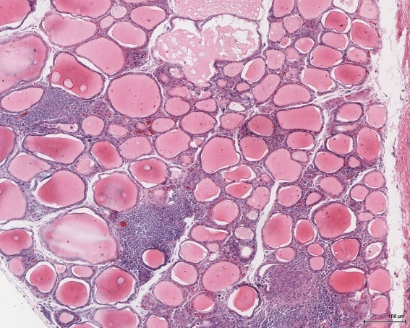
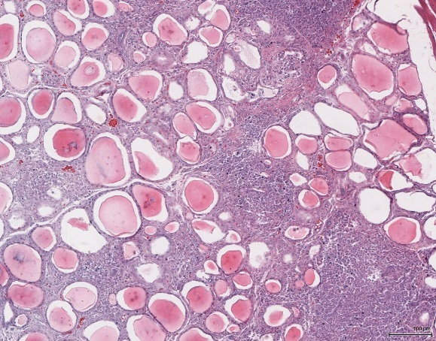
A. N6-Hi
A-subunit
transgenic
B. N6-Hi
A-subunit
transgenic
Supplementary Fig. S1.
Thyroiditis in N6 Hi-expressor TSHR
A-subunit transgenic and non-
transgenic NOD.H2^{h4} mice.
Examples of lymphocytic
infiltration varying from moderate
(A,C,D) to minimal (B) are shown
for thyroid histology (hematoxylin
and eosin, 10x magnification; three
transgenic mice; one non-transgenic
mouse).
C. N6-Hi
A-subunit
transgenic
D. N6-Hi
wt

Slide 2
Supplementary Fig. S2.
Regression of TSHR A-subunit ELISA
(OD 490 nm) versus TBI (% inhibition of
TSH binding). Patterned area highlights
positive TBI values for mice, albeit with
low ELISA values typical of those seen
in NOD.H2^{h4} recipients of the Hi-expressor
TSHR A-subunit transgene.
Data not previously published as a regression
for Lo-expressor NOD.H2^{h4} mice reported in
Rapoport B, Aliesky HA, Banuelos B, Chen CR,
McLachlan SM. A unique mouse strain that
develops spontaneous, iodine-accelerated,
pathogenic antibodies to the human thyro-
trophin receptor. J Immunol. 2015; 194:
4154-61.-61.
ELISA values
for Hi crosses
100
80
60
TSH binding inhibition (%)
40
20
0
0.0
0.2
0.4
0.6
0.8
1.0
TSHR A-subunit ELISA OD (490 nm)

Slide 3
Supplementary Fig. S3.
Regression of TBI (% inhibition of TSH
binding ) versus TSAb (% control). Dotted
lines indicate “cut-off” points for TBI and TSAb.
The patterned area shows that sera
negative for TBI also lack TSAb activity.
Data not previously published as a regression
for Lo-expressor NOD.H2^{h4} mice reported in
Rapoport B, Aliesky HA, Banuelos B, Chen CR,
McLachlan SM. A unique mouse strain that
develops spontaneous, iodine-accelerated,
pathogenic antibodies to the human thyro-
Trophin receptor. J Immunol. 2015; 194:
4154-61.-61.
1200
800
TSAb (% control)
400
0
0
20
40
60
80
TBI (% inhibition of TSH binding)

