Slide 1
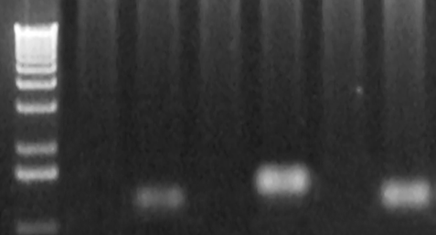
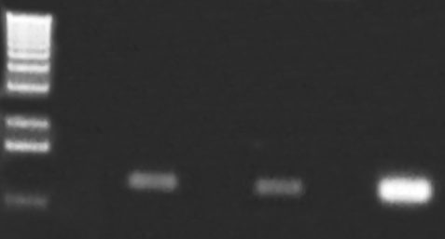
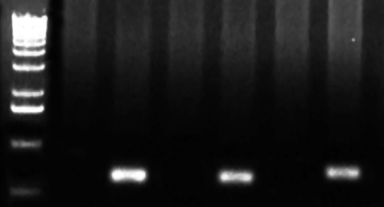
A.
B.
C.
F1
GOI
pDT
hDHFR
GFP
Plasmid
R1
pHD22Y/GOI-GFP
F1
pDT
GFP
hDHFR
R1
WT 1 WT 2 WT 3 WT 4 WT 5 WT 6 WT 7 WT 8 WT 9
Kb
3.0-
2.0-
1.5-
1.0-
1. PF3D7_1122900
2. PF3D7_0208900
3. PF3D7_0219600
4. PF3D7_1475500
5. PF3D7_0320800
6. PF3D7_0217500
7. PF3D7_0503400
8. PF3D7_1329100
9. PF3D7_1031000
Supplemental Fig. S1. Tagging of selected genes with GFP at their C-termini. A. A diagram shows predicted integration event of the plasmid at the selected genes using a single cross-over homologous recombination strategy. Blue boxes indicate the regions used for homologous recombination. GOI, selected gene of interest. F1 and R1 show the positions of primers for integration-specific PCR. Note: F1 for PF3D7_1031000 was designed at 5’ UTR due to gene coding region is short. B. Gel pictures show the results of integration-specific PCR for the nine selected genes listed in (C). All transfections were done in the laboratory strain 3D7. Genomic DNA from 3D7 was used as wild type (WT) control.

