Slide 1


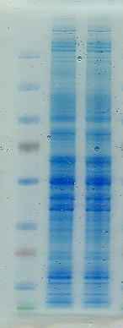
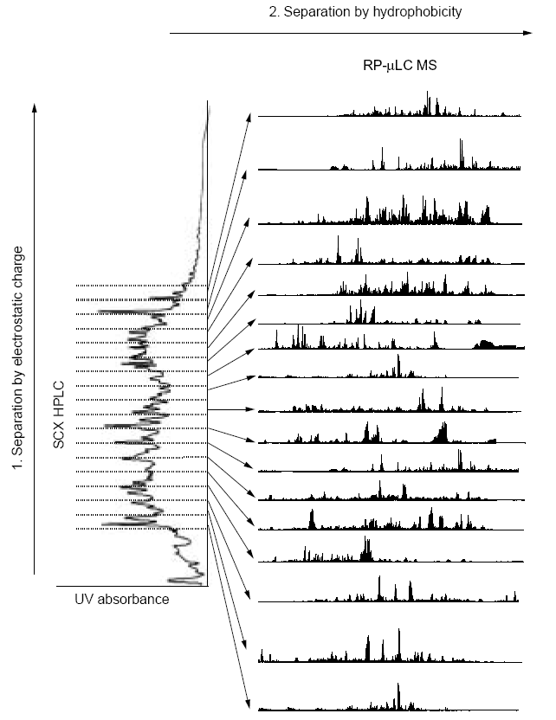
Figure S1
A
B
C
D
shControl
shPEAK1
Control shRNA
MW maker
shPeak1
LC/MS/MS
in triplicate
PEAK1
GAPDH
Control shRNA-expressing cells
180
115
80
In-gel digestion
65
• Selection of shPeak1 regulated proteins
• Bioinformatic analysis
Peak1 shRNA-expressing cells
50
30
25
2X biological replicates
15
10

