Slide 1
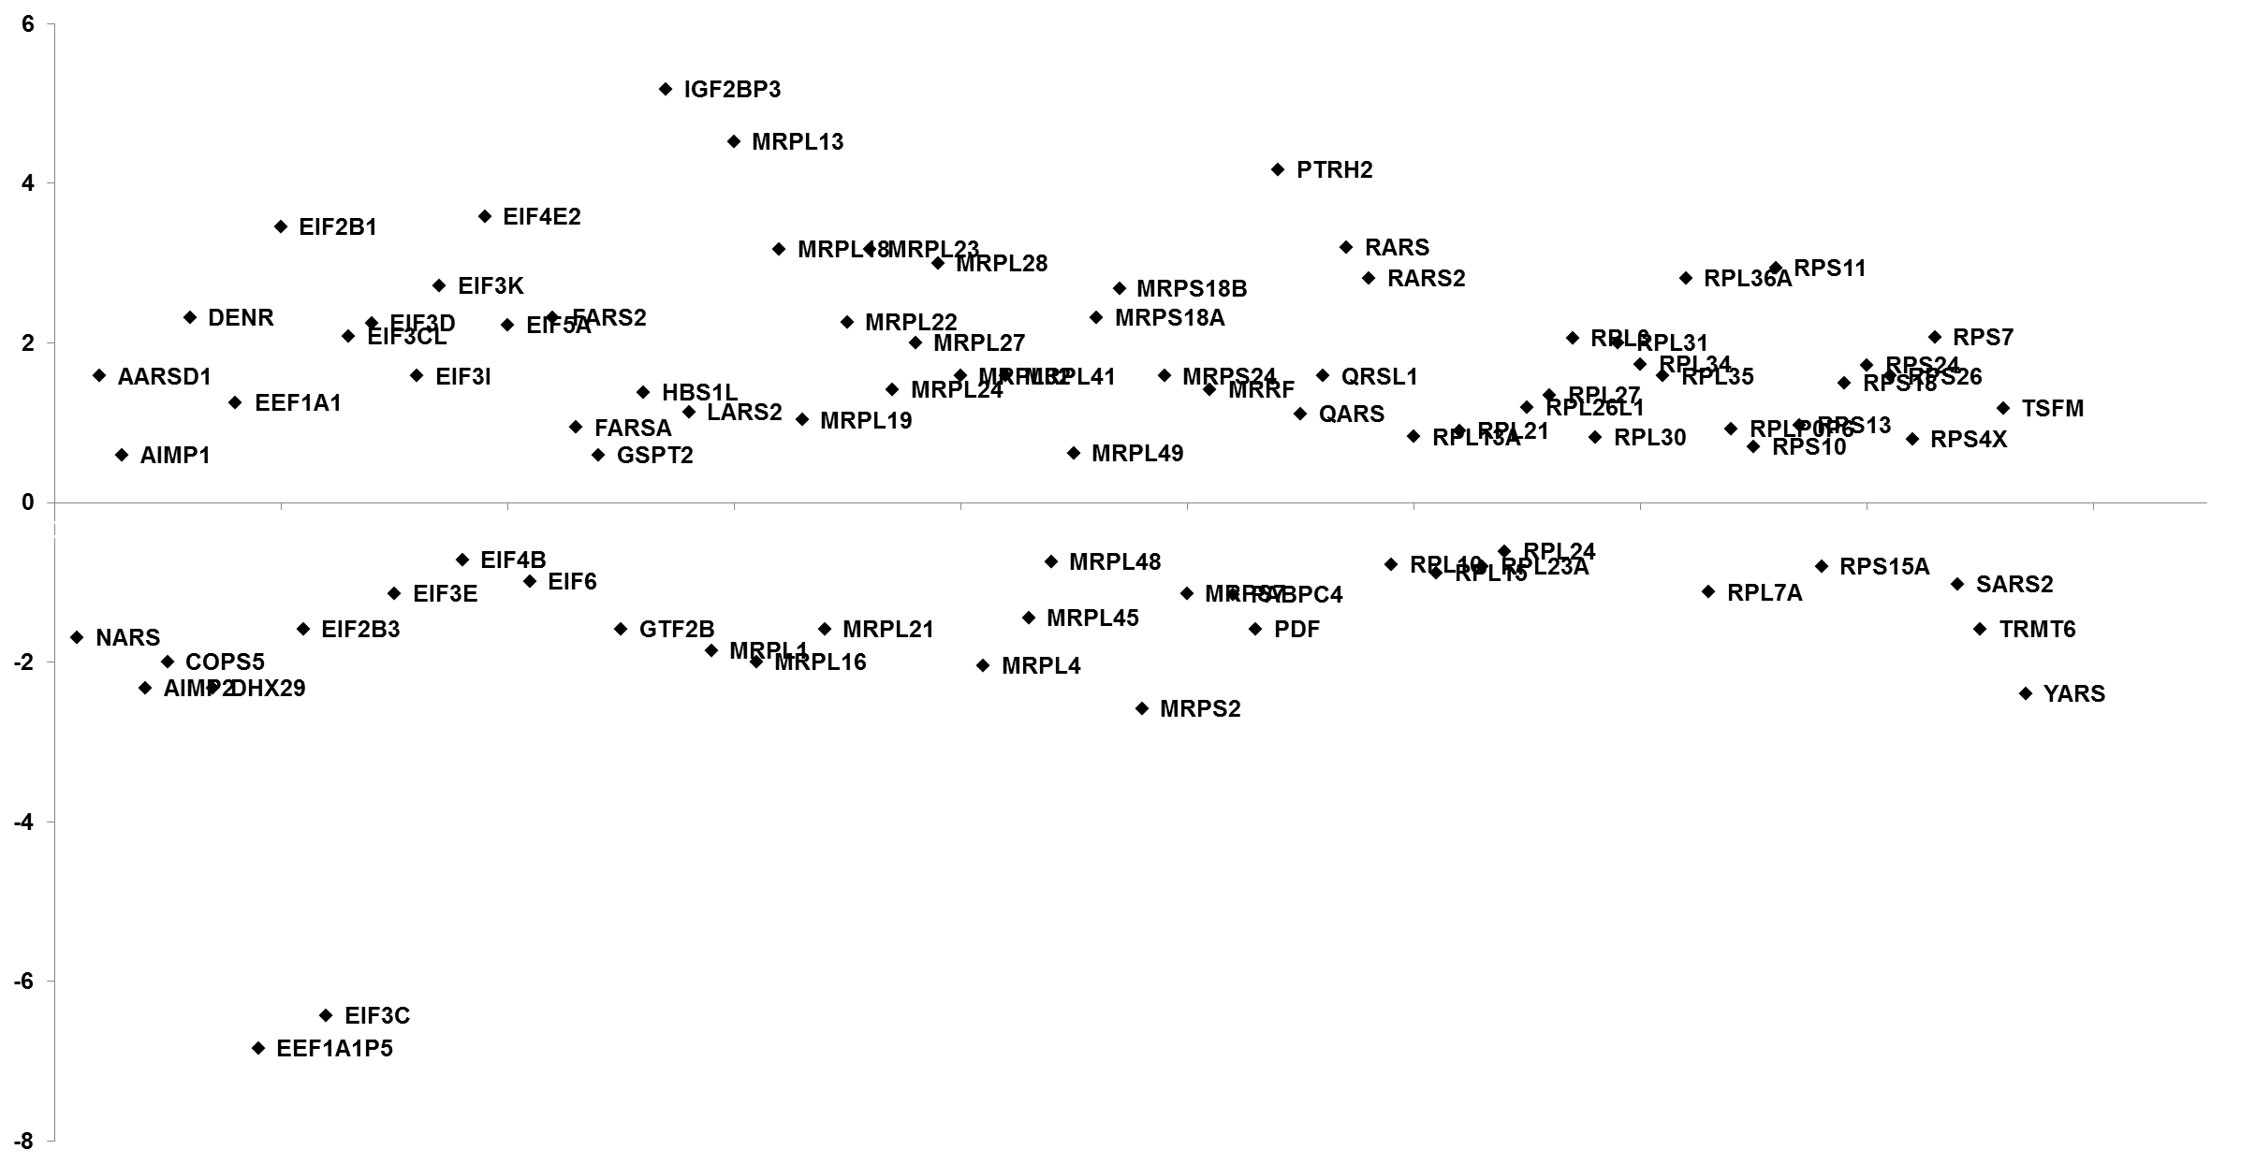
Protein Translation
Figure S2A
log2 ratio

