Slide 1


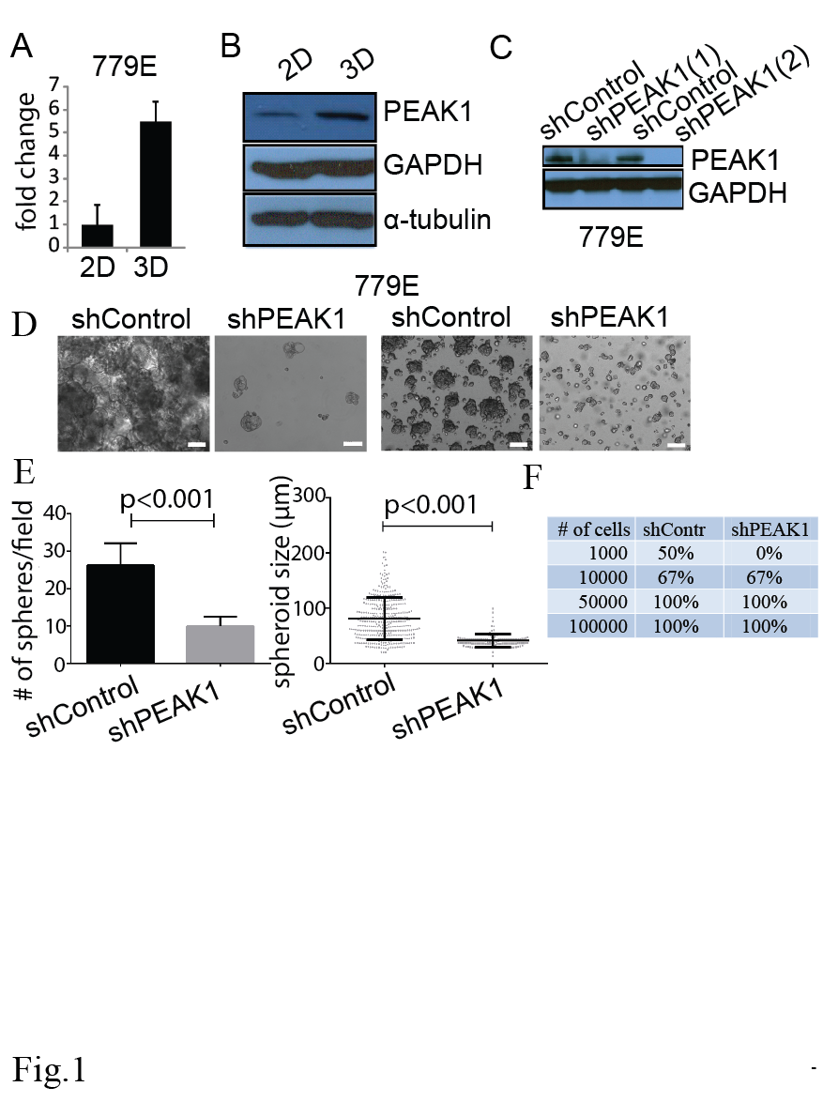
Figure S4
shPEAK1(1)
shPEAK1(2)
shPEAK1(1)
shPEAK1(2)
shC
shC
shC
shC
PEAK1
YAP1
GAPDH
Tubulin

