Slide 1
Gamma-glutamylpolyamine synthetase GlnA3 is involved in the first step of
polyamine degradation pathway in Streptomyces coelicolor M145.
Sergii Krysenko¹, Nicole Okoniewski², Andreas Kulik¹, Arne Matthews¹, Jan Grimpo¹, Wolfgang Wohlleben¹, Agnieszka Bera¹*
¹Microbiology and Biotechnology, University of Tübingen, Interfaculty Institute of Microbiology and Infection Medicine, Germany,
²Microbial Bioactive Compounds, University of Tübingen, Interfaculty Institute for Microbiology and Infection Medicine, Germany
Supplementary material:
S1: Structural superposition of the GlnA3-model structure and the reference target structures PauA7 and GlnA.
S2: Phenotypic analysis of parental strain and complemented glnA3 mutant on defined Evans-agar supplemented with polyamines.

Slide 2
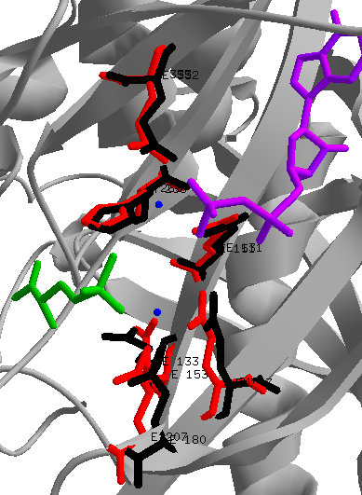
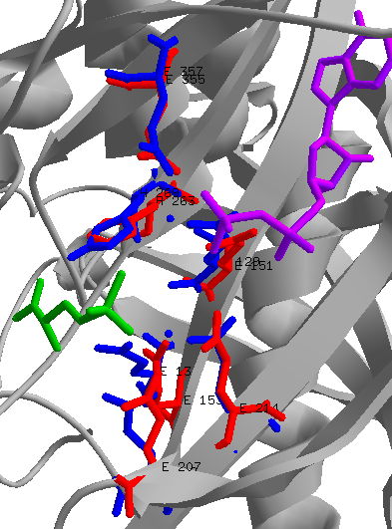
Supplementary material S1
Superposition of PauA7/GlnA3
Superposition of GlnA/GlnA3
ADP
ADP
N1
N2
N1
N2
PPT
PPT
Six residues coordinating metal ions N1 and N2 are conserved in GlnA3 model

Slide 3
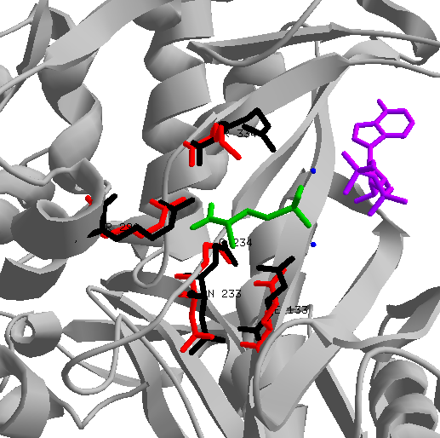
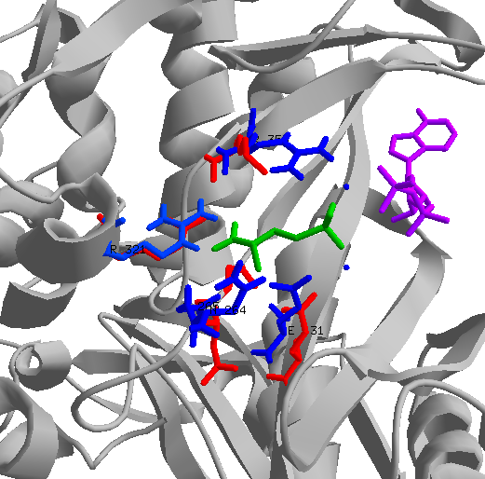
Supplementary material S1
Superposition of PauA7/GlnA3
Superposition of GlnA/GlnA3
K/R
ADP
ADP
PPT
PPT
Four residues coordinating glutamate binding are conserved in GlnA3 model

Slide 4
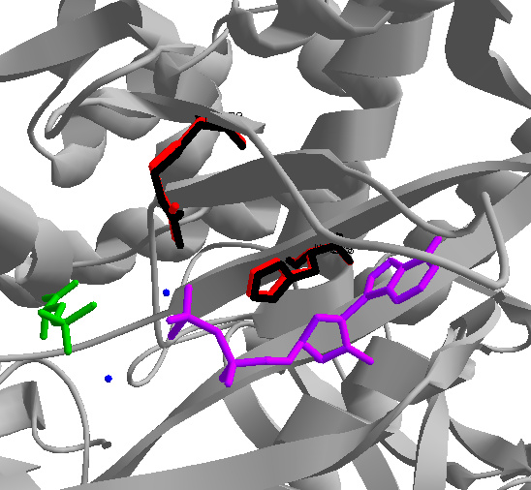
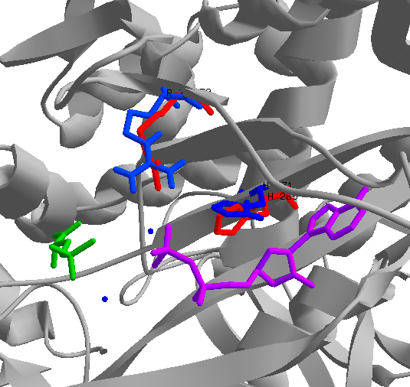
Supplementary material S1
Superposition of PauA7/GlnA3
Superposition of GlnA/GlnA3
ADP
ADP
PPT
PPT
Two residues coordinating ATP binding are conserved in GlnA3 model

Slide 5
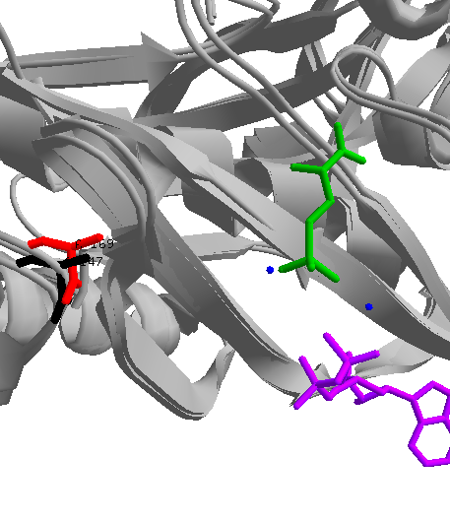
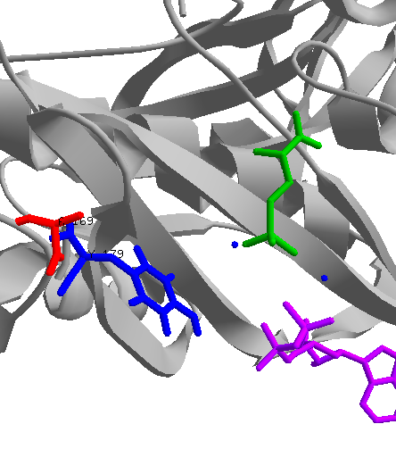
Supplementary material S1
Superposition of PauA7/GlnA3
Superposition of GlnA/GlnA3
PPT
PPT
GlnA3 possess Ala169 instead of the conserved Tyr179, the pocket is more open for substrates much bigger than ammonium

Slide 6
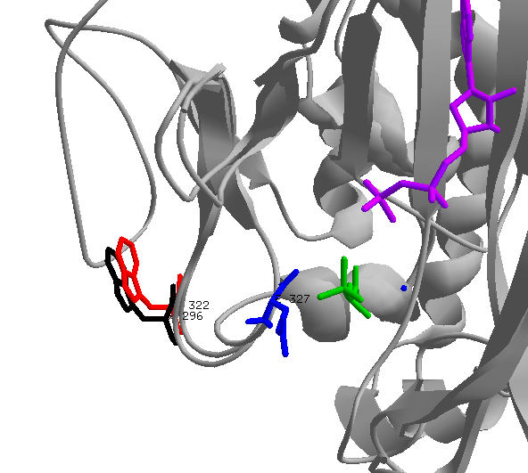
Supplementary material S1
Superposition of PauA7/GlnA/GlnA3
ADP
PPT
GlnA3 possess Trp322 instead of the conserved Glu327, the pocket is more open for substrates much bigger than ammonium

Slide 7
Supplementary material S2
Fig.S2 Phenotypic analysis of parental strain and complemented glnA3 mutant on defined Evans-agar supplemented with polyamines.

