Slide 1
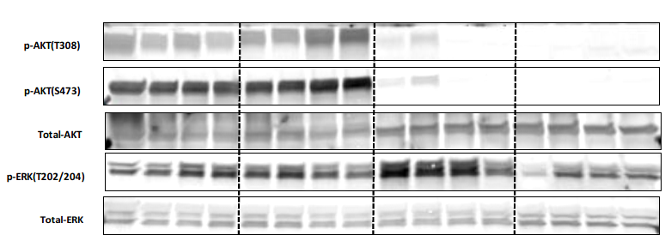

Supplemental Figure 2

