Slide 1
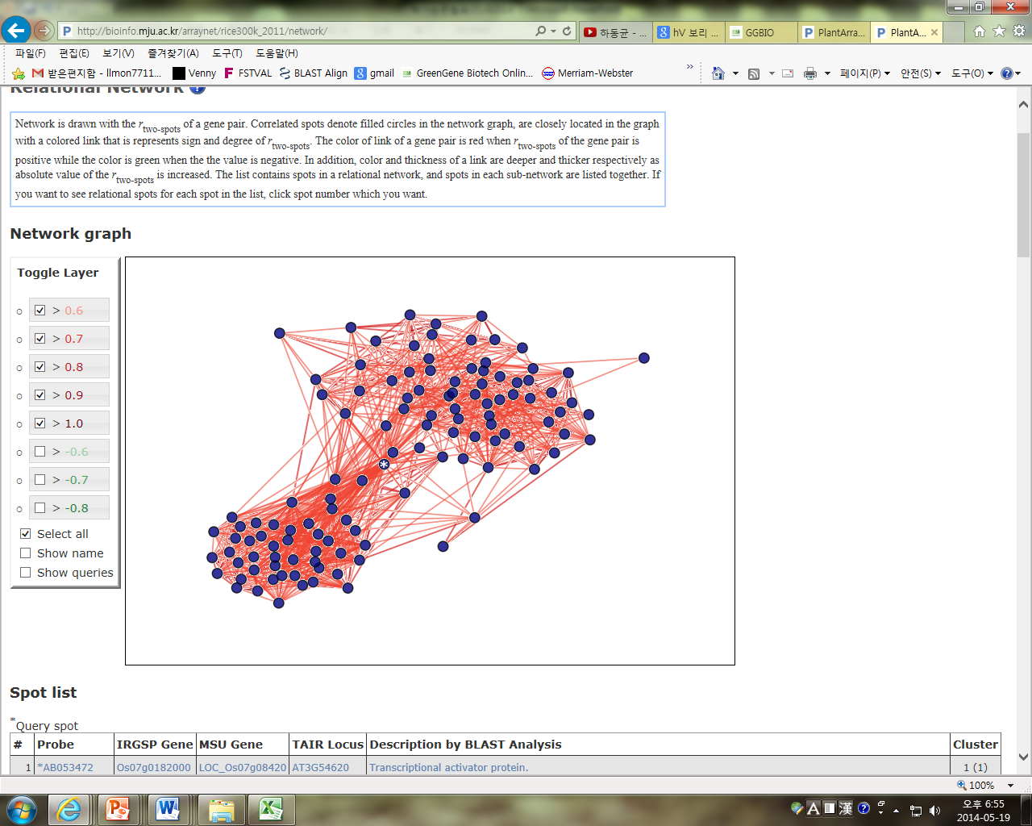
* OsSMF1
Figure S3. The query gene, OsSMF1, is marked by an asterisk. Each circle indicates a gene, and the lines represent correlations between genes. Eighty-five genes were identified as OsSMF1-related genes, with a minimum correlation value of 0.55 and depth of 1.

