Slide 1
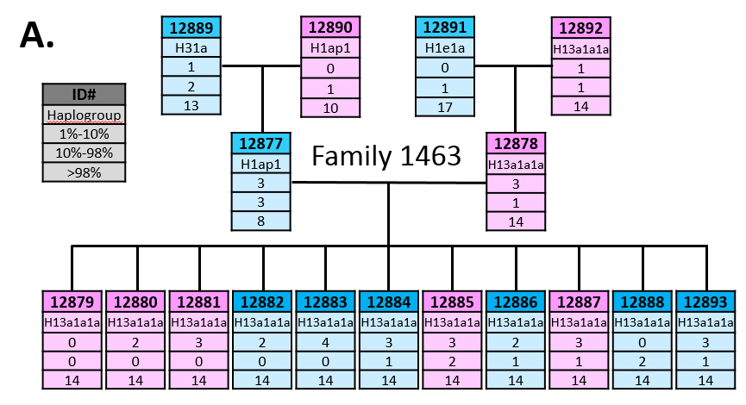
CEPH Family 1463 pedigree

Slide 2
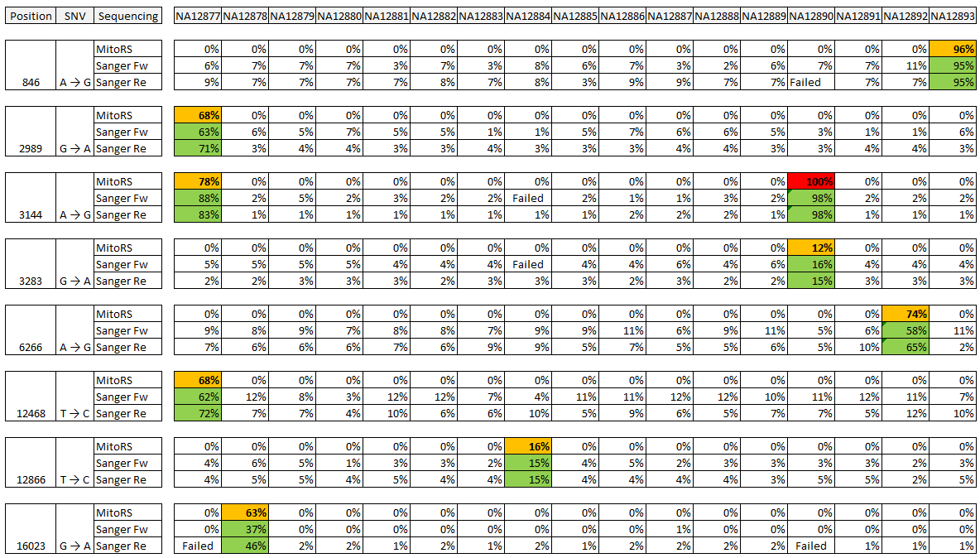
Heteroplasmy level

Slide 3
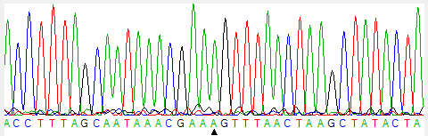
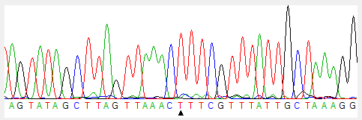
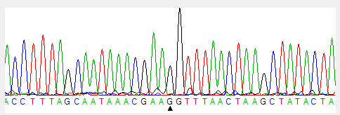
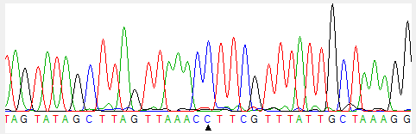
Position 846
Mother
NA12878
A→G 0%
Son
NA12893
A→G 96%
Sanger Sequencing Fw
Sanger Sequencing Re

Slide 4
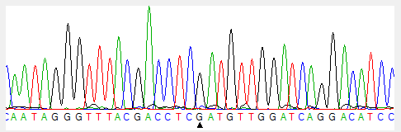
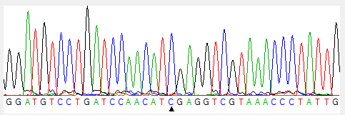
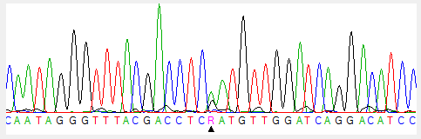
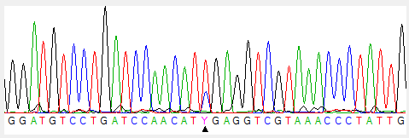
Position 2989
Mother
NA12890
G→A 0%
Son
NA12877
G→A 68%
Sanger Sequencing Fw
Sanger Sequencing Re

Slide 5
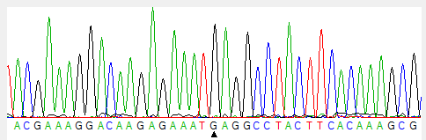
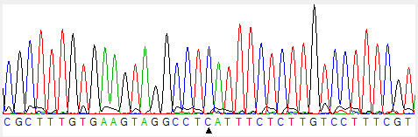
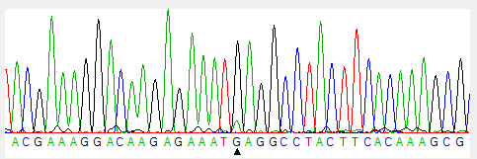
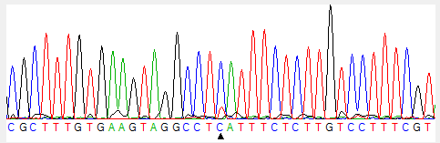
Position 3144
Mother
NA12890
A→G 100%
Son
NA12877
A→G 78%
Sanger Sequencing Fw
Sanger Sequencing Re

Slide 6
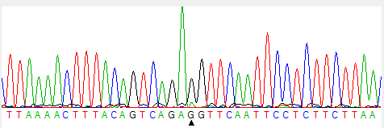
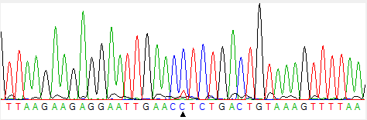
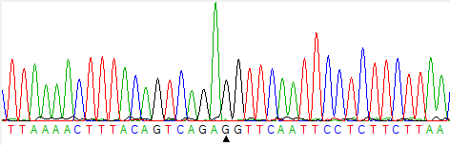
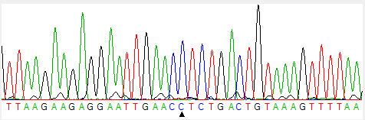
Position 3283
Mother
NA12890
G→A 12%
Son
NA12877
G→A 0%
Sanger Sequencing Fw
Sanger Sequencing Re

Slide 7
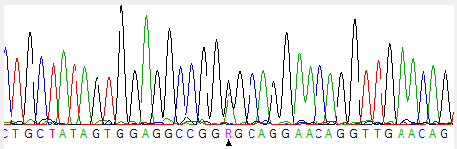
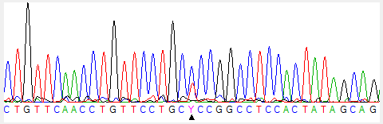
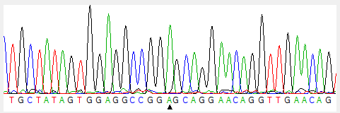
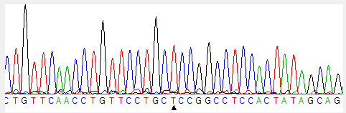
Position 6266
Mother
NA12892
A→G 78%
Daughter
NA12878
A→G 0%
Sanger Sequencing Fw
Sanger Sequencing Re

Slide 8
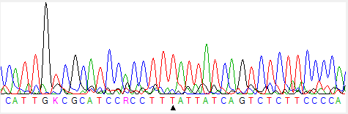
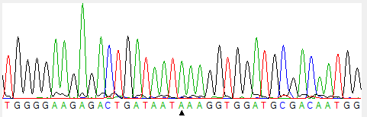
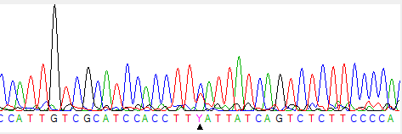
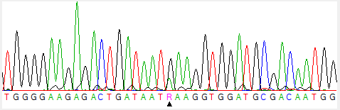
Position 12468
Mother
NA12890
T→C 0%
Son
NA12877
T→C 68%
Sanger Sequencing Fw
Sanger Sequencing Re

Slide 9
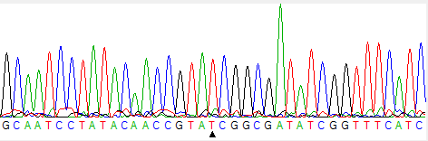
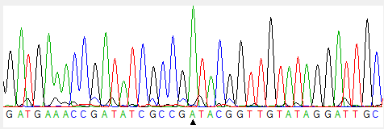
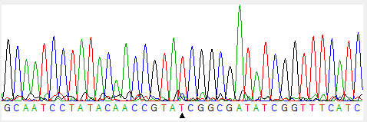
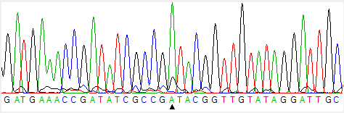
Position 12866
Mother
NA12878
T→C 16%
Son
NA12884
T→C 0%
Sanger Sequencing Fw
Sanger Sequencing Re

Slide 10
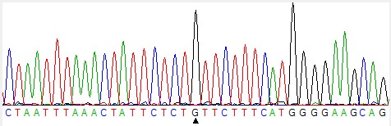
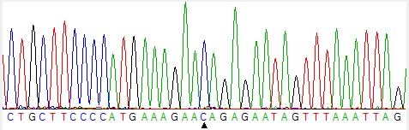
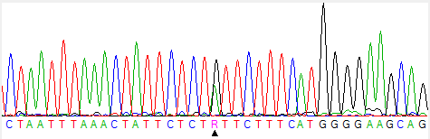
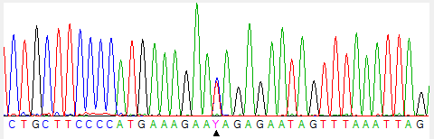
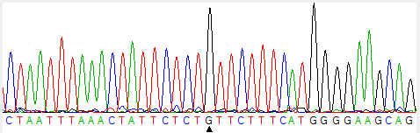
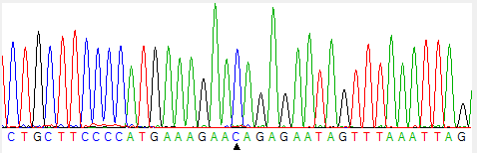
Position 16023
Grand Mother
NA12892
G→A 0%
Mother
NA12878
G→A 63%
Daughter
NA12879
G→A 0%
Sanger Sequencing Fw
Sanger Sequencing Re

Slide 11
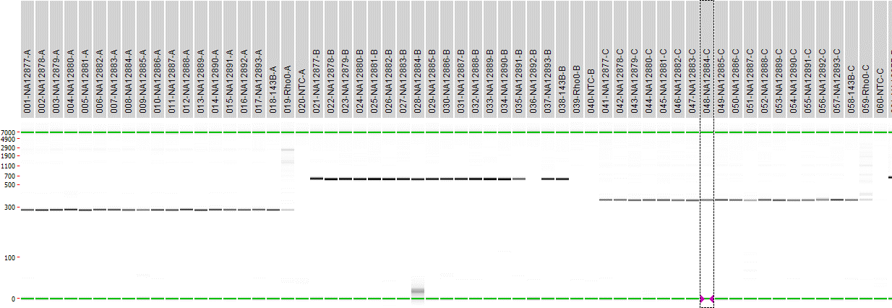
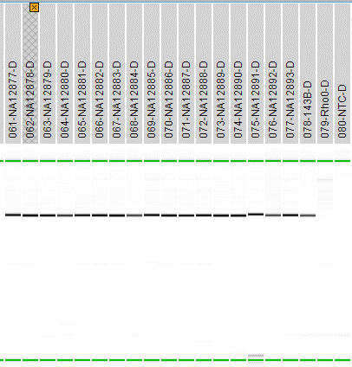
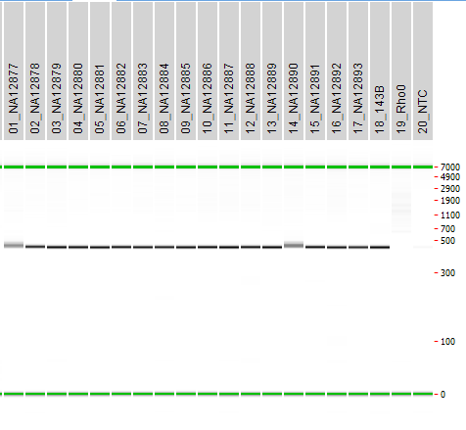
A
B
C
D
E
PCR products used for Sanger
  A: Region 652 – 934 (283 bp)
  B: Region 2’865 – 3’466 (602 bp)
  C: Region 6’129 – 6’466 (338 bp)
  D: Region 12’359 – 12’989 (631 bp)
  E: Region 15’873 – 16’295 (423 bp)

