Slide 1
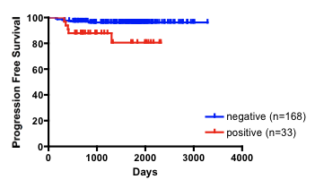
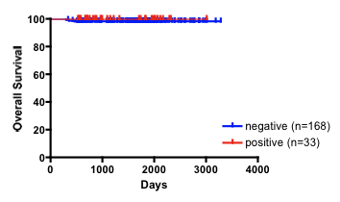
Yamawaki et al. Supplementary Figure S1
(a)
(d)
 | Early (I & II) | Advanced (III & IV)
Positive | 35 (16.7%) | 8 (22.2%)
Negative | 175 (83.3%) | 23 (77.8%)
N.S.
Negative
Positive
(b)
(e)
p=0.0049
HR 4.670
(95%CI = 2.048-55.75)
 | All (n=258) | SOX2 Positive (n= 44) | SOX2 Negative (n= 214)
p53 Positive | 13 (5.0 %) | 3 (6.8 %) | 10 (4.7 %)
p53 Negative | 245 (95.0 %) | 31 (93.2 %) | 204 (95.3 %)
N.S.
(c)
(f)
 | All (n=25) | SOX2 Positive (n= 16) | SOX2 Negative (n= 9)
p53 Positive | 4 (16.0 %) | 2 (12.5 %) | 2 (22.2 %)
p53 Negative | 21 (84.0 %) | 14 (87.5 %) | 7 (77.8 %)
N.S.
N.S.
Supplementary Figure S1. Comparison of SOX2 and p53 expression in endometrial cancer.
(a) Distribution of SOX2 expression in early (FIGO stages I and II; n = 210) and advanced (stages III and IV; n = 31) stages of endometrial cancer (n = 241). (b, c) Kaplan-Meier analyses of progression-free survival (b) and overall survival (c) in patients suffering from stage I endometrial cancer. The patients were stratified into SOX2-positive (red lines, n = 33) and SOX2-negative (blue lines, n = 168) groups. (d) Representative immunostaining images for p53-negative (left) and p53-positive (right) cases. Scale bars: 100 μm. (e, f) Distribution of p53 expression in SOX2-positive and SOX2-negative endometrial cancer of all cases (e, n=258), and pathologically high-grade cases (f, n=25).
Notes:
p53

Slide 2
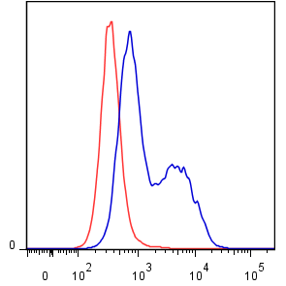
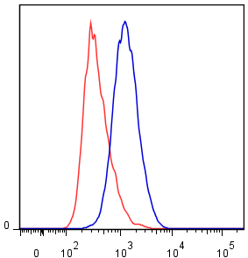

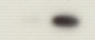


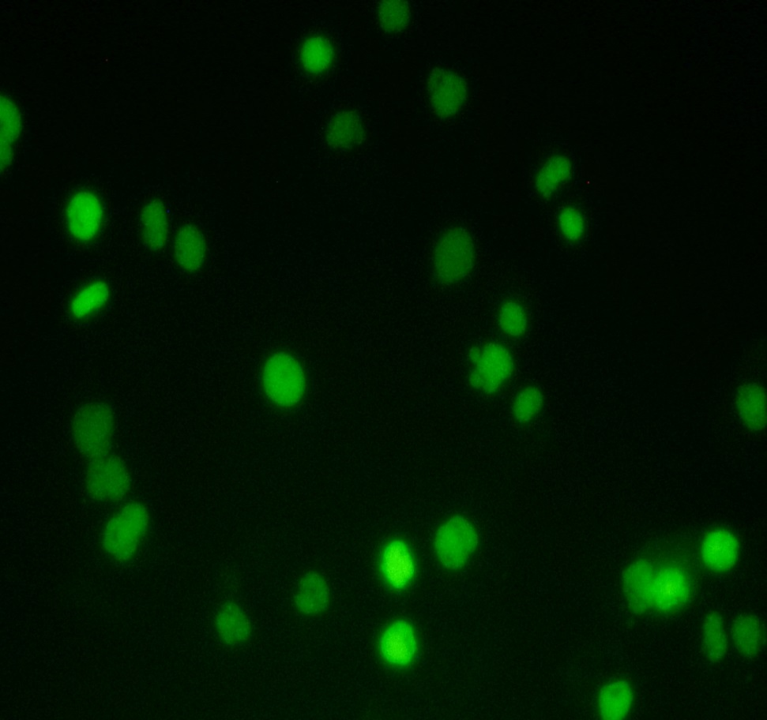
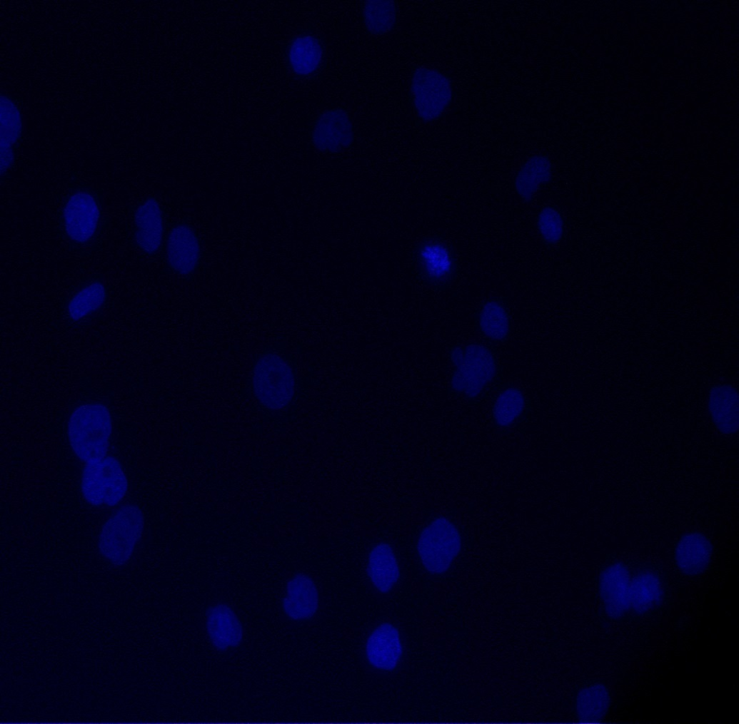
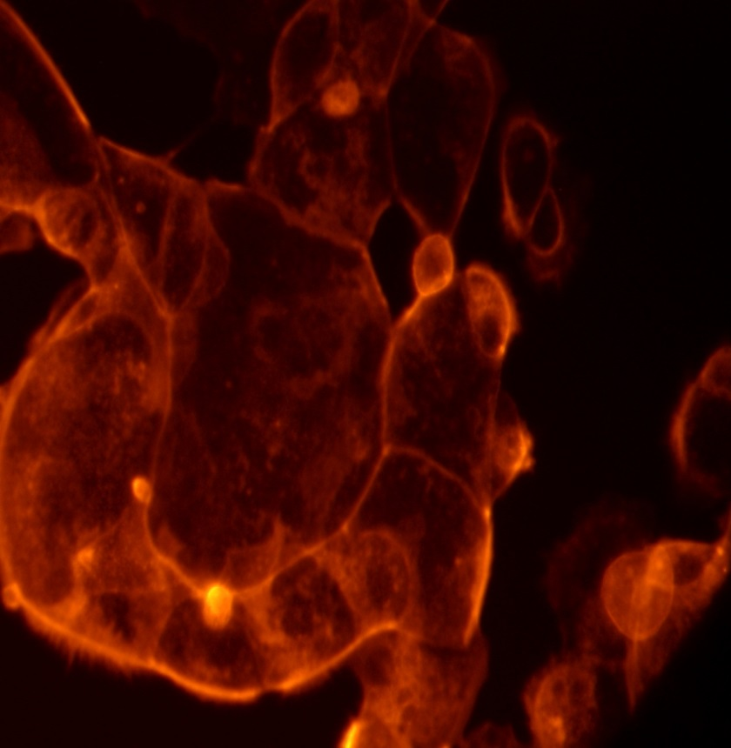
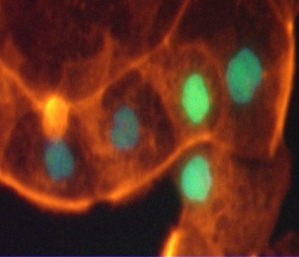
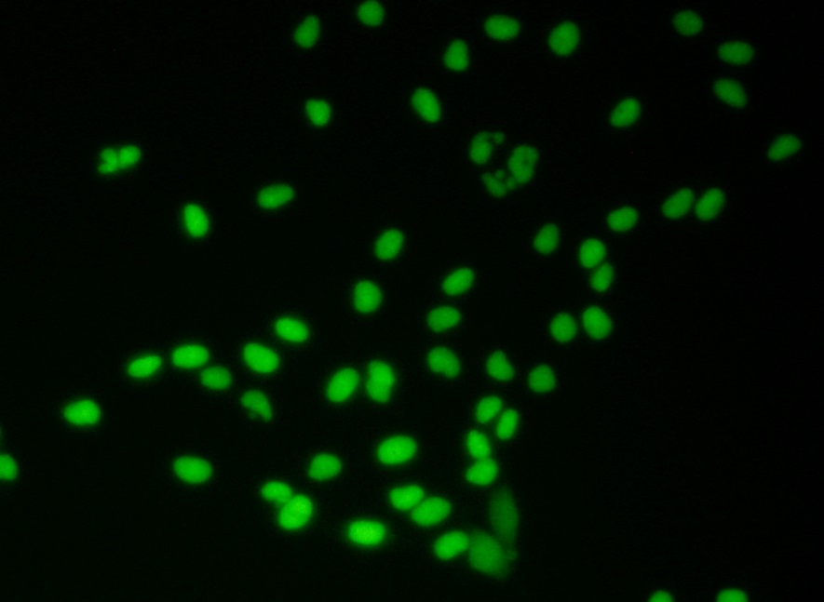
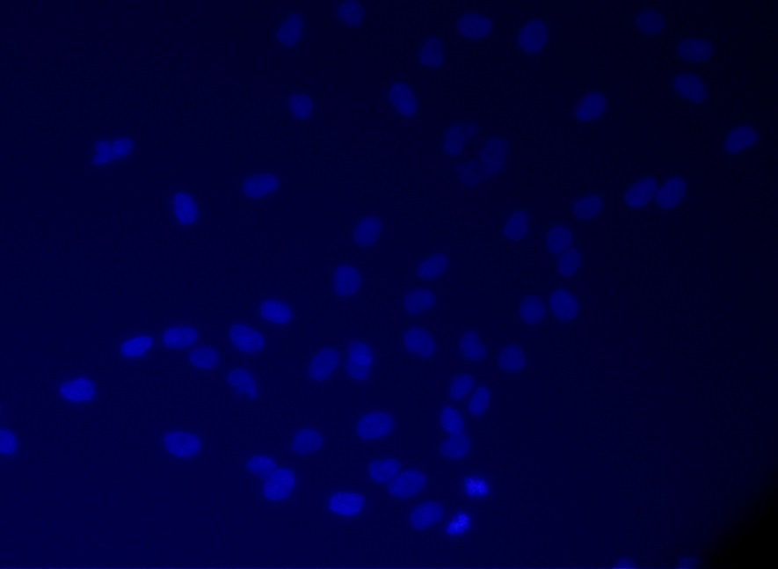
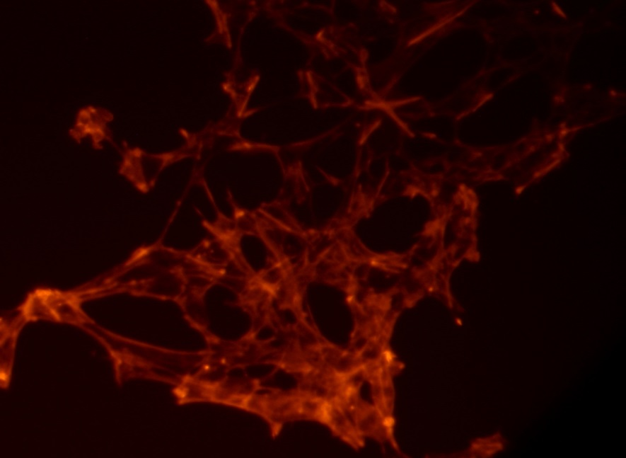
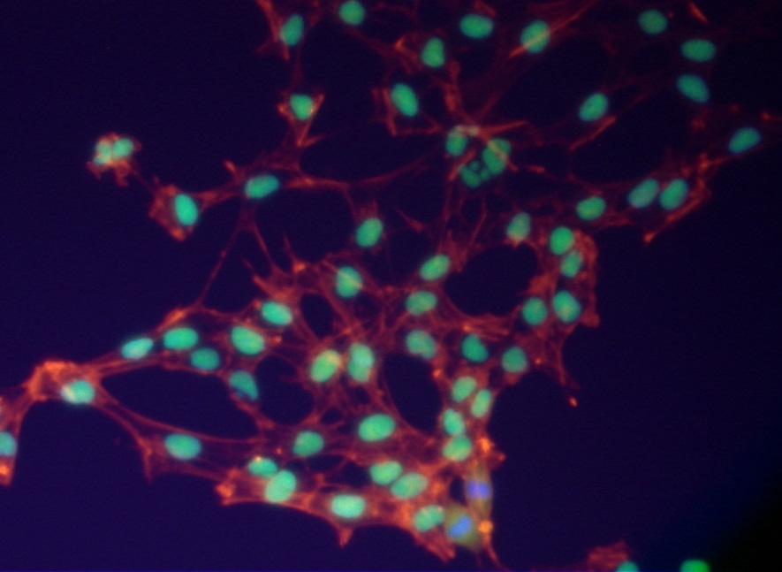
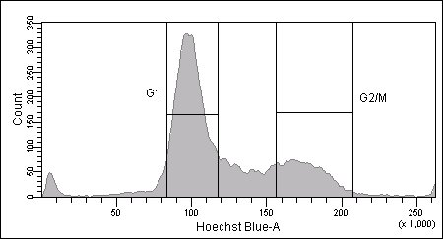
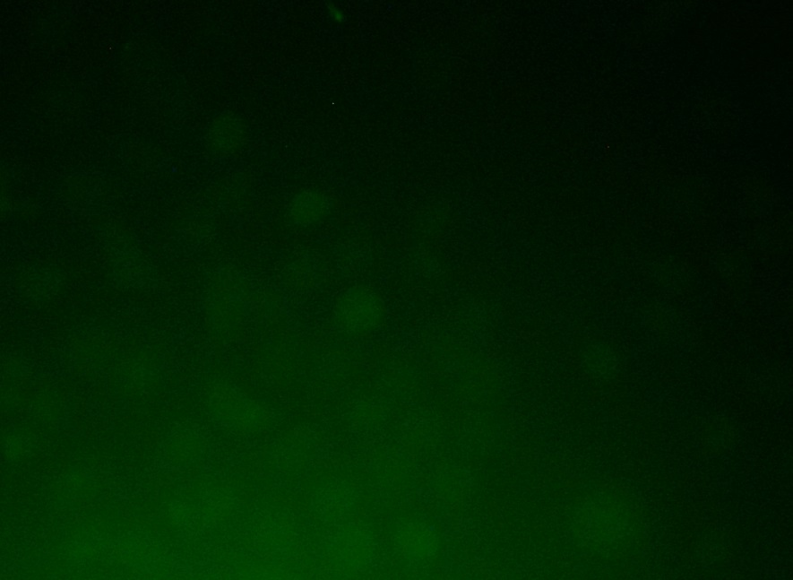
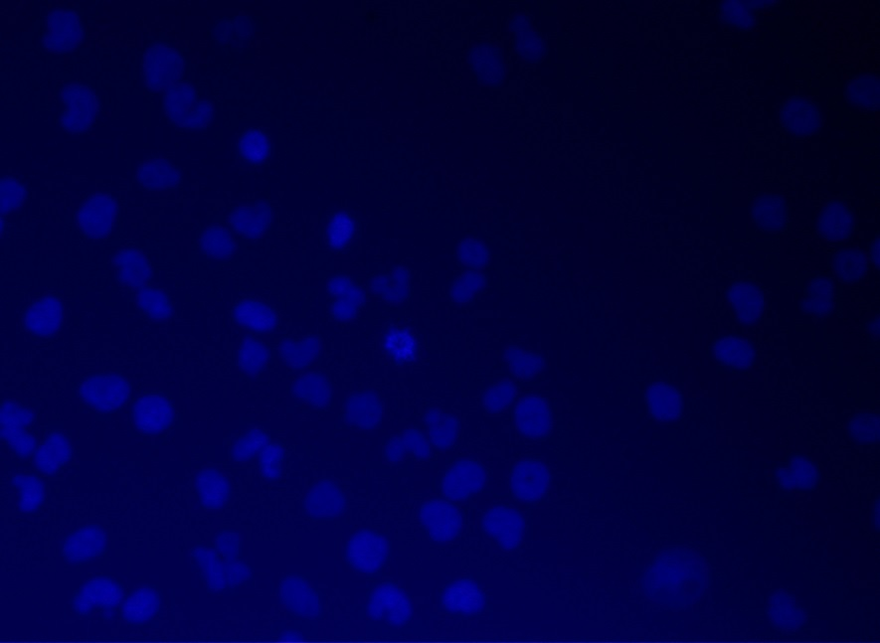
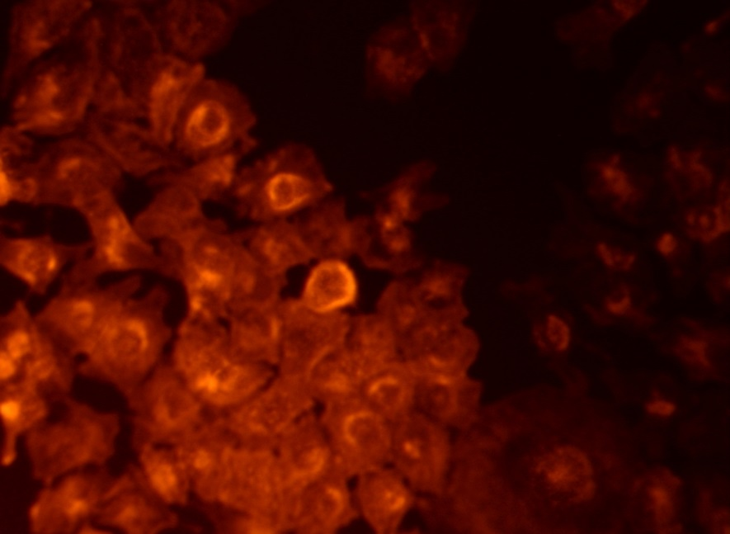
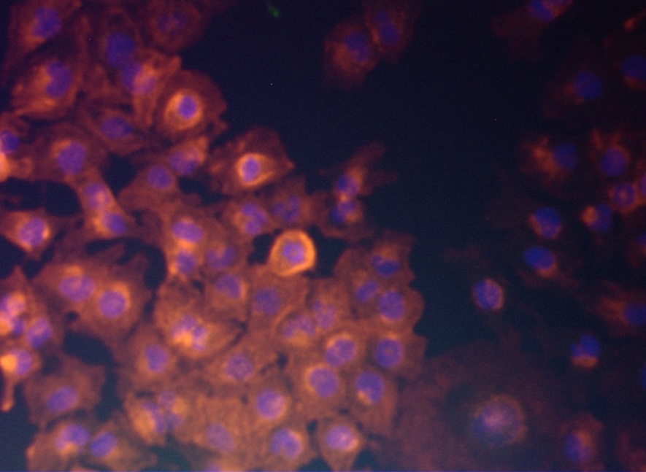
Yamawaki et al. Supplementary Figure S2
(a)
(c)
(f)
EN
HEC59
G1
G2/M
Cell cycle
phase
SOX2 mRNA expression
relative to HEC59
count
SOX2
Cyclin B1
Cyclin E1
Endometrial cancer cell lines
IgG
SOX2
GAPDH
(b)
(d)
(g)
Day 0
Day 7
*
HEC59
SOX2
DAPI
JHUEM7
Relative sox2 mRNA levels
(e)
PA-1
G1
G2/M
HEC1A
count
G1
G2/M
Cell cycle phase
SOX2
DAPI
Palloidin
Merge
DNA content
Supplementary Figure S2. SOX2 expression in human endometrial cancer cell lines. (a) Quantitative real-time PCR analysis of SOX2 mRNA expression levels in endometrial cancer cell lines. PA-1 cells were used as a SOX2-positive control. (b) Images of immunostaining for SOX2, DAPI, and phalloidin. SOX2 expression was localized mainly in the nuclei of endometrial cancer cells. PA-1 and HEC1A cells were used as positive and negative controls, respectively. Scale bars: 50 μm. (c) Flow cytometric analysis of SOX2 expression. (d) Bright-field images of EN cells (left, day 0) and immunofluorescence images of cells after staining with anti-SOX2 antibodies following 7 days of culture (right, day 7). (e) Cell cycle distribution of EN cells, as analyzed using a FACS Aria II instrument after staining of the cells with Hoechst 33342 dye. Cells were separated into G₁ and G₂/M phase subpopulations. (f) Western blot analysis and (g) quantitative real-time PCR analysis of EN cells after separation into G₁ and G₂/M phases. Cyclin B1 and cyclin E1 were also used to confirm the cell cycle phases.

Slide 3





Yamawaki et al. Supplementary Figure S3
(a)
(b)
(c)
EN
SOX2 #7
JHUEM7
SOX2 #6
SOX2 #6
SOX2 #7
Control
SOX2#6
SOX2#7
control
control
Control
SOX2#6
SOX2#7
siRNA
*
*
*
*
SOX2
relative cell growth
relative cell growth
p21
GAPDH
0 1 2 4
(Day)
0 1 2 4
(Day)
(d)
(e)
(f)
*
**
**
*
2.5
2
1.5
relative SA-β-Gal activities
relative cdkn1a mRNA expression
1
DNA binding
0.5
siRNA
Control
SOX2 #7
siRNA
Control
SOX2 #6
SOX2 #7
Supplementary Figure S3. SOX2 is required to modulate the proliferation of endometrial cancer cells. (a) Western blot analyses in EN, and JHUEM7 cells transfected with SOX2 siRNA or control siRNA. (b, c) Time course of cell proliferation for EN (b) and JHUEM7 (c) cells transfected with SOX2 siRNA or control siRNA. (d) SA-β-Gal activity in EN cells transfected with SOX2 siRNA or control siRNA. (e) CDKN1A mRNA expression levels in EN cells transfected with SOX2 siRNA, as analyzed by quantitative real-time PCR. (f) Chromatin immunoprecipitation (ChIP) was used to detect the SOX2-CDKN1A interaction in EN cells.

Slide 4
Yamawaki et al. Supplementary Figure S4
 | All (n=31) | p53 Negative (n=21) | p53 Positive (n=10)
SOX2 Positive p21 Negative | 5 (16.1%) | 3 (14.3 %) | 2 (20.0 %)
SOX2 Positive p21 Positive | 3 (9.7%) | 2 (9.5%) | 1 (10.0 %)
SOX2 Negative p21 Negative | 11 (35.5%) | 9 (42.9 %) | 2 (20.0%)
SOX2 Negative p21 Positive | 12 (38.7%) | 7 (33.3%) | 5 (50.0%)
Supplementary Figure S4. Stratification of SOX2/p21 immunostaining based on p53 expression.
p53 expression in four subtypes of SOX2 and p21staining pattern in advanced endometrial cancer (n=31).
Notes:
p53

