Slide 1
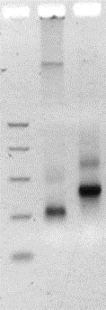
S1 Fig.
A
1 - cfDNA
2 - Genomic library
cfDNA
750
500
300
150
Genomic library
50
1
2
B
Capture probe
primer extension
C
READ 1
P5
P7
READ 2

