Slide 1
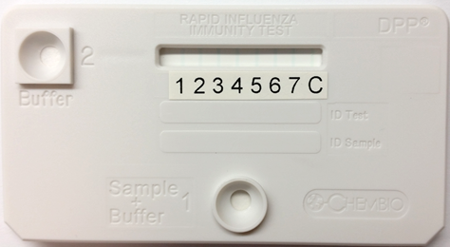
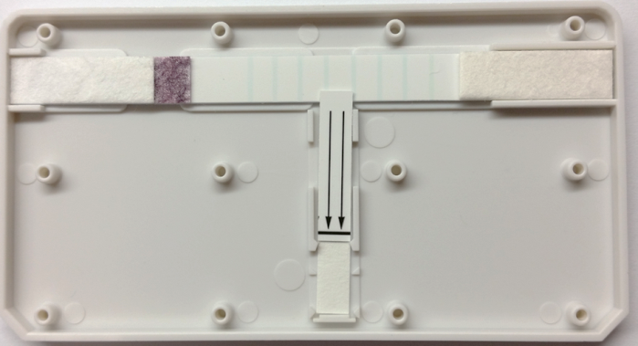
Figure S1
      H13 HA1 A/shorebird/DE/68/2004
      B/B+B/W HA1 (B/Brisbane/60/2008 and B/Wisconsin/1/2010)
      pH1/ H3 HA1 (A/CA/07/2009+A/Per/16/2009)
      H2 HA1 A/Japan/305/57
      H5 HA1 A/Indonesia/05/2005
      H7-N HA1 A/Shanghai/2/2013
      H9 HA1 A/Hong Kong/33982/2009
      PA control
Colloidal gold protein A pad
Lateral strip (S2 Strip)
Buffer port
Sample port
Vertical strip (S1 strip)

