Slide 1
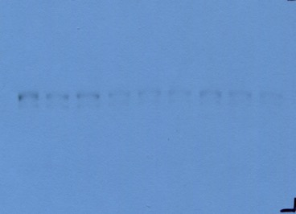
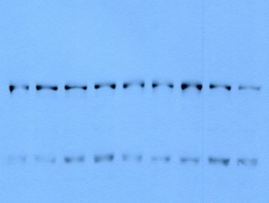
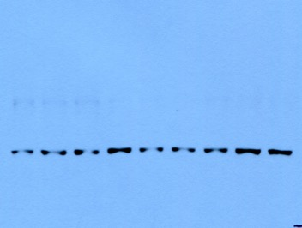
Fig 2B
MW (kDa)
pY-STAT3
79, 86
STAT3
79, 86
Non-specific band
STAT3
α-Tubulin
55

Slide 2
Fig 2D
MW (kDa)
pY-STAT3
79, 86
iNOS
130
α-Tubulin
55
STAT3
79, 86
α-Tubulin
55

