Slide 1
Figure 4 raw blots

Slide 2
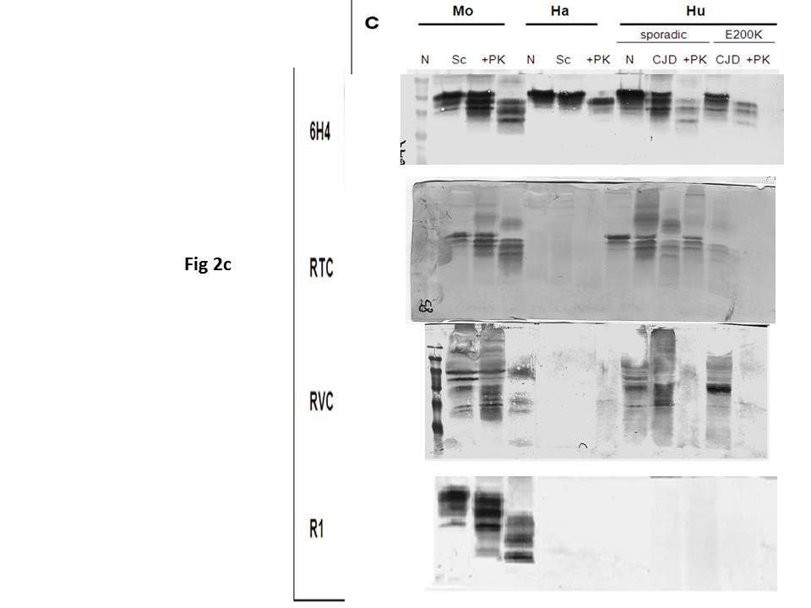
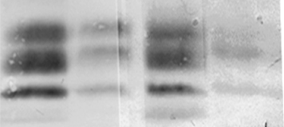
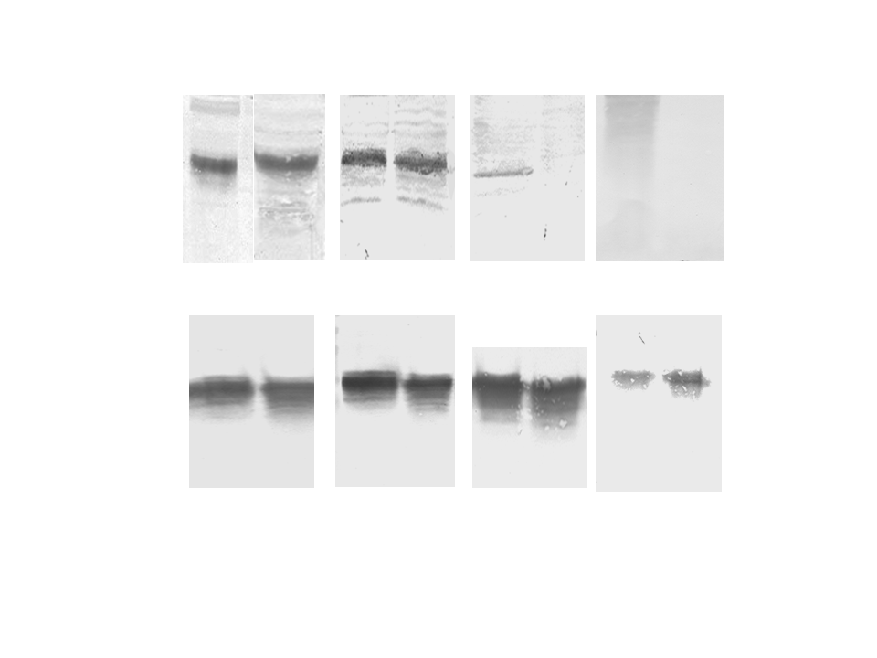
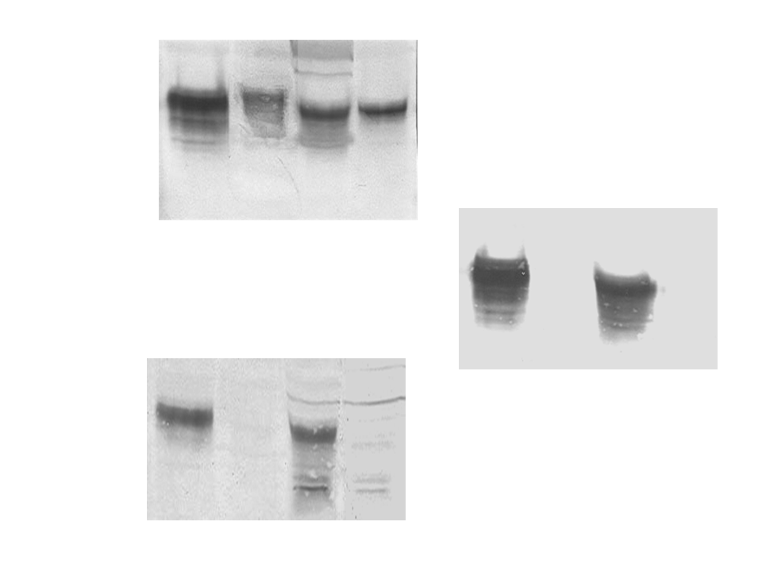
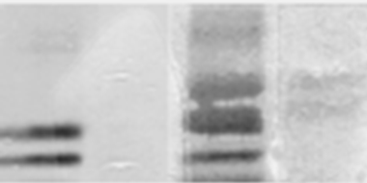
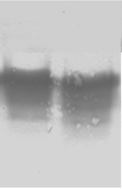
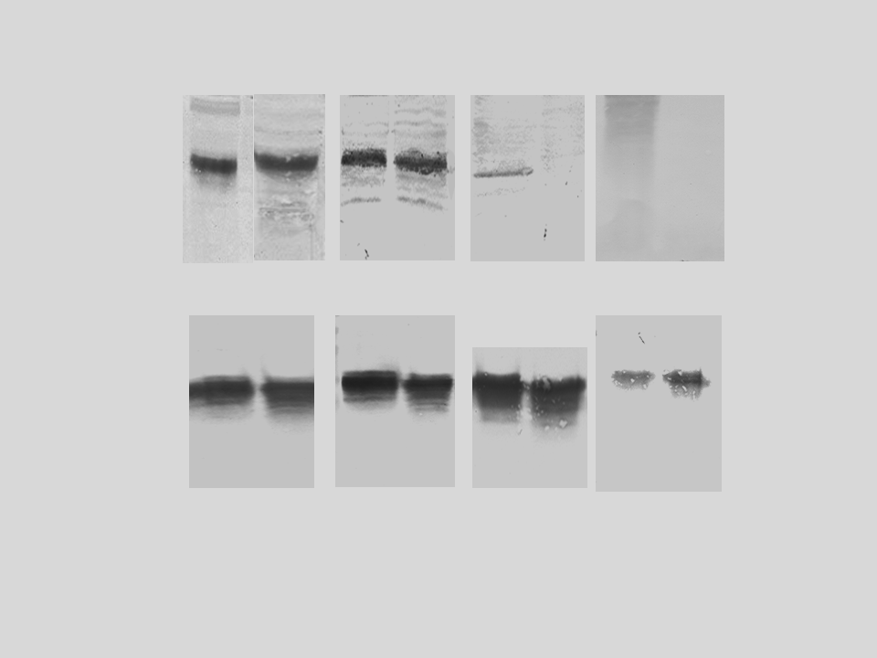

Raw gels for Figure 2A, 2B, 2C, 2D
b
d
Mo Hu Mo Hu
a
Hu Mo
Hu Mo
Hu Mo
Hu Mo
mAb
6H4
Hu Bo Mo Ha
pAb
RVC
mAb
IPC2
mAb
6H4
+VE
+VM
+KM
pAb
RTC
pAb
RVC
pAb
RTC
mma - - + +
+Ox KM
+TM
pAb
RVC

Slide 3
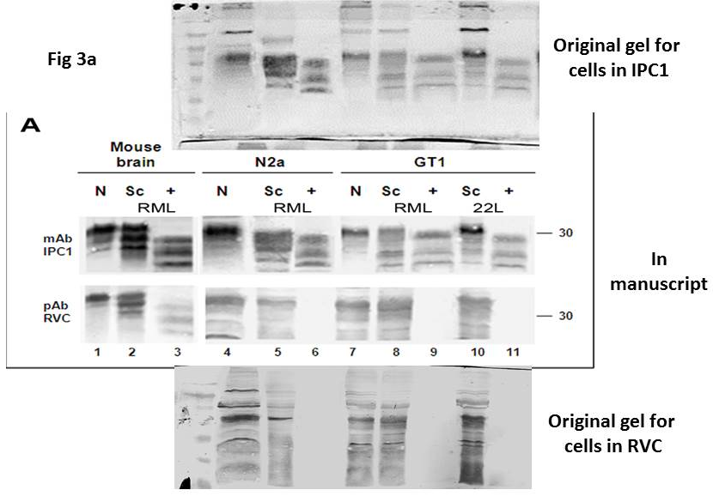
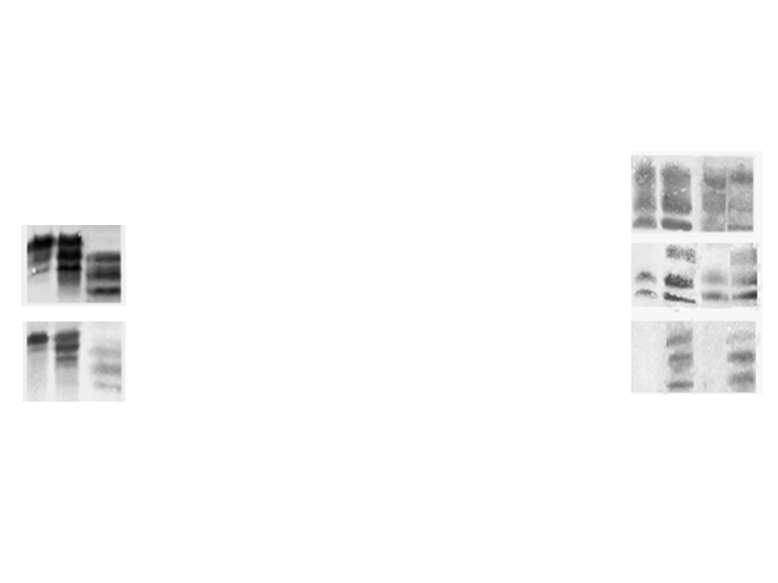
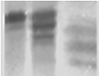
Uncropped blots for Figure 3A and 3B
b
Sc Sc
N2a GT1
a
Mouse
brain
N Sc +
RML
mAb
6H4
mAb
IPC1
30
mAb
IPC2
pAb
RVC
pAb
RVC
30
2 3
MMA - + - +

Slide 4
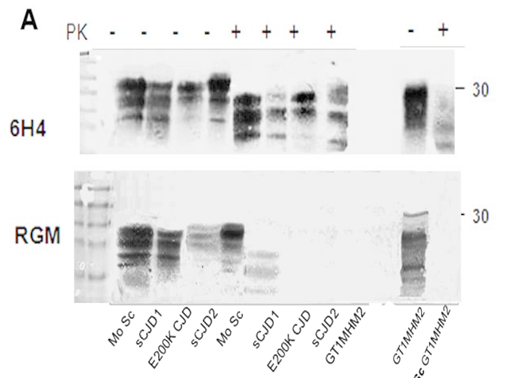
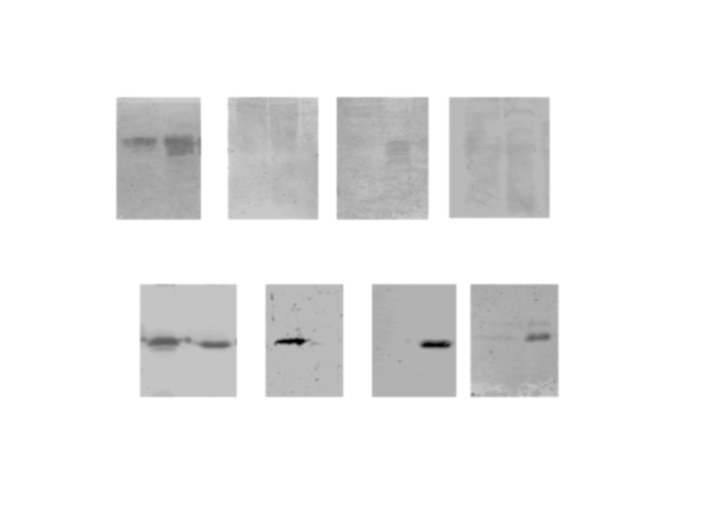
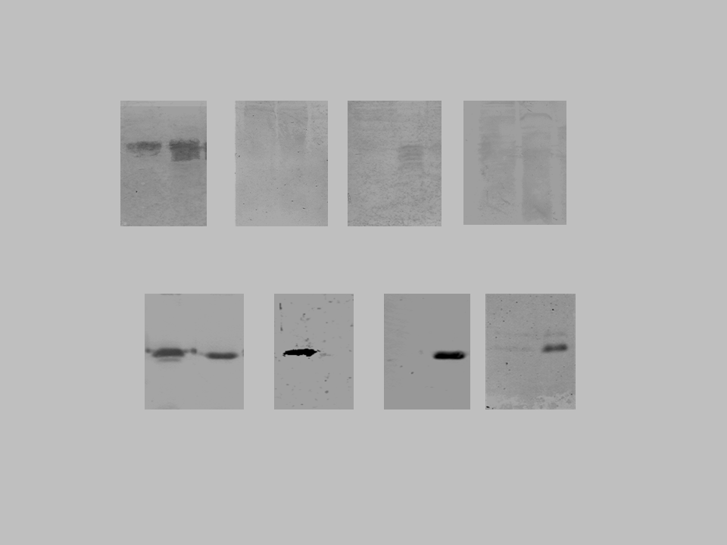
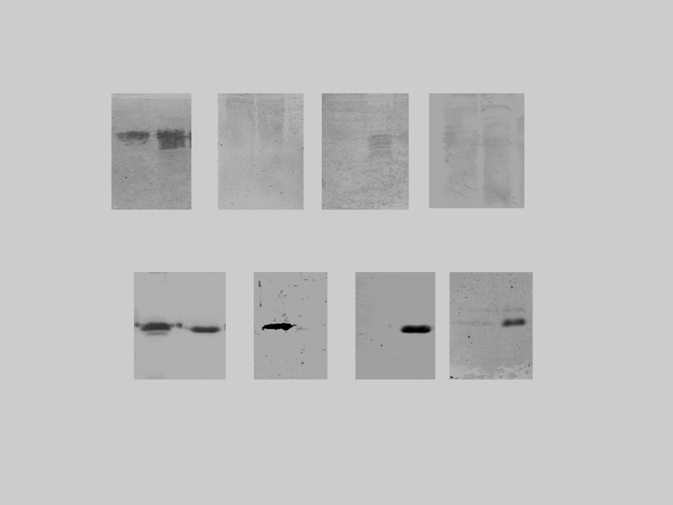
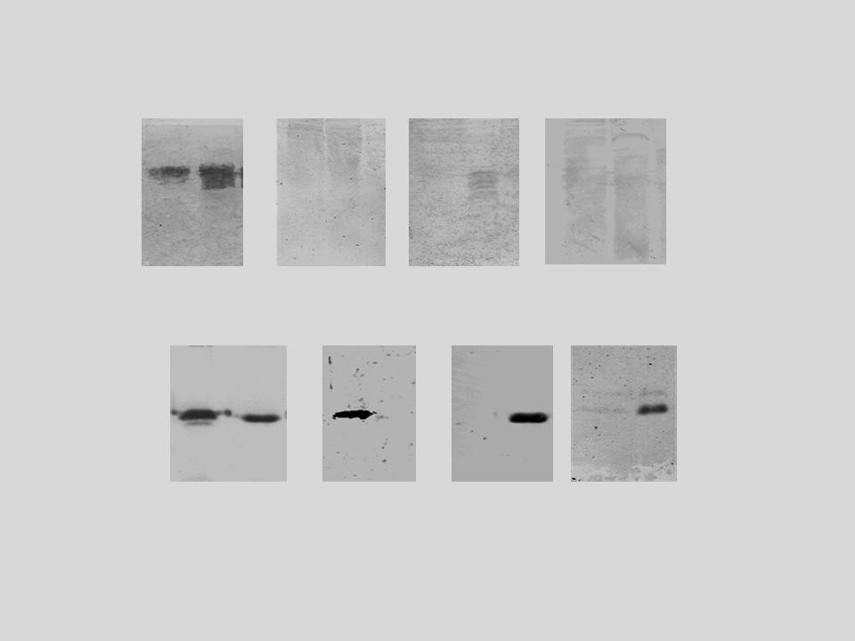
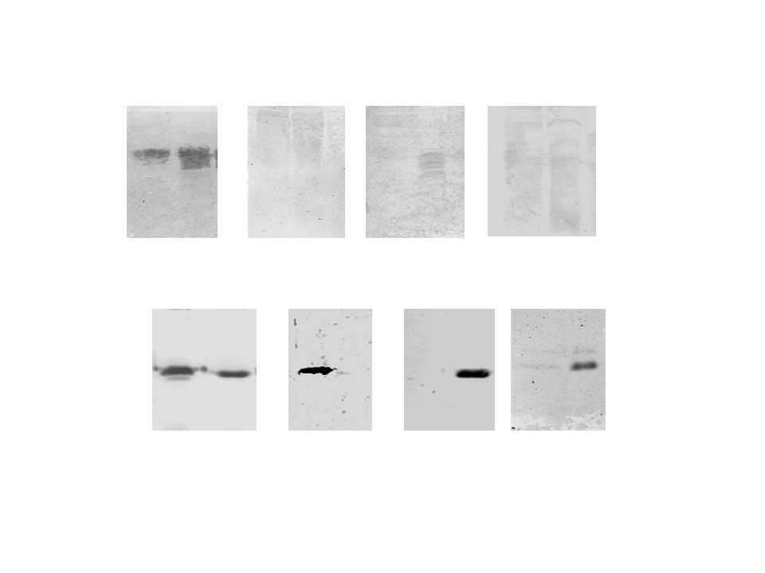

Uncropped blots for Figure 5B and 5C
Figure 5
b
Hu Mo
Hu Mo
Hu Mo
Hu Mo
30
+KM
+VM
+VE
c
mAb
3F4
pAbl
DZS18
mAb
IPC2
pAb
RGM
Human
recPrP
E200K wt E200K wt E200K wt E200K wt

