Slide 1
Supplemental Figures.

Slide 2

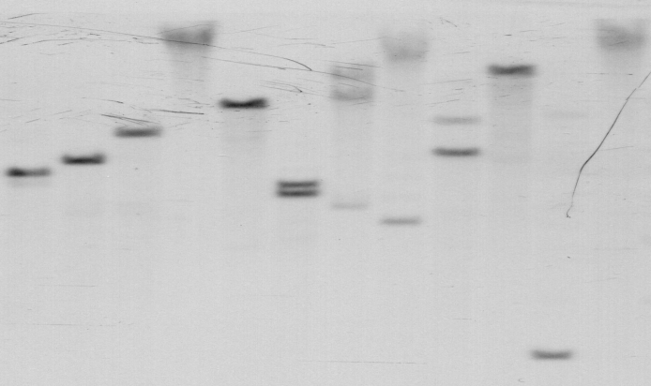
a)
wc wc
Wc wc
kb
10
6
4
b)
Eco RI
Bam HI
Hind III
Sph I
Nco I
Not I
Xba I
Xho I
Pst I
Sst I
Kpn I
Sal I
kb
12
8
8
4
4
3
3
Figure S1. Wc is associated with Ccd1 gene cluster.
(a) Southern blot analysis of a backcross population segregating Wc. BamHI digests of genomic DNA from wc wc and Wc wc segregants were probed with the Ccd1 cDNA and imaged using a short exposure time (6 h).
(b) Southern blot analysis of multiple restriction enzyme digests probed with Ccd1 cDNA using a short exposure (6 h).

Slide 3
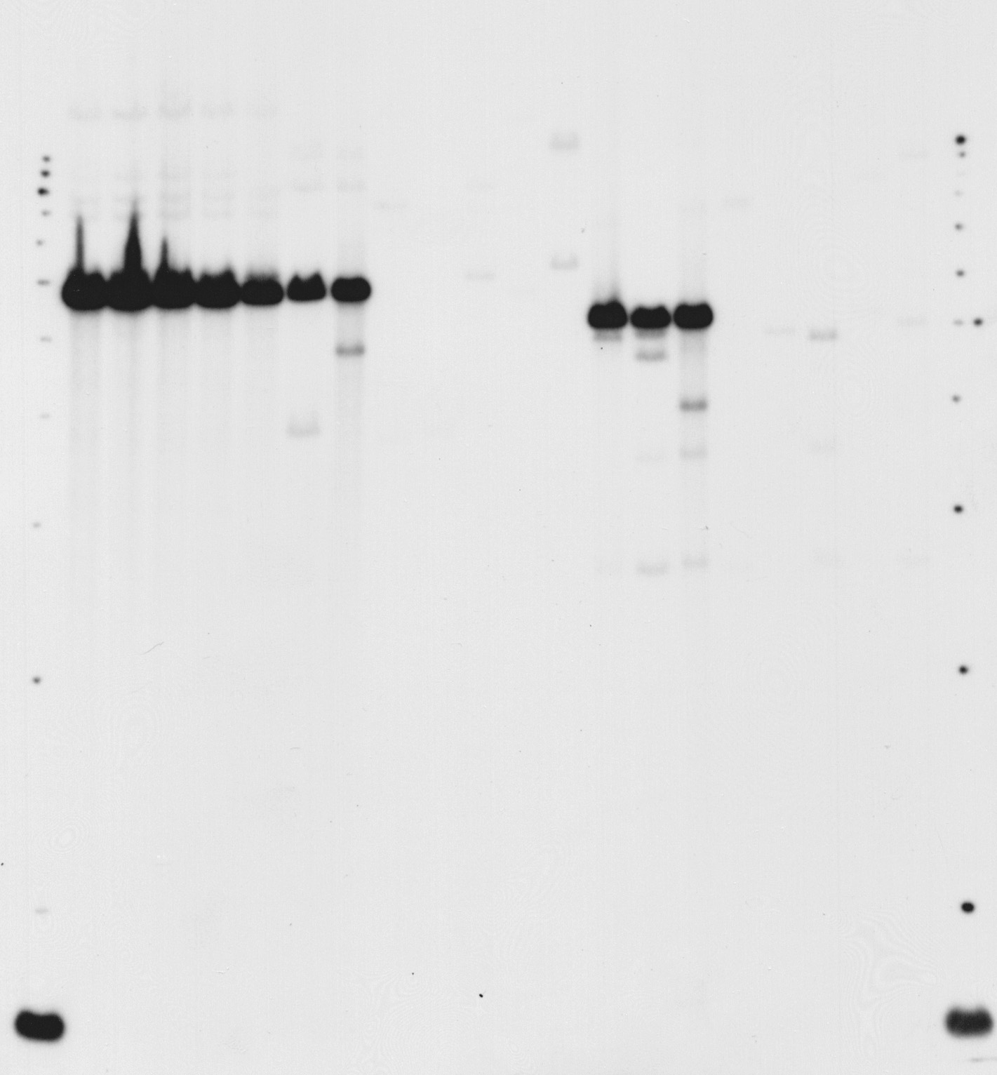
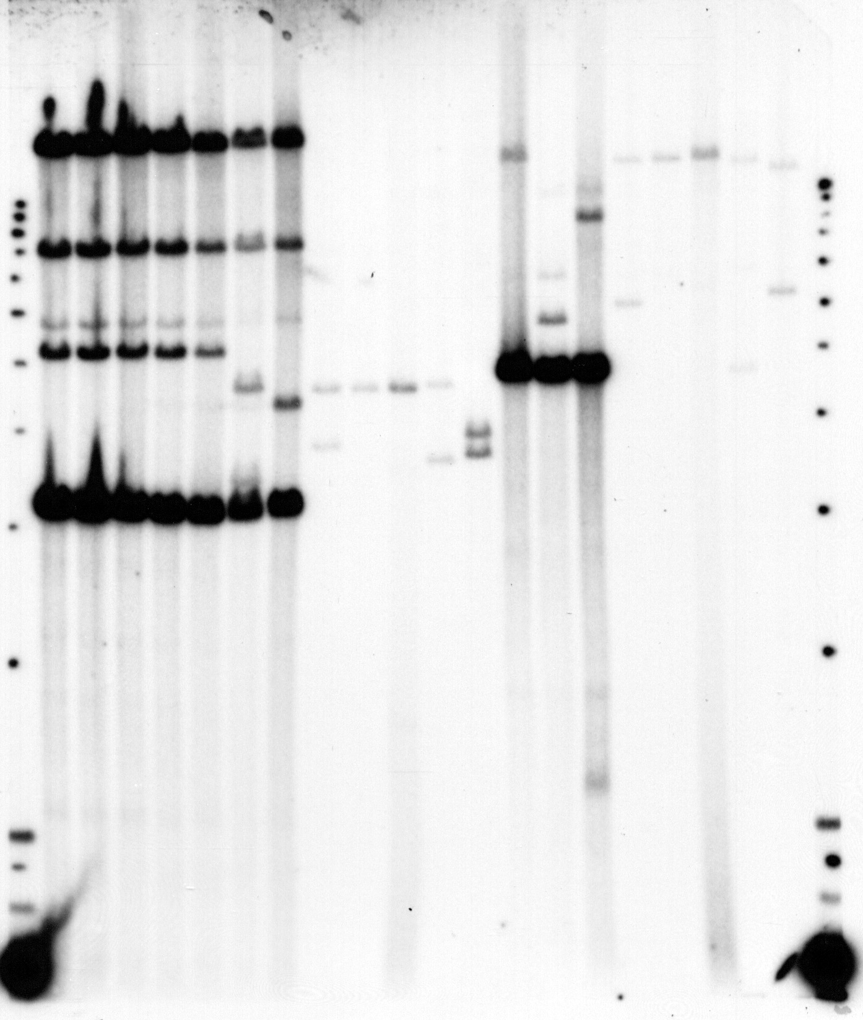
a)
BamHI
Tam3Lc
BamHI
BamHI
Probe Wc2.0
Probe CSU453 (cDNA)
b)
BamHI
EcoRI
BamHI
EcoRI
1
2
3
4
5
6
7
8
9
10
11
12
5
6
7
8
9
10
11
12
1
2
3
4
5
6
7
8
9
10
11
12
5
6
7
8
9
10
11
12
kb
12
10
8
6
4
Probe: csu453
Probe: Wc 2.0 kb
Figure S2. Southern analysis of Ccd1 in Wc and non-Wc maize and teosinte.
(a). Position of probes used in the analysis; (b). The same DNA blot was probed with csu453 and Wc2.0. Blots were exposed for 6hrs after hybridization. Lanes 1- 5: Individual Wc homozygotes; 6: Silver Queen heterozygote; 7: A188; 8: Yellow wc-Ref allele; 9: Mo17; 10: B73; 11: Z.m. Mexicana; 12. Z.m. Parviglumis..

Slide 4
a) Ccd1r helitron transposons:
Hel1 A/TCTAAgtTATTAAA… …CGCCCGGTAGGGCGCTgCCCTATTCTAG-/T
GHIJKLM9002 A/TCTAAagTATTAAA… …gcgCCcGTAtGGgcgccCCaTgTTCTAG-/T
TUVW9002 A/TCTcttcTATTAAA… …CGCCCGaTAGGGCGCTttCCTATTCTAG-/T
Hel2 A/TCTCTACTACTTAT… …tCaTAtatttatgaatGgAggTtaCTAGg/T
sh2-7527 A/TCTCTACTACTTAT… …CCGTAGCAACGCACGGacATtcACCTAG-/T
ba-Ref A/TCTCTACTACTTAT… …CCGTAGCAACGCACGGGtATaTACCTAG-/T
b) Wc Tam3L transposons:
Tam3Lb-3’ TAtAGATGTccAAACGGgCGGcACgGcaCGGCCCG
Tam3 TAaAGATGTgaActgGGcCGtGcCaatTCGGCCCG
Ac TAggGATGa—-AAACGGtCGGGACcGgTCGGtaaa
Consensus TA.AGATGT..AAACGG.CGGGAC.G.TCGGCCCG
TATAGATGTCCAAACGGGCGGCACGGCCCGGCCCAGCCCGAGCCCGT------TTGAGCC Tam3Lc right(3)
TATAGATGTCCA-ACGGGCGGCACGGCCCGGCC-AGCC-GAGCCCGT------TTGAGCC Tam3Lc right(2)
TATAGATGTCCAAACGGGCGGCACGGCCCGGCCCGGCC-GAGCCCGT------TTGAGCC Tam3Lc right(1)
TATAGATGTCCAAACGGGCGGCACGGCACGGCCCGGCCC-AGCCCGAGCCCGATTGAGCC Tam3Lc left(1)
TATAGATGTCCAAACGGGCGGCACGGCACGGCCCGGCCC-AGCCCGAGCCCGATTGAGCC Tam3Lc left(2)
TATAGATGTCCAAACGGGCGGCACGGCCCGGCCCAGCCCGAGCCCGT------TTGAGCC Tam3La-3’
TATAGATGTCCAAACGGGCGGCACGGCACGGCCCGGCCC-AGCCCGAGCCCGATTGAGCC Tam3Lb-3’
TATAGATGTCCAGAAAGCACGTGGCCCGTTAGCCCGGCACGAAGCACGATTTTTTAGCAC Tam3La-5’
TATAGATGTCCAGAAAGCACGTGGCCCGTTAGCCCGGCACGAAGCACGATTTTTTAGCAC Tam3Lb-5’
Figure S3. Transposons in Ccd1r and Wc loci. (a) Terminal sequences of Hel1 and Hel2 insertions upstream of B73 Ccd1r have conserved features of maize helitron transposons. Hel1 and Hel2 insertions were delineated by alignment of B73 and teosinte Ccd1r sequences. Terminal sequences contain motifs conserved in helitron transposons. (b) Terminal sequences of Tam3L transposon insertions in Wc have conserved features of hAT family transposons The 60 bp sequences of the 5’ termini of Tam3La and Tam3Lb transposons (oriented with respect to the transposase coding sequence are identical and contain conserved motifs in termini of Antirrhinum Tam3 and maize Ac transposons. Tam3La-3’ and Tam3Lb-3’ end sequences differ at three positions (bold red and bold black text respectively) including a six base indel. The right and left ends (shown as reverse complement) share a 12 bp pair inverted repeat (bold blue text). Both ends of Tam3Lc resemble Tam3L-3’ termini. The left end is derived from Tam3Lb-3’, whereas the Tam3Lc-right sequence (bold red text) is closely related to Tam3La-3’. Numbers in parentheses indicate different Tam3Lc copies included in the bac sequence numbered right to left (see main text).

Slide 5
a) Progenitor locus
Ccd1r
b) Tam3L shower
d
b
a
Ccd1r
c) Wc creation by macro-transposition
Wc
Ccd1r
d) Wc: tandem duplication of Ccd1
d
c
b
a
Wc
e) Wc: Unequal-crossovers
d
c
b
a
d
c
b
a
f ) Wc: Current structure
d
c
c
b
a
Figure S4. Model for Wc creation and gene amplification. (a) The Ccdr progenitor locus. (b) a shower of Tam3L elements blankets the progenitor Ccd1r locus with insertions. (c) Tam3La and Tam3Ld form a macro-transposon during replication and insert a duplicate of the Ccd1r locus at a site 1.9 Mb upstream. (d) At the Wc locus, the Ccd1 gene is duplicated again, this time by a cryptic interaction of Tam3L elements that also creates a new, composite Tam3Lc sequence. (e) Copy number of repeated units is further amplified by unequal crossing over among Wc alleles. (f) The current structure of Wc repeats is shown. Open triangles,Tam3L elements; black triangles, Tam3L-3’ termini; red, Ccd1, light blue, P450; purple, Tglu; blue, Rpl21.

Slide 6
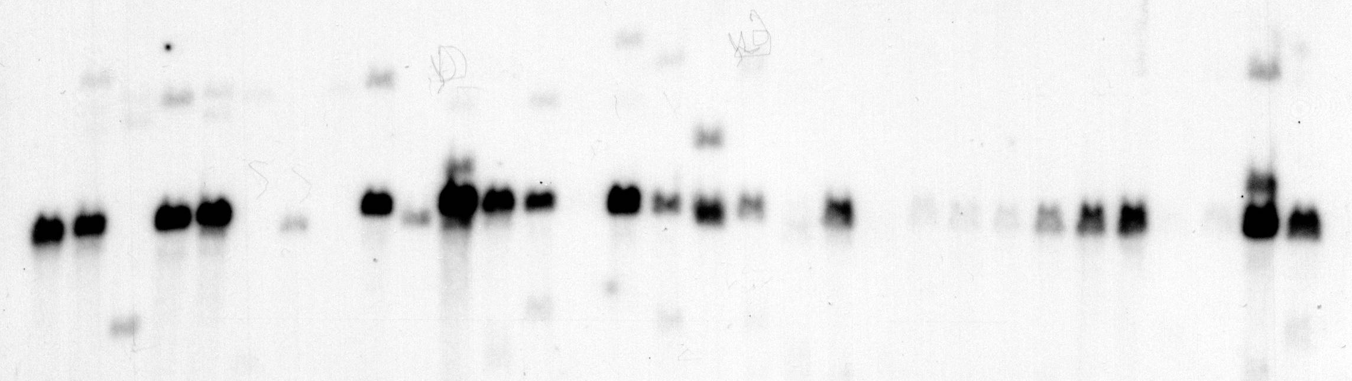
a)
1
2
3
4
5
6
7
8
9
10
11
12
13
14
15
16
17
18
19
20
21
22
23
24
25
26
27
28
29
30
31
b)
Lane Genotype Grain color Accession
1 Country Gentleman Wc all white NSL5613
2 Puebla 27 Blanco, Mexico Wc seg 3:1 white:yellow PI628480
3 CML247, Mexico all white PI595541
4 Mo24W Wc all white PI587144
5 Ky228 Wc all white PI587136
6 H105W all white PI587127
7 Huancavelica 147, Peru all white PI571793
8 Mo15W all white PI558518
9 Tzi8, Nigeria Wc all white PI506246
10 Cuzco 9, Lima Peru all pale yellow PI503671
11 Puebla 42, Mexico Wc seg 3:1 white:yellow PI488974
12 Chile 301, Santiago, Chili Wc all white PI485410
13 Lima 19, Peru Wc seg 3:1 white:yellow PI485353
14 Aguascalientes 8, Mexico all white PI484401
15 Jalisco 43, Mexico Wc seg 3:1 white:yellow PI483560
16 Santander S 356, Columbia Wc all white PI445401
17 Puebla 32, Mexico Wc all yellow-brown PI484595
18 Boyaca 462 Wc all white PI444165
19 White Midget, US all white NSL5631
20 NC336 Wc all white Ames 27164
21 NC33 all white Ames 27139
22 I29 all white Ames 27115
23 CML218 all white Ames 27086
24 CML91 all white Ames 27079
25 CML10, Mexico Wc all white Ames 27072
26 K55, US Wc all white Ames 22754
27 Mexico 37 Wc all white Ames 19558
28 Guanajuato 36, Mexico all white Ames 19481
29 Guerrero 3, Mexico all white Ames 19467
30 White Dent OP Wc all white Ames 04836
31 Hays White, WI, US Wc all white Ames 01829
Figure S5. Distribution of the Wc haplotype in selected inbred lines.
(a). Southern analysis of EcoRI digested genomic DNA with Ccd1 cDNA (csu453) as a probe. The multiple copies of Ccd1 appeared in a strong band (arrow) at the predicted size of 6.5kb. (b). Information of the inbred lines used in the Southern analysis.

Slide 7
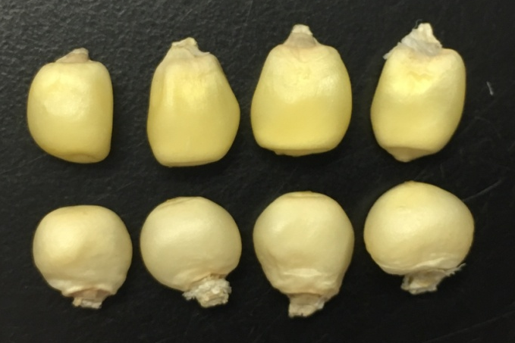
wc y1 Bn1
Wc y1 Bn1
Figure S6. Wc enhances the white-endosperm phenotype of y1 in a Bn1 background. In this material, greater whiteness of the Wc phenotype is attributed to inhibition of Bn1, a widespread allele in maize lines (Stinard, 2010). Maize RILs from the B73xKy21 NAM population (Yu et al., 2008) with wc y1 p1-ww Bn1 (Z014E0178, top) and Wc y1 p1-ww Bn1 (Z014E0038, bottom) genotypes were obtained from the Maize Coop Genetics Stock Center (Urbana, IL). The SNP genotype data for RILs (panzea.org) were used to select genotypes at p1, y1, Bn1 and Wc and Ccd1r loci. The p1-ww genotype (Ky21 allele) was selected using marker S_48117486 to minimize interference from pericarp color. The B73 (wc Ccd1r-B73) and Ky21 (Wc Ccd1r-Ky21) haplotypes were distinguished using a block of 57 SNP's in the interval between chromosome 9 coordinates 150 Mb and 152.8 Mb (B73 v2 coordinates). The y1 genotype was inferred from closely linked markers S_82011697 and S_82648835 on chromosome 6. The Bn1 genotype was fixed by selecting B73 SNPs over the entire interval between 120.3 Mb and 166.0 Mb on chromosome 7 (bin 7.03 of the genetic map), a region expected to include the Bn1 locus.

