Slide 1
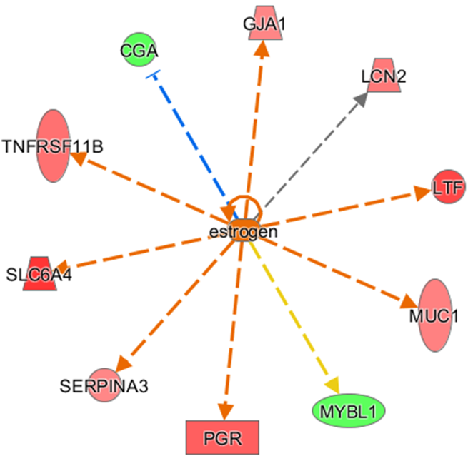
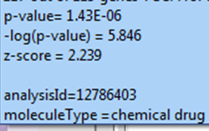
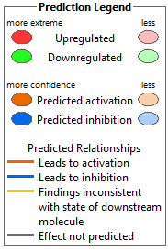
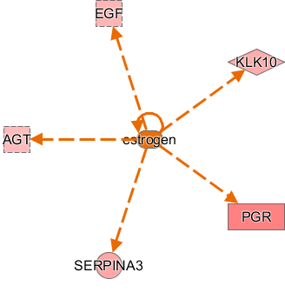
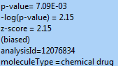
A) TCGA dataset
®20000- 2015 QIAGEN All rights reserved
B) AI dataset
®20000- 2015 QIAGEN All rights reserved
Supplemental Figure S2 Estrogen: Common up-stream effector in the TCGA and AI-datasets
Estrogen: Common up-stream effector of significant differentially expressed genes in each and both datasets (TCGA and AI). PGR and SERPINA3 are the common genes in both datasets.

