Slide 1
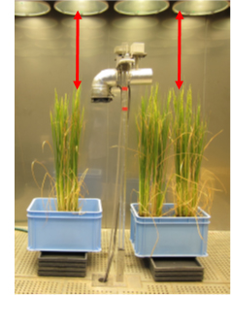
A
B
Spikelet fertility(%)

