Slide 1
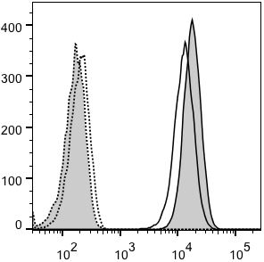
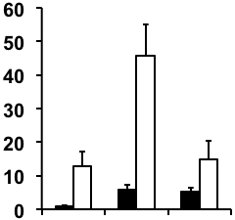


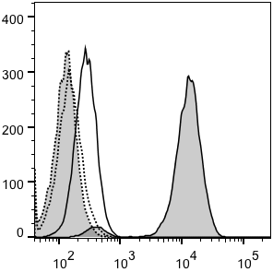
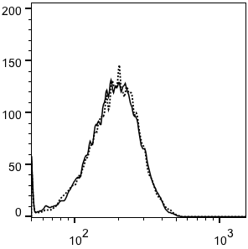
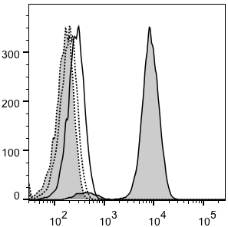
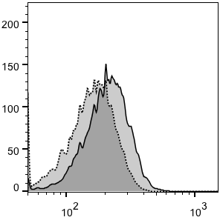
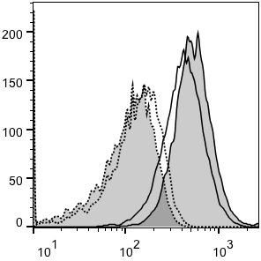
A
B
C
pSV2
pSV2
W632
B27
B27
HC10
pSV2
B18
B27
Number of Cells
IgG
B51
Relative Expression
W632
B27
W632
B18
B51
B27
D
IP:
HC10
W632
Ratio
(W632 / HC10)
2.9
WB:
3B10.7
12.9
8.0
Dilution:
1
5
pSV2
F
Number of Cells
B27
IgG
ABC.m3
E
pSV2
G
HLA-ABC.m3
Number of Cells
B27
IgG
pSV2
MARB4
pSV2
Number of Cells
B27
Number of Cells
B27
IgG
IgG
ME1
HC10
ME1
MARB4
HC10
Figure 1

Slide 2
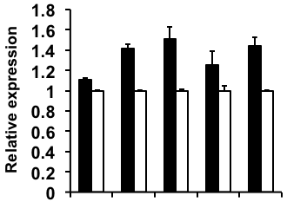


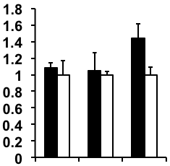
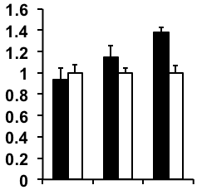
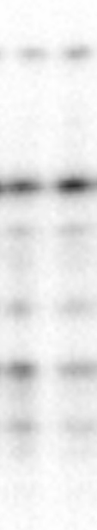
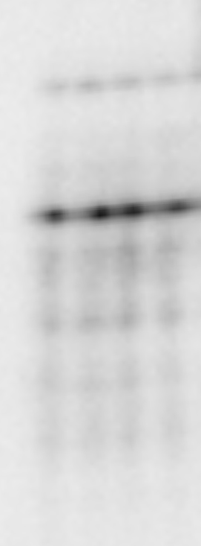
A
B
**
**
**
*
ERAP1
**
Scram
shRNA:
shRNA:
ERAP1
ERAP1
GAPDH
Scram
W632
ABC.m3
ME1
MARB4
HC10
C
Cell Surface W632 IP
D
Cell Surface HC10 IP
ERAP1
shRNA:
Scram
*
ERAP1
shRNA:
Scram
**
B18
B18
B51
Relative Expression
B51
Relative Expression
B27
B27
IP:
W632
B18
B51
B27
IP:
HC10
B18
B51
B27
WB:
3B10.7
WB:
3B10.7
Figure 2

Slide 3
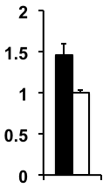
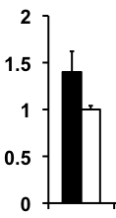
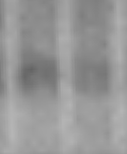
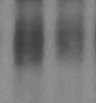
A
Cell Surface HC10 IP
B
Whole Cell HC10 IP
*
*
ERAP1
ERAP1
Scram
shRNA:
Scram
shRNA:
shRNA:
Relative Expression
ERAP1
Relative Expression
HMW
Scram
HMW
IP:
HC10
IP:
HC10
WB:
3B10.7
WB:
3B10.7
B27
B27
Figure 3

Slide 4
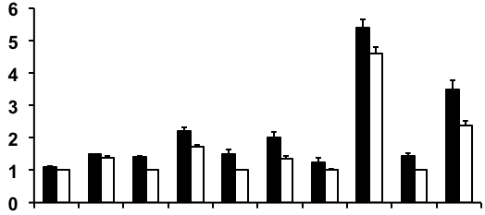
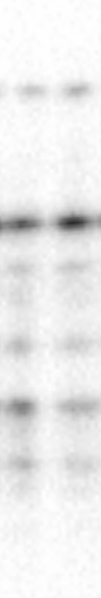
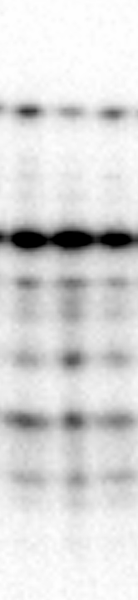
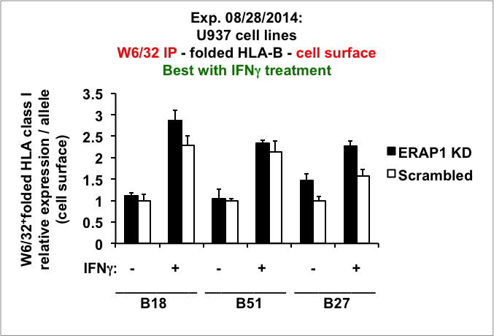
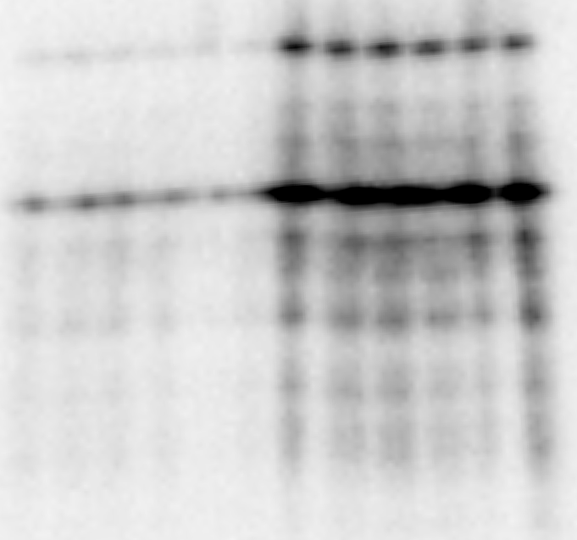
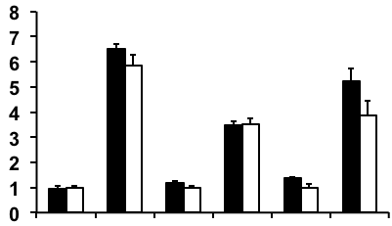
A
B
*
shRNA:
ERAP1
**
ERAP1
ERAP1
Scram
Scram
Scram
shRNA:
Relative Expression
**
**
ERAP1
**
**
**
*
*
**
GAPDH
IFNγ:
_
+
_
_
_
_
_
IFNγ:
+
+
+
+
+
mAb:
W632
ABC.m3
ME1
MARB4
HC10
C
D
Scrambled
Scrambled
Scrambled
ERAP1
Scrambled
ERAP1
ERAP1
ERAP1
shRNA:
shRNA:
Cell Surface W632 IP
Cell Surface HC10 IP
B18
B18
*
B51
*
B51
Relative Expression
Relative Expression
B27
*
B27
IFNγ:
_
+
IFNγ:
_
+
_
+
_
+
IFNγ:
_
+
IFNγ:
_
+
_
+
_
+
IP:
W632
B18
B51
B27
IP:
HC10
B18
B51
B27
WB:
3B10.7
WB:
3B10.7
Figure 4

Slide 5
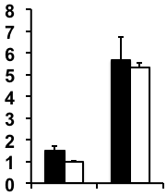
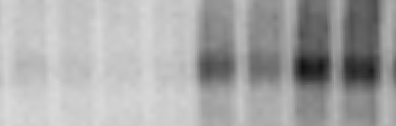
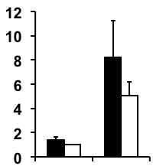
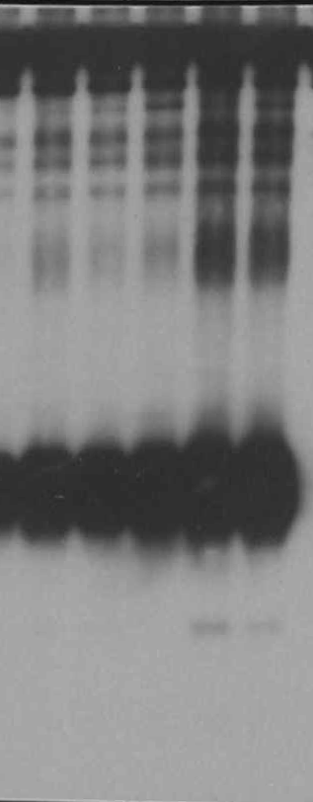
C
A
Cell Surface
HC10 IP
ERAP1
ERAP1
Scram
Scram
shRNA:
HMW
Relative Expression
_
*
IFNγ:
+
IP:
HC10
WB:
3B10.7
_
IFNγ:
+
shRNA:
ERAP1
B
Scram
Whole Cell
HC10 IP
ERAP1
ERAP1
Scram
Scram
shRNA:
HMW
Relative Expression
IFNγ:
_
+
*
IP:
HC10
WB:
3B10.7
_
IFNγ:
+
Figure 5

Slide 6
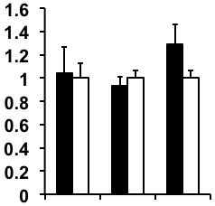
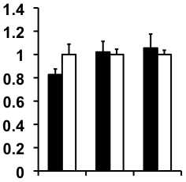
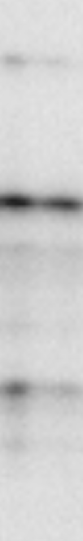
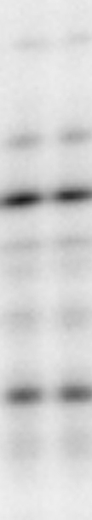

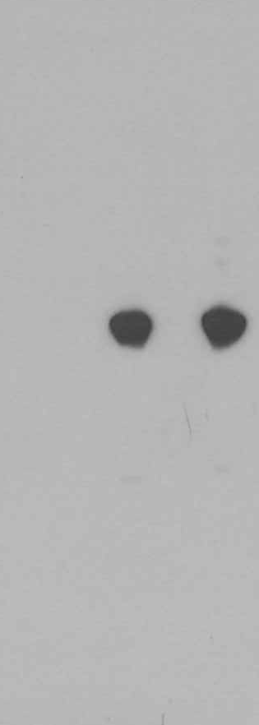
A
B
Whole Cell W632 IP
Whole Cell HC10 IP
ERAP1
shRNA:
Scram
*
ERAP1
shRNA:
Scram
B18
B18
B51
B51
Relative Expression
Relative Expression
B27
B27
IP:
W632
B18
B51
B27
IP:
HC10
B18
B51
B27
WB:
3B10.7
WB:
3B10.7
C
D
E
ERAP1
Scram
1
shRNA:
2
3
4
5
B18
B18
IP:
1 = IgG2a, cell surface
2 = HC10, cell surface
3 = IgG2a, cell surface
4 = IgG2a, cell lysate
5 = HC10, PBS only (no cells)
B51
B51
IgG
B27
B27
IP:
HC10
WB:
3B10.7
WB:
α-mIgG
WB:
3B10.7
Figure S1

Slide 7
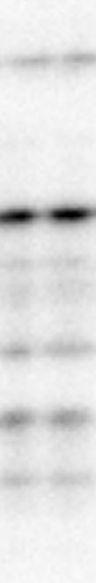
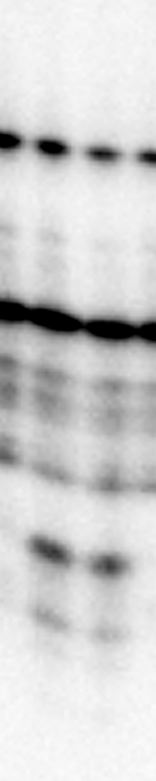
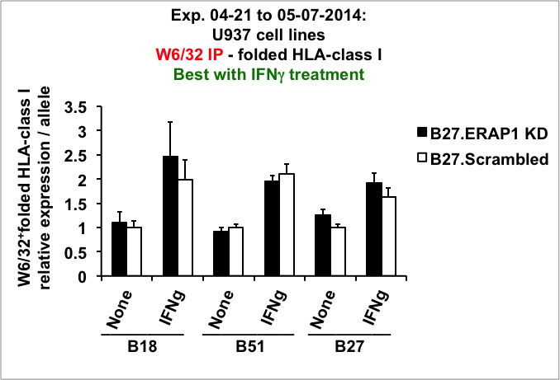
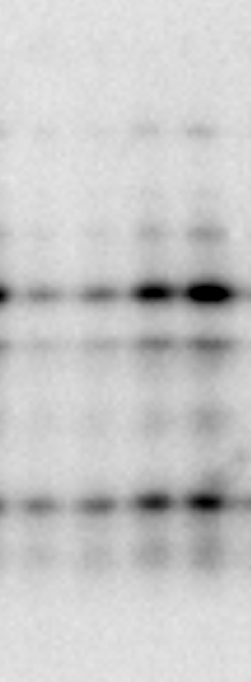
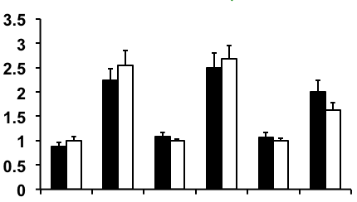
A
B
Scrambled
Scrambled
Scrambled
Scrambled
ERAP1
ERAP1
ERAP1
ERAP1
shRNA:
shRNA:
Whole Cell Lysate HC10 IP
B18
Whole Cell Lysate W632 IP
B18
B51
*
B51
*
Relative Expression
Relative Expression
B27
B27
IFNγ:
_
+
IFNγ:
_
+
_
+
_
+
IFNγ:
_
+
IFNγ:
_
+
_
+
_
+
IP:
W632
B18
B51
B27
IP:
HC10
B18
B51
B27
WB:
3B10.7
WB:
3B10.7
Figure S2

