Slide 1
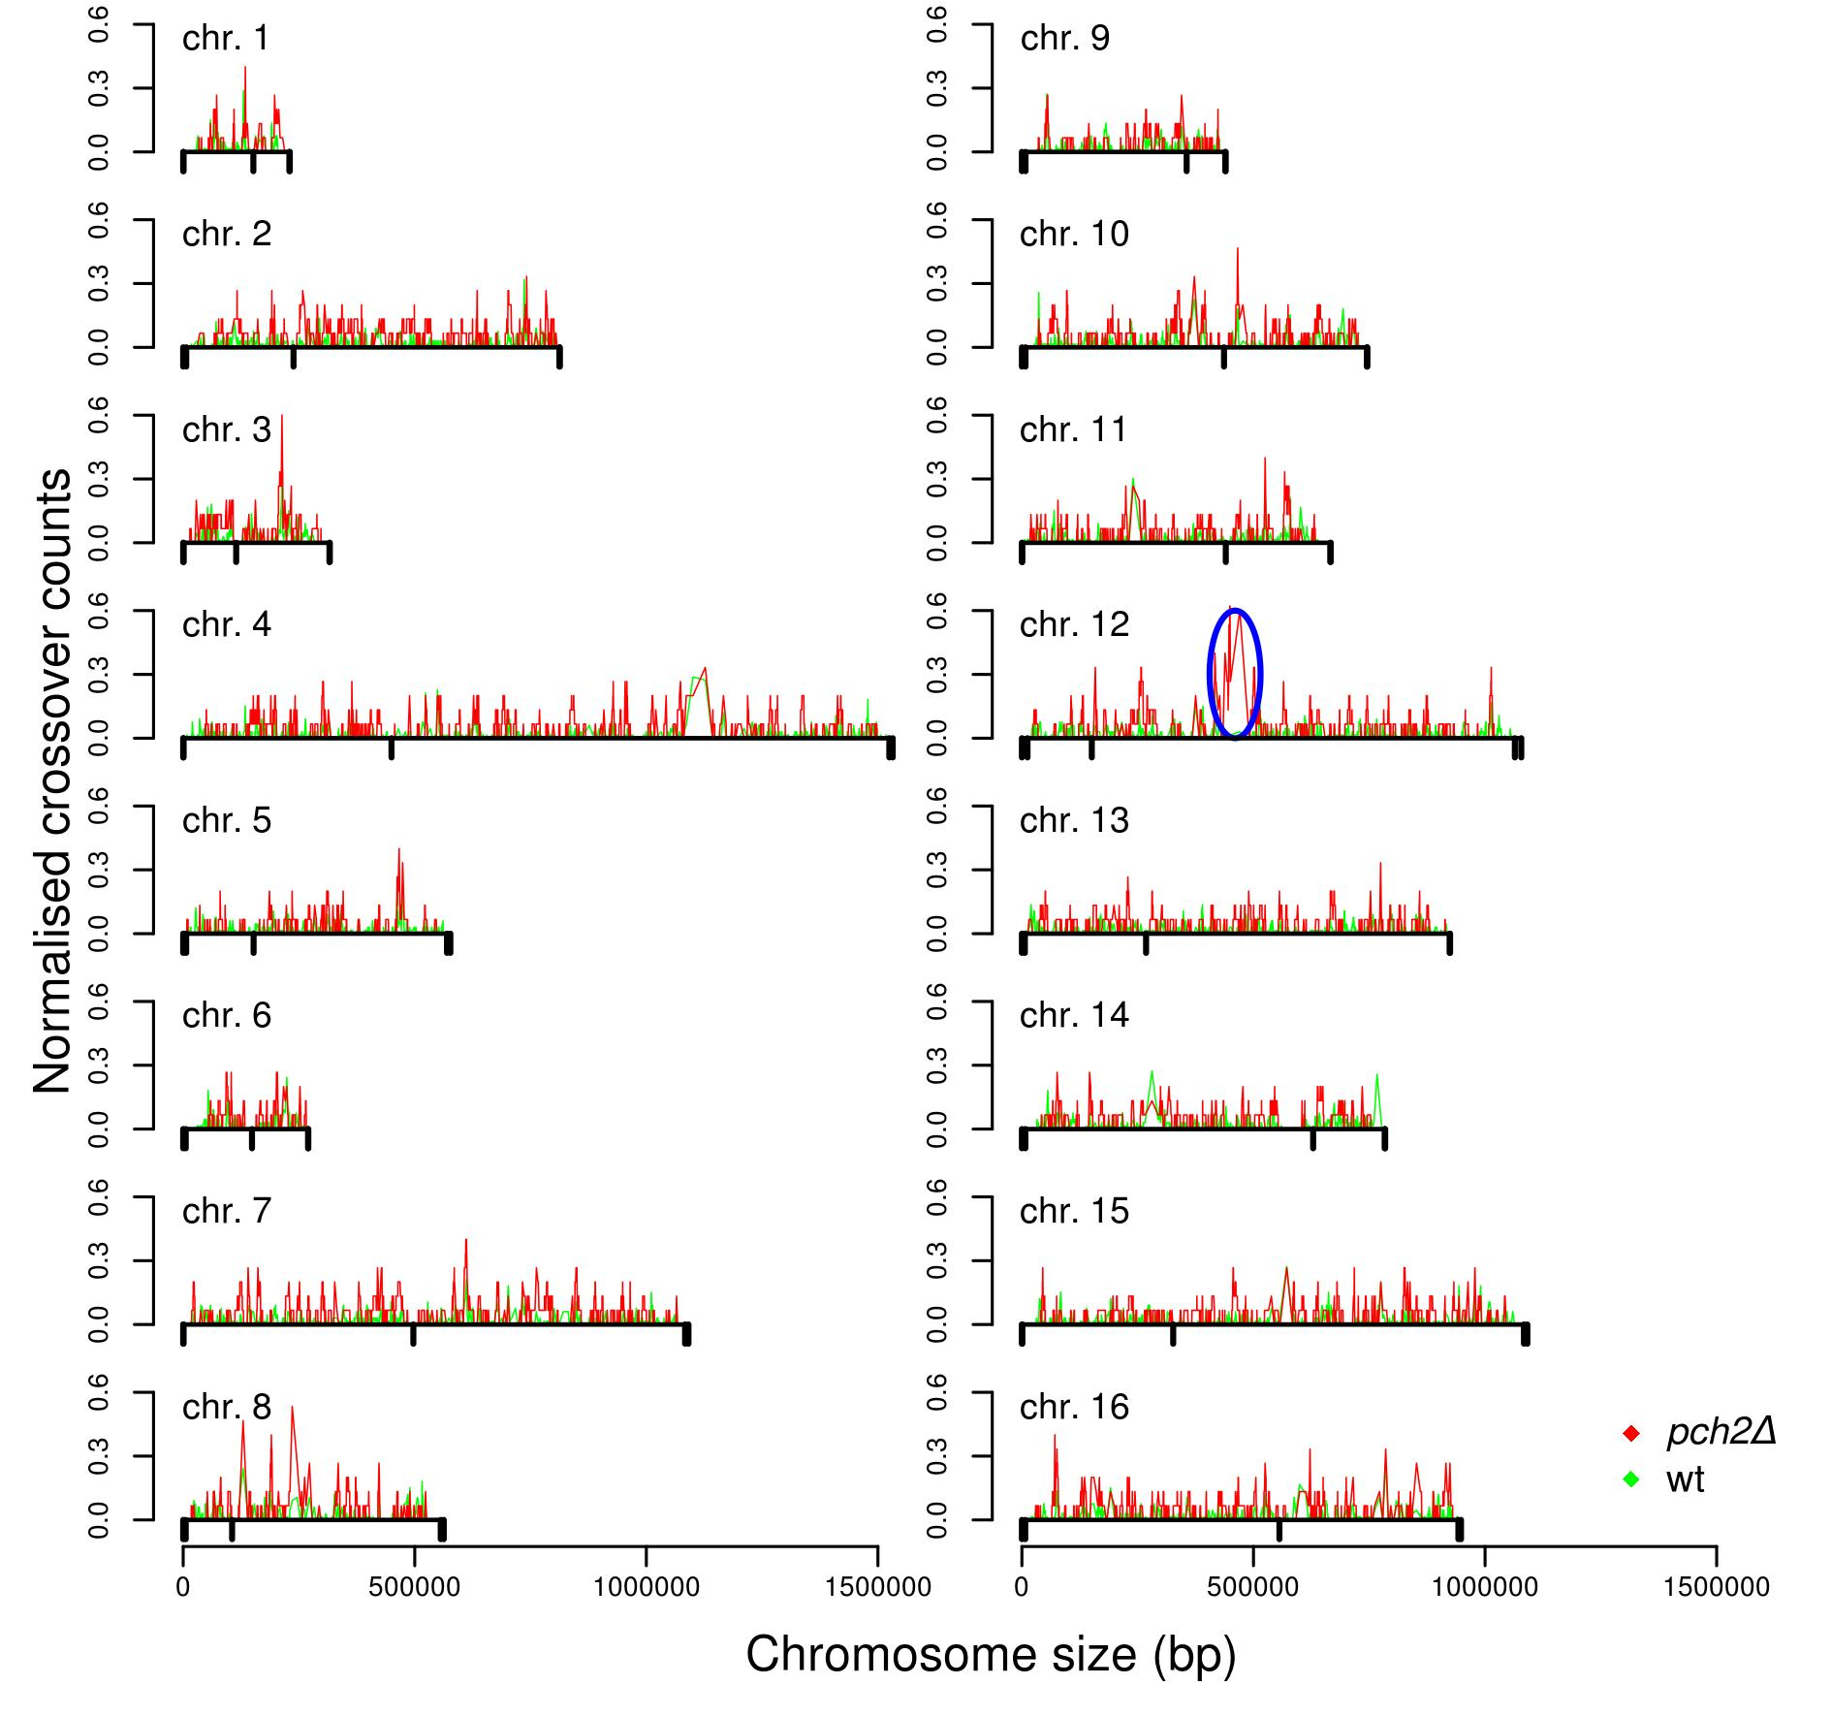
Figure S6 Chromosome wide distribution of crossover counts for wild type (green) and pch2Δ (red). Actual crossover counts were divided by the number of tetrads to get normalized counts. Chromosome size is shown in base pairs. Oval circle shows enhanced crossovers at the vicinity of the rDNA locus.

