Slide 1
Supplementary Table S1
Supplementary Table S1. List of primers used for ChIP validation of the p27- and PCAF- Binding sites for the gens GRIN3A, SPAG9, ROBO1 and UNC5D.

Slide 2
Supplementary Table S2
Supplementary Table S2. List of primers used in the RT-PCR experiments to determine the levels of the mRNAs of the p27- and PCAF- target genes.

Slide 3
Supplementary Table S3
Supplementary Table S3. List of primers used in the RT-PCR experiments to determine the levels of the primary non-spliced transcripts (pre-mRNAs) of p27- and PCAF- target genes.

Slide 4
Supplementary Fig S1
A
B
p27
PCAF27
Chromosome
Chromosome
Percentage %
Percentage %
Supplementary Figure S1. Distribution of p27- and PCAF- binding sites (BSs) over chromosomes. ChIP-seq using anti-p27 or anti-PCAF were performed in HCT116 cells. Distribution of p27-BSs (A) or PCAF-BSs (B) over chromosomes is represented as a percentage.The percentage of chromatin corresponding to each chromosome respect to the total is referred as genome.

Slide 5
Supplementary Fig S2
Supplementary Figure S2. Distribution of p27- and PCAF-binding sites (BSs) according to biological functions. The number of genes showing p27- or PCAF-BSs and involved in four specific biological functions are represented. The percentage of genes having p27-BSs that also show PCAF-BSs is also indicated.

Slide 6



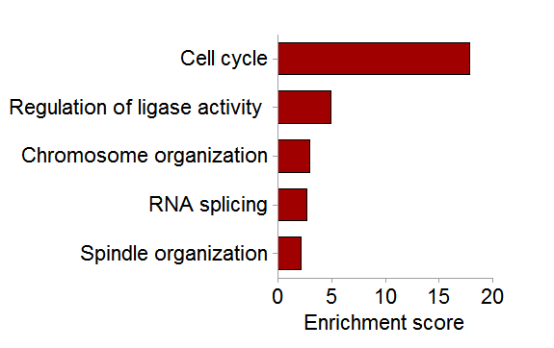
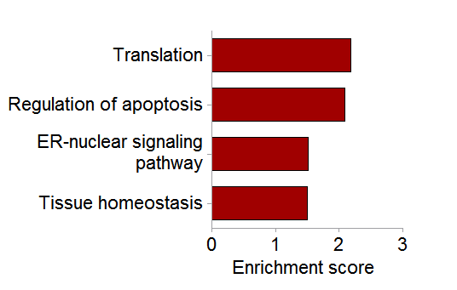
Supplementary Fig S3
A
Ctrl
shRNA
PCAF
p27
PCAF
p27
Actin
B
C
GO PCAF down-regulated genes
GO PCAF up-regulated genes
D
Supplementary Figure S3. Gene ontology analysis of differentially expressed genes in PCAF knock down (PCAF-KD) HCT116 cells. (A) Knock down of p27 or PCAF in HCT116 cells. Cells were infected with lentiviral vectors including specific shRNAs for PCAF or for p27. Then, the amount of p27 and PCAF was determined by WB. Actin levels were used as a loading control. (B) Biological functions enriched in down-regulated genes in PCAF-KD cells. (C) Biological functions enriched in up-regulated genes in PCAF-KD cells. Gene Ontology (GO) analysis was performed using the DAVID program. (D) Biological processes enriched in the group of 156 genes that are differentially expressed in PCAF-KD cells and containing PCAF-BSs.

Slide 7




Supplementary Fig S4
A
WB
CRISPR
CRISPR
CTR p27KO
CTR PCAF
p27
PCAF
Tubulin
Tubulin
B
**
**
***
*
ns
*
ns
*
Supplementary Figure S4. Proliferation rates in HCT116 knocked down (KD) for p27 or PCAF by using the CRISPR/Cas9 methodology. In the case of p27 experiments were performed in cells from an homozygous clon (p27KO) whereas in the case of PCAF we used cells knocked down but prior to selection of clons (A) Levels of PCAF and p27 in HCT116 control, p27KO or PCAFKD as determined by WB. Tubulin levels were used as a loading control. (B) Generation times in the different cells were determined by counting the cells at different times (1, 2 and 3 days) after plating. Results are the mean value ± SD of three different experiments. Statistical analyses were performed using the T-student’s test comparing p27KO CR cells vs control ( ) or PCAF CR cells vs control ( ). (*) P <0.05, (**) P <0.01 and (***) P <0.001.

Slide 8
Supplementary Fig S5
A
**
*
**
**
B
C
Supplementary Figure S5. Expression of p27- or PCAF-Target genes (TGs) in p27-Knock down (KD), PCAF-KD and double KD (2KD)-cells. (A) HCT116 cells were knocked down for PCAF or p27 using CRISPR/Cas9. Then, the mRNA levels of several target genes having only p27- or PCAF- Binding sites in their vicinity were analyzed by qPCR. Results are the mean value ± SD of three different experiments and are represented as fold change vs control. Statistical analyses were performed using the T-student’s test. (*) P <0.05, (**) P <0.01 and (***) P <0.001. (B) The protein levels of common TGs (p27- and PCAF-TGs) were determined by WB in p27KO or PCAF-KD cells (see also Supplementary Figure S4A). Tubulin was used as a loading control. (C) The levels of p27, PCAF and several common TGs were determined by WB in double knock down cells (2KD). Tubulin levels were used as a loading control.

Slide 9
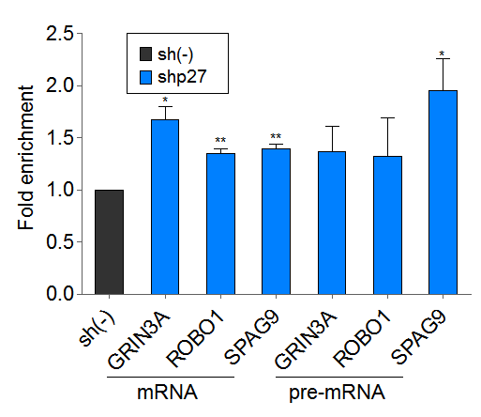



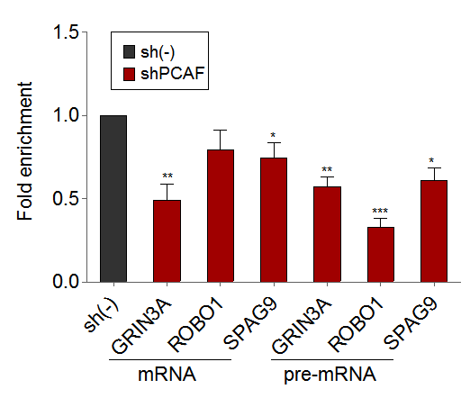
Supplementary Fig S6
MCF7-cells
A
B
**
shRNA
*
**
*
*
Ctrl
PCAF
p27
**
PCAF
p27
Actin
C
*
Supplementary Figure S6. Effect of the knock down of p27 or PCAF on the expression of target genes in MCF7 cells. (A) Cells were infected with lentiviral vectors including specific shRNAs for PCAF, p27 or control (Ctrl). Then, the effect on p27 or PCAF levels was determined by WB. Actin levels were used as a loading control. The levels of mRNA or of the primary non spliced transcript (pre-mRNA) of different target genes were determined by qPCR in p27-KD cells (shp27) vs control (sh(-)) (B) or in PCAF-KD cells (shPCAF) vs control (sh(-)) (C). In all experiments results are the mean value ± SD of three different experiments and are represented as fold change vs control. Statistical analyses were performed using the T-student’s test. (*) P <0.05, (**) P <0.01 and (***) P <0.001.

Slide 10


Supplementary Fig S7
PAX5
p27
PAX5
PCAF
Supplementary Figure S7. Alignment of the canonical PAX5 consensus sequence with sequence motifs enriched in p27 and PCAF binding sites. The sequence motifs enriched in p27 (upper panel) or PCAF binding sites (bottom panel) obtained from Figure 2E were aligned with the canonical PAX5 consensus sequence obtained from genecards data base (http://www.genecards.org/).

Slide 11





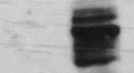











Supplementary Fig S8
A
0h 3h 6h 9h 12h
PAX5
Tubulin
B
C
input
IP
IP
IgG p27
input
IgG PCAF
PCAF
PCAF
PAX5
PAX5
p27
p27
D
E
IP
IP
IP
IP
input
p27 IgG
p27 IgG
PAX5 IgG
input
IgG PAX5
PAX5
PCAF
PAX5
p27
p27
CR-Ctrl
CR-PCAF
MEFs p27^{-/-}
MEFs WT
Supplementary Figure S8. PAX5 interacts with both p27 and PCAF. (A) Quiescent HCT116 cells were activated to proliferate by serum addition. Then, at different times they were collected and the levels of PAX5 were determined by WB. Tubulin levels were used as a loading control. HCT116 proliferating cells were subjected to immunoprecipitation (IP) with anti-p27 (B) or anti-PCAF (C). Then levels of PCAF, PAX5 and p27 were determined by WB. IP with an unspecific IgG was used as a control. (D) HCT116 cells were knocked down for PCAF using the CRISPR/Cas9 methodology (CR-PCAF) (see also Supplementary Figure S4A). Then CR-PCAF-cells and control cells (CR-Ctrl) were subjected to IP with anti-p27 or with unspecific IgG used as a control. PAX5 and p27 levels were subsequently determined by WB. (E) Proliferating Mice Embryo Fibroblasts (MEFs) from WT or p27^{-/-} animals were subjected to IP with anti-PAX5 or with an unspecific IgG used as a control. PCAF, PAX5 and p27 levels were subsequently determined by WB.

Slide 12
Supplementary Fig S9
A
p27-BS
***
***
***
***
B
p27-BS
***
PCAF-BS
*
**
***
**
**
**
***
Supplementary Figure S9. Interaction of p27 and PCAF with their chromatin binding sites under different conditions. (A) An homozygous clon of HCT116 cells knocked out for p27 using CRISPR/Cas9 (p27KO, see Supplementary Figure S4A) was used to determine the specificity of the interaction of p27 with its specific chromatin binding site in several target genes. Determination was performed by ChIP using anti-p27 in HCT116 p27KO cells vs control. Results are represented as the binding of p27 in control cells relative to p27KO cells. (B) ChIP analysis of the association of p27 (left panel) or PCAF (right panel) with their respective chromatin binding sites in several target genes were performed in control HCT116 cells or in cells knocked down for PAX5 by using an specific shRNA (see Figure 6). All results are the mean value ± SD of three independent experiments. Statistical analyses were performed using the T-student’s test. (*) P <0.05, (**) P <0.01 and (***) P <0.001.

