Slide 1
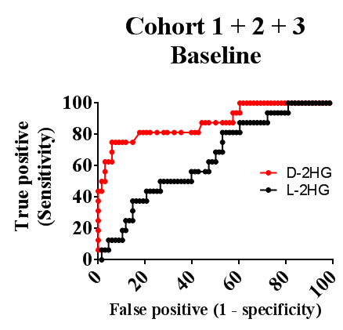
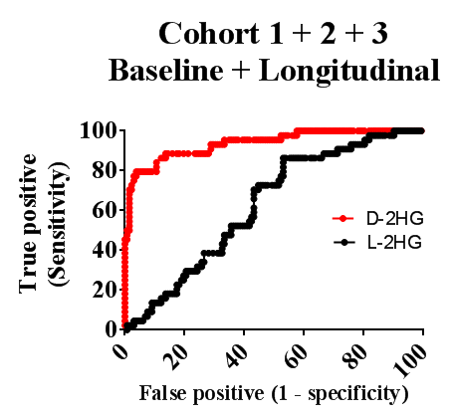
Suppl. Figure 1
A
B
Suppl. Figure 1. Determination of sensitivity, specificity and accuracy using ROC curves. (A) Baseline (N=84). (B) Baseline with longitudinal samples (N=176). D-2HG (in red) and L-2HG (in black) levels collectively collected from Cohorts 1, 2 and 3 from wild type and IDH1/2-mutated gliomas were used to generate ROC curves to assess the predictive validity of this subtype in our assay. The area under the curve (AUC) of the ROC curve for the baseline and baseline + longitudinal progression D-2HG were 0.877 and 0.938, respectively (p<0.0001).
Notes:
Suppl. Figure 1. Determination of sensitivity, specificity and accuracy using ROC curves.
(A) Baseline (N=84). (B) Baseline with longitudinal samples (N=176). D-2HG (in red) and L-2HG (in black) levels collectively collected from Cohorts 1, 2 and 3 from wild type and IDH1/2-mutated gliomas were used to generate ROC curves to assess the predictive validity of this subtype in our assay. The area under the curve (AUC) of the ROC curve for the baseline and baseline + longitudinal progression D-2HG were 0.877 and 0.938, respectively (p<0.0001).

Slide 2
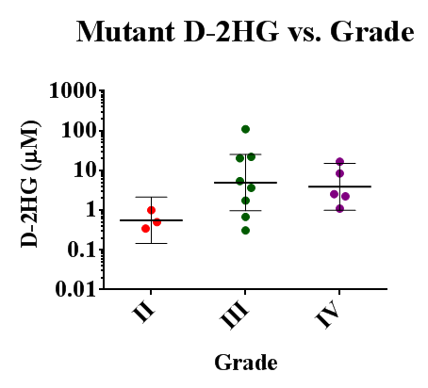
Suppl. Figure 2
Suppl. Figure 2. CSF levels of D-2HG and WHO grade of IDH mutant gliomas. A positive trend is observed between the D-2HG levels found in the CSF of patients with mutated IDH gliomas and tumor grade (WHO 2007 classification); however, it does not reach statistical significance.

Slide 3
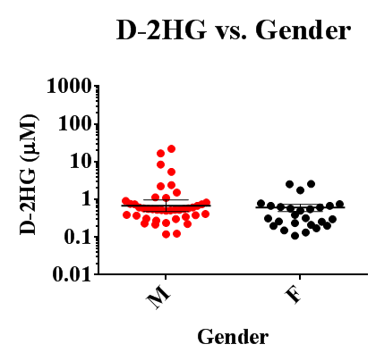
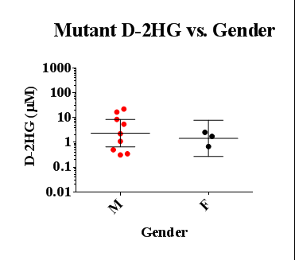
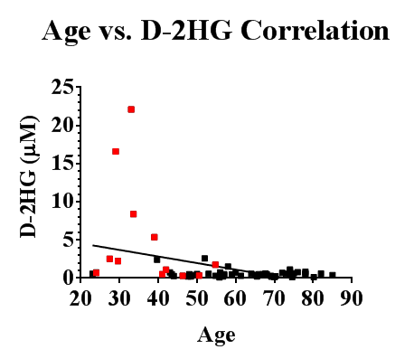
Suppl. Figure 3
A
B
C
Suppl. Figure 3. CSF D-2HG levels and gender/age. Analysis of D-2HG levels in CSF from all samples (A) or from samples derived from patients with mutated IDH gliomas (B) vs. gender (M, male; F, female) shows no significant correlation. (C) There is also no correlation with age within the IDH mutated sample group alone (shown in red), while an inverse correlation for D-2HG levels vs. age is observed in all samples.

Slide 4
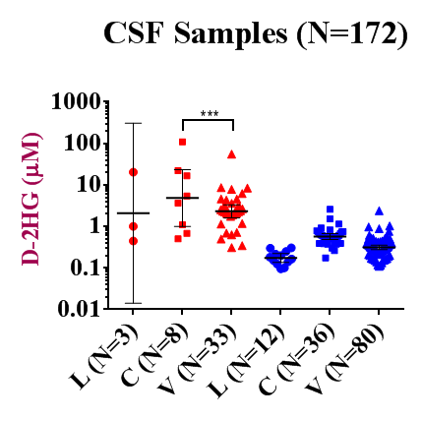
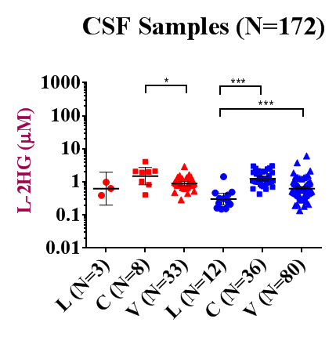
Suppl. Figure 4
A
B
D-2HG (μM)
L-2HG (μM)
Mut
WT
Mut
WT
Suppl. Figure 4. D- and L-2HG levels in CSF drawn at different locations in WT and mutant IDH glioma patients. Multiple comparisons using one-way ANOVA within mutated or WT IDH sample groups showing
(A) D-2HG and (B) L-2HG levels from Lumbar (L), Cisternal (C) and Ventricular (V) CSF draws. Significant differences between highlighted groups are indicated. Tukey correction was applied for multiple groups comparisons.

Slide 5
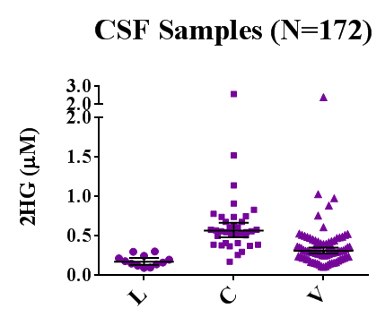
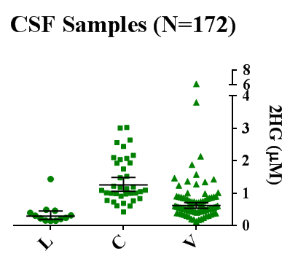
Suppl. Figure 4 (continued)
WT CSF Samples (N=128)
C
D-2HG
L-2HG
Suppl. Figure 4. (continued)
(C) Comparison of D- and L-2HG levels in the CSF of patients with WT IDH gliomas drawn from different anatomical locations highlights metabolite gradients C>V>L (highest to lowest) and shows that L-2HG levels are about 2-fold higher than D-2HG levels. L, lumbar (N=12), C, cisternal (N=36) and V, ventricular (N=80). Geometric means with 95% CI are indicated. Note two different concentration scales for D- and L-2HG.

Slide 6
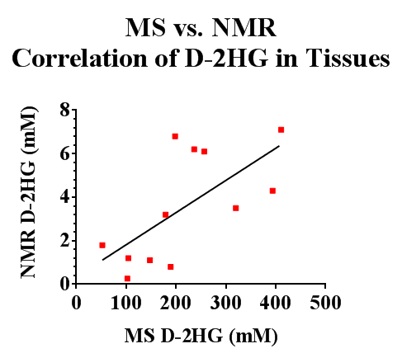
Suppl. Figure 5
Suppl. Figure 5. Comparison of NMR and MS for the detection of D-2HG in tumor tissue and CSF. Comparison of the levels of D-2HG in tumors from an independent set of patients (N=12) measured by both NMR HRMAS (Kalinina et al., 2012; ref.#16) and the MS methodology presented in the current paper identified a significant correlation (r= 0.6639; p=0.0185). The tissue samples were derived from Emory University patients with IDH1/2 mutated gliomas of grades II (N=3), III (N=5) and IV (N=4) diagnosed as OD, AA, AOA, AOD or secondary GBM (Kalinina et al., 2012).
Method: Homogenize frozen tissue in 1mL of MilliQ water in 12X75mm glass tubes. Centrifuge at 4,000 rpm for 5 mins. at 4°C. Filter the supernatant (~800µL) with a pre-washed 10K Ultra centrifugal filter (Amicon) using a micro-centrifuge at 10,000 rpm for 15 mins. Determine protein concentration and proceed to 2-HG quantification by MS as described in Methods.

