Slide 1
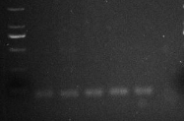

A
M E L N Af Am Nc
90bp
B
M E L N Af Am Nc
350bp
Additional file 2: Figure S2. PCR analysis of the vertical transmission of CLS-Ht and RLS-Ht in H. tibetensis. a CLS-Ht. b RLS-Ht. Lane M: DNA marker; Lane E: eggs; Lane L: larvae; Lane N: nymphs; Lane Af: adult females; Lane Am: adult males; Lane Nc: negative control

